Slide 1
Session 1: Migraine 101
Facilitator: [INSERT NAME HERE]
[INSERT DATE & TIME HERE]
NOTICE: This slide deck intended for educational purposes only and you are encouraged to adapt this slide deck to suit your clinic, services and community.
This slide deck was created in 2019 at the UBC Pharmacists Clinic by Dr. Jillian Reardon, BSc (Pharm), ACPR, PharmD, RPh, with the help of Caitlin Chew (PY3) and adapted in June 2023 by Dr. Nikki Domanski, BSc, PharmD, RPh, ACPR and Carmen Leung (PY3).

Slide 2
Land Acknowledgement
[We invite you to create a land acknowledgement to recognize the traditional, ancestral, and unceded land that your office/clinic is located on]

Slide 3
Welcome!
What are Pharmacist-led Migraine Group Appointments?
What can you expect at each session?
Notes:
Thank you for joining us today for our first session of our three-part series. These appointments are meant to provide you with information, educational materials surrounding migraines and migraine management, as well as allow for discussion, and questions with people who may be experiencing similar challenges or experiences.
As you know, this is one session out of our three-part series.
Today we will be covering: what are migraines, why they occur, types of headache, common triggers, as well as non-pharmacological treatment options.
Next month we will be covering: treatment options for both acute migraines and prevention of migraines
In our third group appointment, we will cover new migraine treatment option that have been recently marketed or will soon come to market, as well as natural health products that are also used for the treatment of migraines.

Slide 4
Introduction
Future option:
1:1 appointments with a pharmacist at [CLINIC]
Session 1
(DATE)
[60 mins]
Session 2
(DATE)
[60 mins]
Session 3
(DATE)
[60 mins]

Slide 5
Session Outline
Introduction
Education session
Group discussion
Debrief

Slide 6
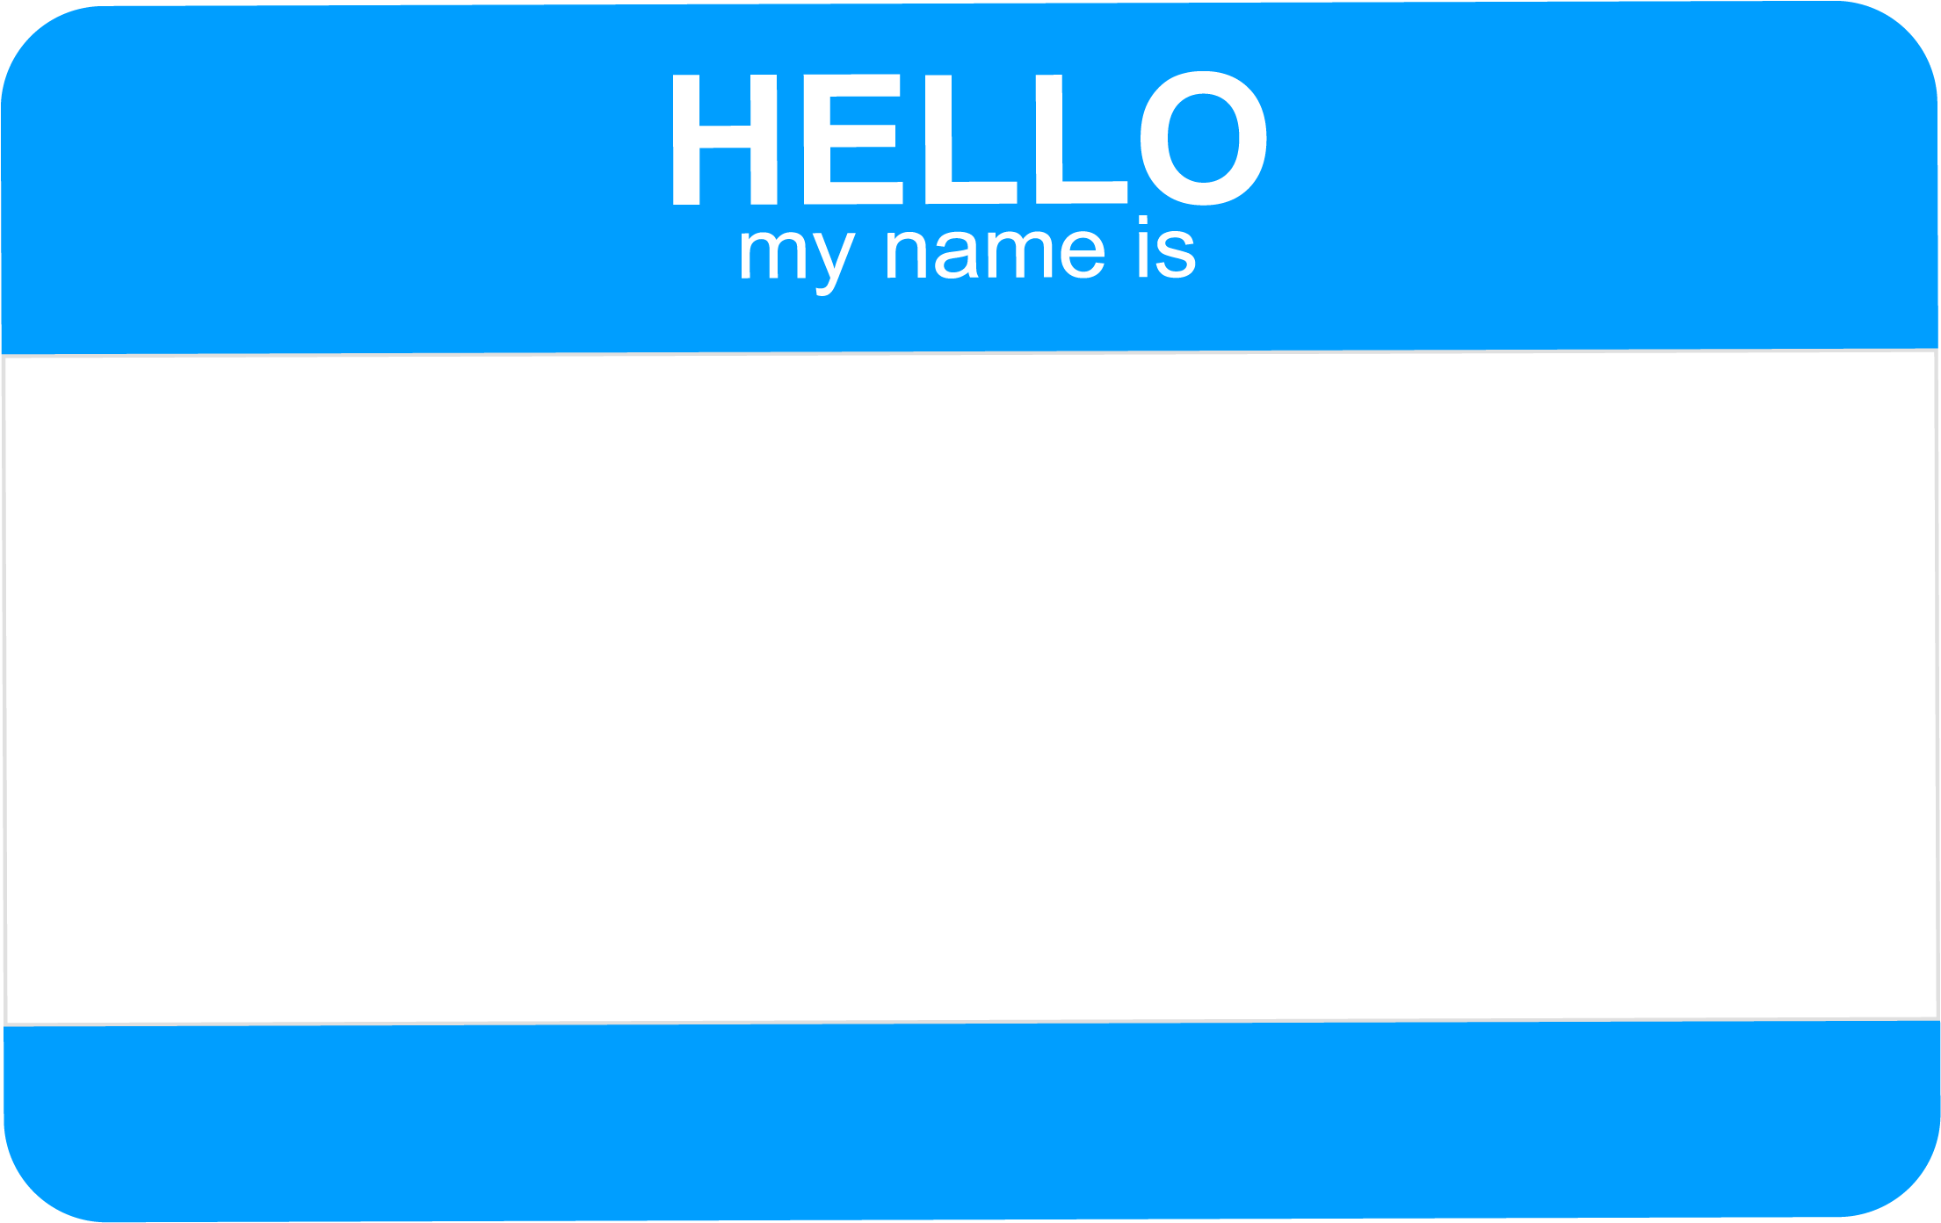
Image 1
Notes:
Go around and introduce yourselves:
Name
What you hope to gain from these group appointments

Slide 7
Ice Breaker
Image 2
Notes:
Have the group find 3 things in common

Slide 8
Ground Rules
Image 3
Notes:
Now we’ll move onto setting some ground rules for the rest of this session today and our future appointments
Facilitator is allowed to park individual-specific questions: out of respect to other members of the group - some questions may be too specific and should be reserved for one-on-one appointments/a later time. (to ensure that the conversation doesn’t go off on tangents)
Other examples:
No talking over others
Allow everyone the opportunity to contribute and speak
Confidentiality
Cell phones off

Slide 9
True/False
About 2.7 million Canadians have a migraine diagnosis.
Migraine is a neurological disorder.
Migraine is caused by both by genetic and environmental factors.
TRUE
Notes:
Please note this slide is animated and TRUE / FALSE will show on click.
Ask people to raise their hands or if conducting virtually, consider asking participants to write in the chat box or launch a poll

Slide 10
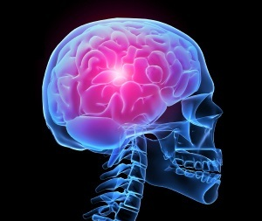
Migraine
Common myth “It’s all in your head”
Migraine is a neurological disorder.
Image 4
Notes:
Emphasize that there is an actual physiological explanation for migraines, it’s not all in your head.
Explanation of pathophysiology:
-Predisposition/vulnerable brain ”instability in how brain deals with incoming sensory information”

Slide 11
Causes of Migraine
Mechanism of migraine is not completely understood
Research suggests a complex interaction of multiple genetic and environmental factors
Genetic factors
~50% heritability
Genetics makes nervous system highly excitable
Environmental factors
Changes in genes that predisposes individuals to migraine headache
Notes:
Take home point:
Many people think that migraines are caused due to a lack of oxygen to the brain, but this is in fact not true.

Slide 12
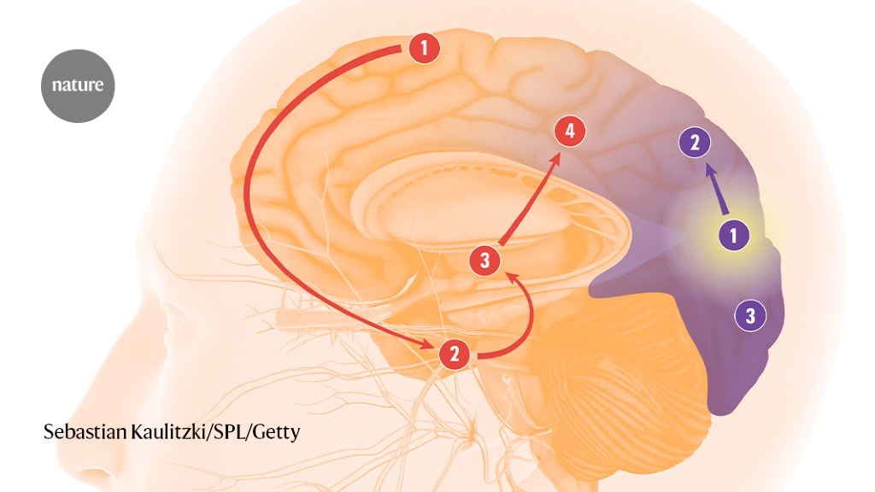
Image 5
Notes:
Brain functions by sending electrical pulses
Triggers of headache cause over-activity of nerves leading to release of chemicals in the brain causing inflammation (trigeminal nerve largest nerve in the face, responsible for touch, pain, temperature)
The released chemicals can also stimulate blood vessels to widen.
This activates the pain pathway resulting in headache.
The location of the headache depends on which part of the nerve is over-activated.

Slide 13
True/False
Not all headaches are migraines.
You must have an aura for it to be a migraine.
TRUE
FALSE
Notes:
Please note this slide is animated and TRUE / FALSE will show on click
Q1: True
Q2: False

Slide 14
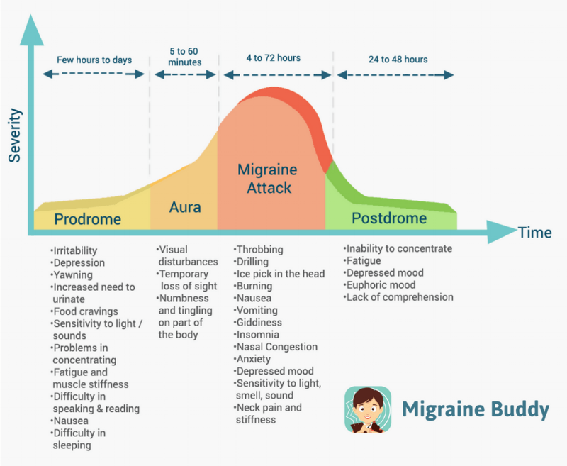
Image 6
Notes:
Typical stages of migraine
Someone may have 1 or all of these components
Are these symptoms familiar to you?

Slide 15
Headache types we will cover
Migraine with/without aura
Tension headache
Cluster headache
Medication Overuse Headache (MOH)
Notes:
Not an exhaustive list; there are also other headache types

Slide 16
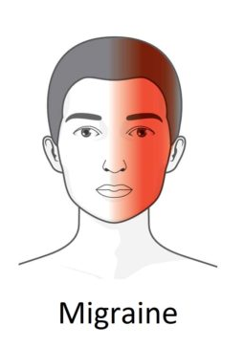
Migraine without Aura
Image 7
Notes:
≥ 5 migraine attacks lasting 4-72 hours each
≥2 of:
Unilateral location
Pulsating quality
Moderate or severe intensity
Inability to complete daily routine physical activity
≥ 1 of:
Nausea and/or vomiting
Photophobia [discomfort due to light exposure] and phonophobia [fear of loud sounds]
Not attributed to another disorder

Slide 17
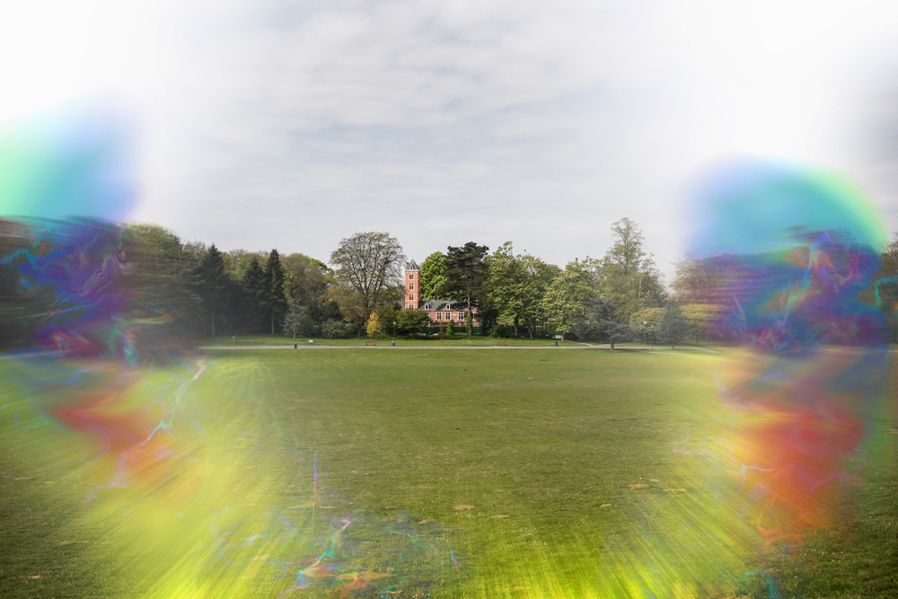
Aura
Fully reversible visual, sensory, or speech symptoms but no motor weakness
Visual symptoms:
Positive: flickering lights, spot, lines, pins and needles
Negative: blind spots
Sensorimotor: tingling, numbness
Positive Visual Aura:
Negative Visual Aura:
Images 8 - 9
Notes:
https://www.youtube.com/watch?v=KYLXaR9frHg
This movement across the visual field is attributed to a cortical spreading depression (CSD). CSD is a wave of electrically excitable neurons and their surrounding cells depolarising. The cells which are normally negatively charged become positively charged.

Slide 18
Migraine with Aura
Image 10
Notes:
≥ 2 attacks
≥ 1 of:
At least one symptom that develops gradually over a minimum of 5 minutes or different symptom that occur in succession or both
Each symptom lasts for 5 - 60 minutes
Headache that meets criteria for migraine without aura begins during the aura or follows aura within 60 minutes
Not attributed to another disorder

Slide 19
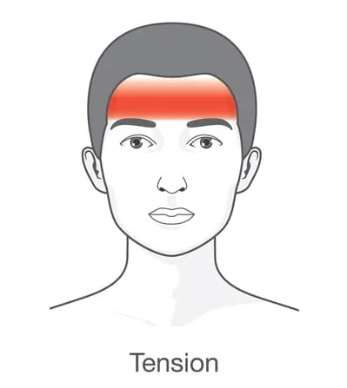
Tension Headache
Image 11
Notes:
Headache due to stress, overwork, anxiety or prolonged muscle strain
Rapidly subsides with relaxation, sleep, or taking pain medication
Sense of pressure or wearing a tight band around the head
Generally not associated with nausea and vomiting and are much less commonly associated with light and sound sensitivity than migraine
Bilateral headache
Non-pulsating pain
Not worsened by activity

Slide 20
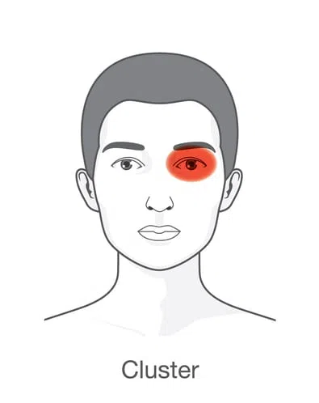
Cluster Headache
Image 12
Notes:
Attacks of severe, unilateral pain that is orbital, supraorbital, temporal or any combination of these
Brief attacks <3 hours
Occur frequently
Associated with other signs and symptoms:
tearing, nasal congestion, rhinorrhea, forehead and facial sweating, eyelid edema, restlessness/agitated during the attack

Slide 21
Types of Headache
 | Migraine without aura | Migraine with aura | Tension type headache | Cluster headache
# of attacks | ≥5 lasting 4-72 hrs each | ≥2 migraine attacks with aura symptoms | Due to stress, overwork, anxiety, prolonged muscle strain | Brief attacks lasting < 3 hours Occuring frequently
Unilateral vs. bilateral | Unilateral | Unilateral | Bilateral | Unilateral (around the eyes/temples)
Main symptoms | Pulsating Nausea/vomiting Discomfort to light and sound exposure | Pulsating Nausea/vomiting Discomfort to light and sound exposure Aura | Non-pulsating pain Not worsened with activity | Tearing Nasal congestion Forehead/facial sweating Swollen eyelids Restlessness
Notes:
This summary table is to provide an overview of all the types of headache we have just talked about.
Briefly go through to review this table – may be easier to understand as it’s all in one place rather than separate slides.

Slide 22
Group Discussion
What type of headache do you experience?
Notes:
If large group, can ask people first to type answers into the chat and then ask a few people to share their experiences out loud

Slide 23
True/False
The more medication I take the more control I will have over my migraines.
FALSE
Notes:
Please note this slide is animated and TRUE / FALSE will show on click
FALSE

Slide 24
Medication Overuse Headache
Underlying headache diagnosis
Headache occurs ≥ 15 days per month
Regular overuse of medications taken for acute and/or symptomatic treatment:
Will be reviewed in more detail during session 2

Slide 25
Notes:
This is a quick video clip explaining a bit more about why migraines occur, signs and symptoms, as well as the multi-faceted approach to migraine treatment.
https://www.youtube.com/watch?v=jHffEt-MXjI

Slide 26
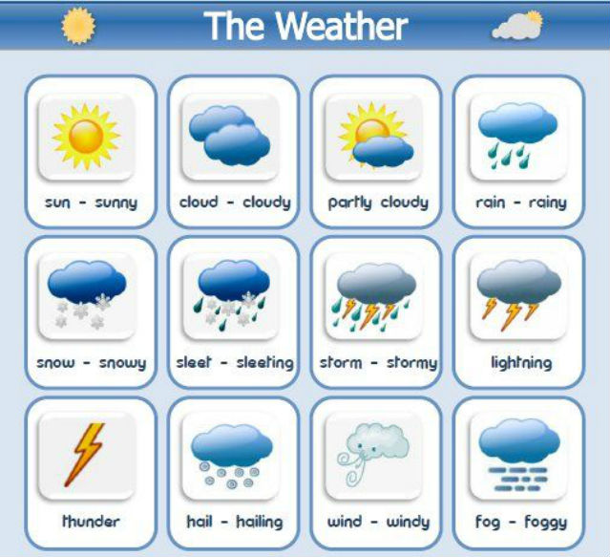
Common Triggers
Stress
Fatigue
Sleep disturbance or variation in sleep schedule
Increased physical activity
Weather changes
High altitude
Missing a meal or change in meal schedule
Images 13 - 14
Notes:
Some people find that certain events are triggers for their headaches. Common triggers include…

Slide 27
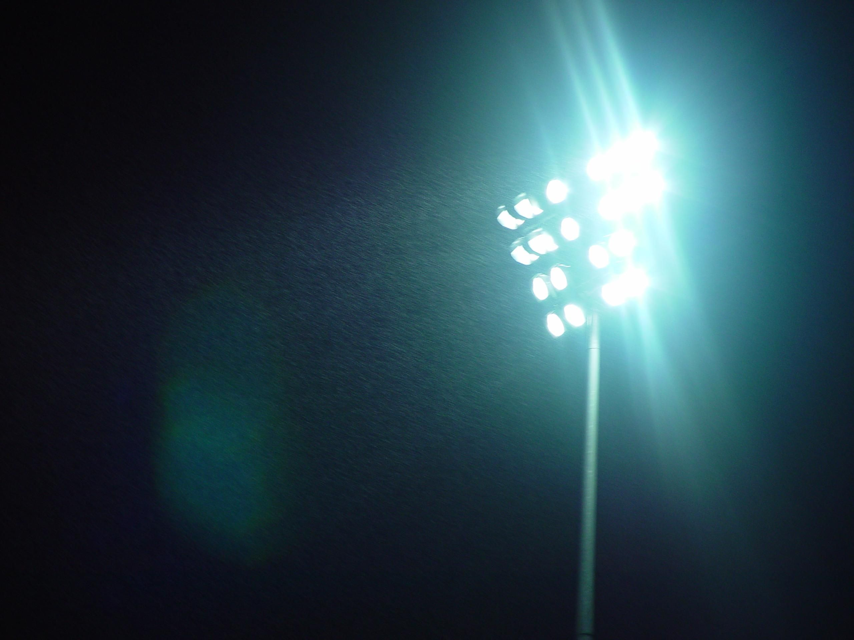
Common Triggers cont.
Environmental factors:
odors, noise, flickering lights
Alcohol and caffeine
Foods and food additives
Menstruation
Medications (e.g., oral contraceptive, vasodilators)
Images 15 - 18
Notes:
Please note that this is not an exhaustive list. Everybody has different triggers but you can use this as a list of things to pay attention to moving forward

Slide 28
Group Discussion
What are some of your triggers?
Notes:
If conducting in person, allow participants to first discuss among each other (i.e., with person next to them). Then bring together into a big group to share some of the common themes or differences.

Slide 29
Non-Pharmacological Treatment Options
Attention to lifestyle and specific migraine triggers
Regular meals
Maintain adequate and regular sleep
Maintain adequate and regular exercise
Relaxation training
Stress management training
Avoidance of known triggers
Keep a Headache Diary
Notes:
Other than paying attention to triggers, many people with headaches find keeping their lifestyle relatively consistent helps them manage their headache better. So that includes things like…
Having regular meals
Maintaining an adequate and regular sleep schedule, even on weekends
And having a regular exercise routine.
It can also be beneficial to engage in relaxation or stress management training to, again, maintain consistency in your lifestyle.
One tool that can help you with your headaches is called a Headache Diary / Journal

Slide 30
Headache Diary
Assessment tool for patients and their care team
Gives bigger picture by tracking headache and relating symptoms to possible triggers
Can be used to aid in diagnosis
Should be able to measure attack frequency, severity, duration, disability, type of treatment, treatment response and adverse effects of medication
Useful for protecting against medication overuse headache and tracking response to medications
Notes:
What exactly is it?
Essentially, it’s an assessment tool that shows the bigger picture to you and your healthcare team by relating your headache and symptoms to possible triggers.
By keeping a headache diary, you’ll be able to track the number, severity and duration of your headaches throughout any given month as well as the symptoms that come along with it, the effect of whatever you do to manage your headaches and, if you use medication, any adverse effects you’ve experienced.
From a health care professional standpoint this is a useful tool to help in diagnosis but it can also help us and you track the response to medication changes and help protect against medication overuse headaches.
So what does a headache diary or journal look like?

Slide 31
Headache Diary
Image 19
Notes:
Comes in paper format
Can track the
Components of the Headache Diary
Date of migraine
Headache severity
Presence of aura
Triggers: menstruation, lifestyle
Medication taken
Effect of acute medication
Current preventative medication
Stable prev = stable preventative medication
New prev = new preventative medication
Number of days for each headache severity within 1 month
Total number of days for acute medication intake

Slide 32
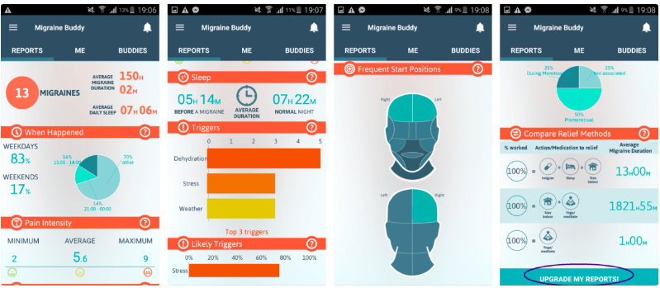
Migraine Buddy App
Online tool
Image 20
Notes:
Available in app form as well
Available on Apple App Store or Google Play Store if you search for the “Migraine Buddy”
Components of the Migraine Buddy App
Date & duration
Pain intensity
Pain location
Drug treatment taken
Reliefs
Symptoms
Auras
Impacts
Start location
Triggers
Menstruation
https://youtu.be/X7jQxS0fZt0 (video showing how the app works)

Slide 33
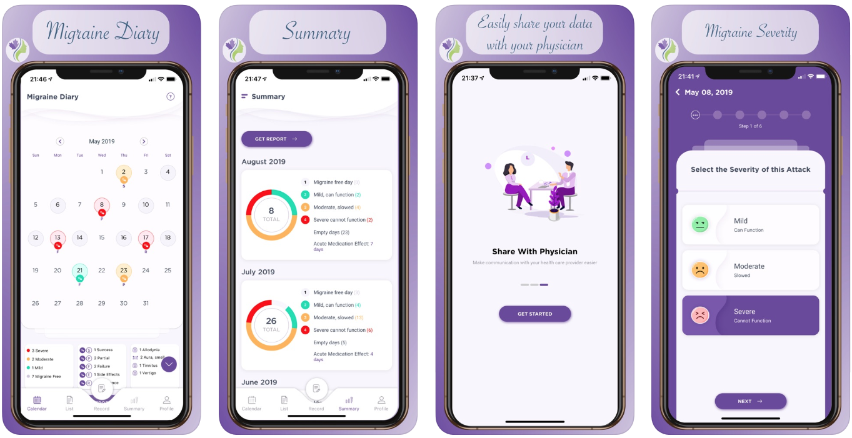
Canadian Headache Tracker
Image 21
Notes:
Another app by the Canadian Headache Society
Tracks similar things
Can customize what to track – e.g., don’t have to track menstruation if not applicable to you

Slide 34
Group Discussion
What are some non-pharmacological treatments that you find helpful?
Notes:
If conducting in person, allow participants to first discuss among each other (i.e., with person next to them). Then bring together into a big group to share some of the common themes or differences.

Slide 35
Goal Setting
After our discussion, what are some of your expectations/goals you hope to achieve with your migraine management?
Write them down, and keep them in mind for our next sessions

Slide 36
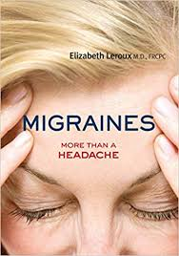
Reputable Resources
https://migrainecanada.org/
https://headachesociety.ca

Slide 37
Debrief of Today’s Session
Feedback
Any requests for future sessions?
Homework assignment: start or maintain headache diary

Slide 38
Agenda for Next Session
Medications for treating a migraine attacks
Preventative medications
Medication overuse headache

Slide 39
References
Becker WJ, Findlay T, Moga C, Scott NA, Harstall C, Taenzer P. Guideline for primary care management of headache in adults. Canadian family physician. 2015 Aug 1;61(8):670-9.
DiPiro JT, Talbert RL, Yee GC, Matzke GR, Wells BG, Posey LM, editors. Pharmacotherapy: a pathophysiologic approach. New York: McGraw-Hill Education; 2014 Mar 22.
Ferrari MD, Klever RR, Terwindt GM, Ayata C, van den Maagdenberg AM. Migraine pathophysiology: lessons from mouse models and human genetics. The Lancet Neurology. 2015 Jan 1;14(1):65-80.
Headache diary. Canadian Headache Society. Available from: https://headachesociety.ca/for-patients
Toward Optimized Practice (TOP) Headache Working Group. 2016 September. Primary care management of headache in adults: clinical practice guideline: 2nd edition. Edmonton AB: Toward Optimized Practice. Available from: http://www.topalbertadoctors.org/cpgs/10065.
Types of Headache. [Cited May 3 2019]. Available from: https://drshehadi.com/wp-content/uploads/2017/07/types-of-headaches.jpg

Slide 40
Image References
Image 1: pngkit, 2018 Image 2: freepik, 2023 Image 3: Image 3 by Unknown author is licensed under CC BY-NC.​ Image 4: Image 4 by Unknown author is licensed under CC BY-SA-NC.​ Image 5: Visual Guide to Migraine Headaches, 2020 Image 6: Migraine Buddy, 2018 Image 7: Premier Neurology & Wellness Center, 2015 Image 8: The Will Erwin Headache Research Foundation, 2019 Image 9: Vision Science Academy, 2022 Image 10: Premier Neurology & Wellness Center, 2015 Image 11: Premier Neurology & Wellness Center, 2015 Image 12: Premier Neurology & Wellness Center, 2015 Image 13: Image 13 by Unknown Author is licensed under CC BY-SA-NC | Image 14: Image 14 by Unknown Author is licensed under CC BY-NC-ND​ Image 15: Image 15 by Unknown author is licensed under CC BY-NC. Image 16: Image 16 by Unknown author is licensed under CC BY-SA. Image 17: Image 17 by Unknown author is licensed under CC BY-SA.​ Image 18: Image 18 by Unknown author is licensed under CC BY. Image 19: Migraine Canada, 2022 Image 20: Migraine Buddy App, 2023 Image 21: Migraine Tracker, 2022

Slide 41
Thank you!

