Slide 1
Session 2: Migraine Treatment Options
Facilitator: [INSERT NAME HERE]
[INSERT DATE & TIME HERE]
NOTICE: This slide deck intended for educational purposes only and you are encouraged to adapt this slide deck to suit your clinic, services and community.
This slide deck was created in 2019 at the UBC Pharmacists Clinic by Dr. Jillian Reardon, BSc (Pharm), ACPR, PharmD, RPh, with the help of Caitlin Chew (PY3) and adapted in June 2023 by Dr. Nikki Domanski, BSc, PharmD, RPh, ACPR and Carmen Leung (PY3).

Slide 2
Land Acknowledgement
[We invite you to create a land acknowledgement to recognize the traditional, ancestral, and unceded land that your office/clinic is located on]

Slide 3
Introduction
Future option:
1:1 appointments with a pharmacist at [CLINIC]
Session 1
(DATE)
[60 mins]
Session 2
(DATE)
[60 mins]
Session 3
(DATE)
[60 mins]

Slide 4
Session Outline
Reflection on last session
Introduction to acute and preventative treatments for migraine
Migraine Overuse Headaches
Debrief
Anything else you would like to cover?

Slide 5
Ice Breaker Activity
Image 1
Notes:
Idea #1: require pen and paper for each group (groups of 2 or 3)
In your group, find 10 things you all have in common and write them down.
It can’t be obvious like “we all have ears.” Ex| “we all have an older brother.”
First group to find ten things in common wins.

Slide 6
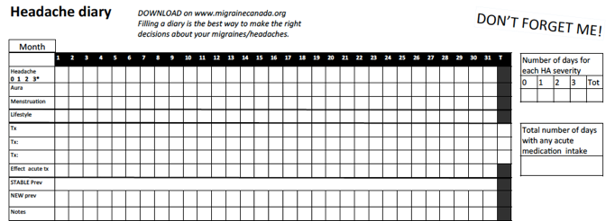
Recap from Last Session
Causes of migraine
Common triggers
Non-drug strategies
Headache Diary
Image 2
Notes:
This can be a discussion activity/review concepts discussed last time/encourage questions.
Discussion of Headache Diary:
Share highlights or insights from your headache diary
Prompting questions:
Did you find it helpful to track your migraines?
Did you discover any triggers from tracking your migraines?
When do you find your migraines come on/are the worst?

Slide 7
Reflection Questions
Q: Headache Diary progress: were you able to capture migraines throughout the month?
Q: Did the Headache Diary help you to learn something about your migraines that you previously were unaware of?
Q: Have you made any progress with your personal goal? What have been barriers or facilitators to this?

Slide 8
When should you take acute migraine medications?
Wait until the pain becomes unbearable
At onset of migraine
30 minutes into the migraine
Wait until the pain is bothersome
Image 3
Notes:
Please note this slide is animated and correct answer will show on click.
Should be taken at onset of migraine. Some patients find it effective to take at onset of aura (anecdotal).
We’ll discuss more about this when after we go through some of the medication options.

Slide 9
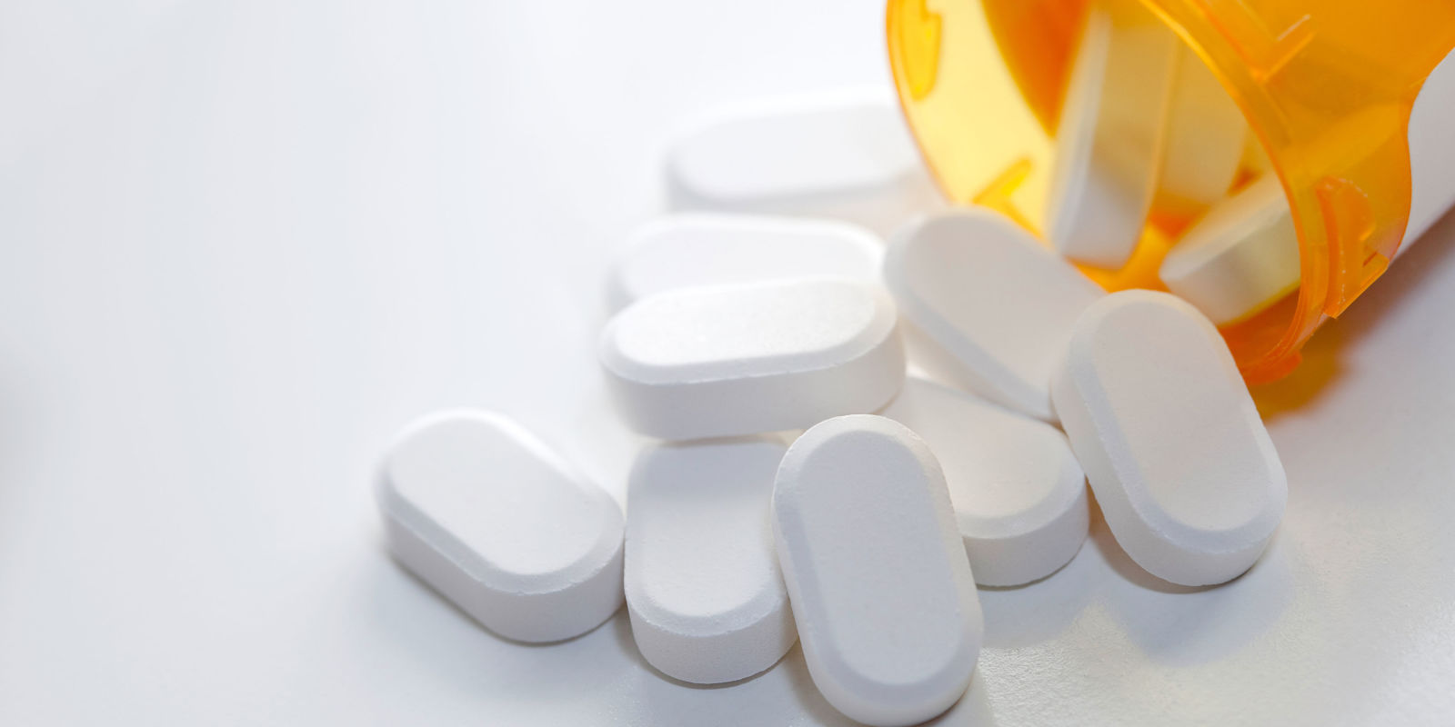
Medication Options
Image 4

Slide 10
Acute Treatment
Simple analgesics
NSAIDs
Acetaminophen
Triptans
Anti-emetic (anti-nausea)
Dihydroergotamine (DHE), ergotamine, opioids, barbiturate
Notes:
Acute = ONLY when attack is occurring. Jillian will touch on long-term preventative therapy.
Black = the ones we’re going to touch on
Grey = not as common
Does anyone have familiarity with any of the drugs listed besides NSAIDs or acetaminophen? (May need to explain what NSAIDs are).
Introduce concept of “abortive therapy”

Slide 11
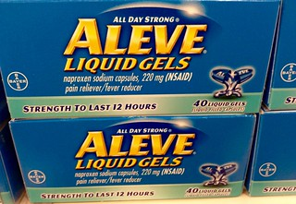
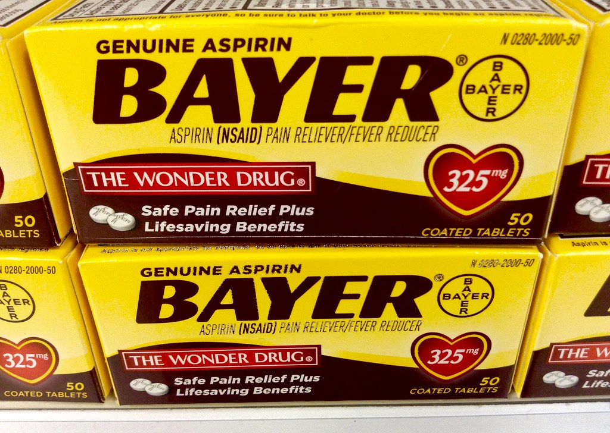
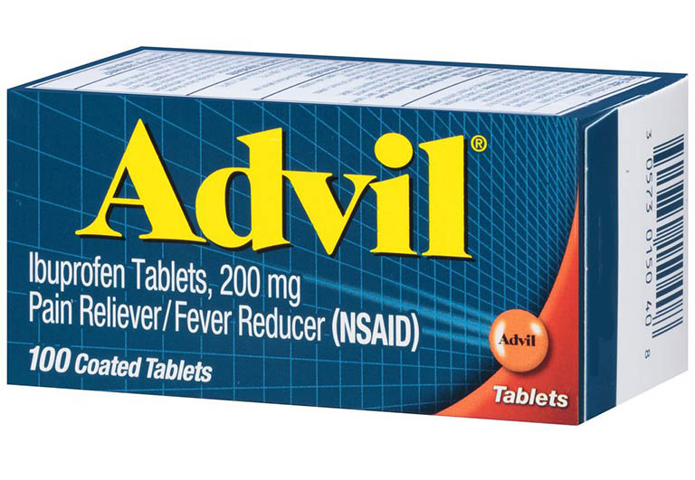
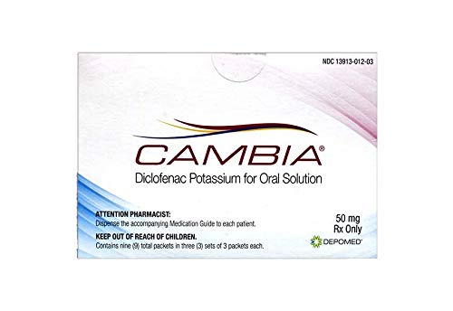
NSAIDs
Images 5 - 8
Notes:
Explain what an NSAID is (non-steroidal anti-inflammatory drug).
Point out that these are all different types of NSAIDs: Aleve, Advil and ASA being over the counter, while Cambia (diclofenac powder) requires a prescription.
All of these are used for the acute treatment of migraines.

Slide 12
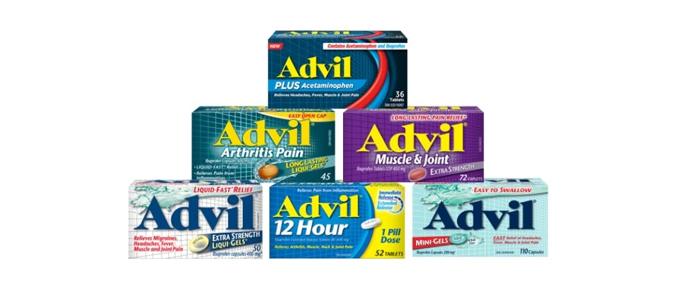
What’s the Difference?
Image 9
Notes:
Ask the individuals, what’s the difference between all these "Advils" to start up a conversation.
Some of these have multiple ingredients. For migraines, try and choose single entity products, because you don’t always need each component of the medication.
Cannot always switch between “regular” and “Muscle and Joint” due to the strength of drug.
It’s important to look at the labels and determine how many milligrams of active ingredient there is in each pill.
All of these Advil products are essentially the same, they are just marketed different to target different patients. Advil “Migraine” will not help your migraine any differently.

Slide 13
NSAIDs
Drug | ASA, Ibuprofen, Naproxen, Diclofenac
Use | Mild-moderate headaches Can be combined with triptans in severe cases Choose alternative if ineffective in past
Benefit | More accessible Years of experience with use
Side Effects | Stomach irritation, stomach bleeding, kidney dysfunction, worsening of high blood pressure or other cardiac conditions
Contraindications | Stomach ulcers, history of stomach bleed, ASA-induced asthma, first or last trimester of pregnancy
Caution | Cardiovascular disease, kidney dysfunction
Notes:
It should be noted that some NSAIDs are over the counter while others are by prescription. This is related to the risk of side effects that may require extra monitoring.
Define contraindication.

Slide 14
Ibuprofen Dosing
400-800 mg at start of migraine pain then 400 mg every 4-6 hours as needed
Maximum 1200 mg per day (OTC dosing)
Image 10
Notes:
Ibuprofen is the most commonly used and accessible NSAID.
OTC max 1200
Rx max 2400

Slide 15
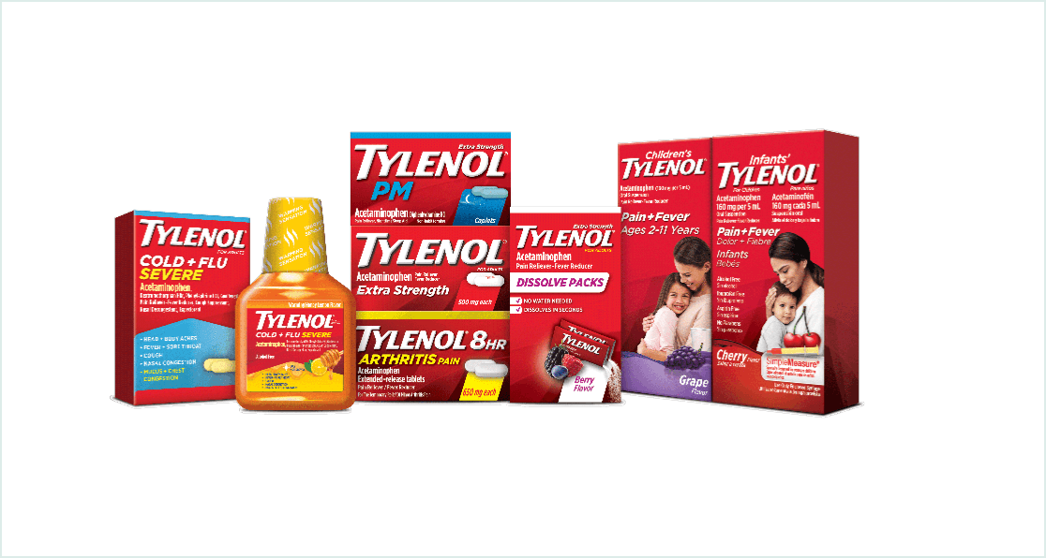
What’s the Difference?
Image 11
Notes:
Again, what’s the difference between all of these products?
Some of these have multiple ingredients (muscle and body, back pain, nighttime, cold). Try and choose single entity products, because you don’t always need each component of the medication.
Cannot always switch between “regular” and “Muscle and Body” due to the strength of drug.
It’s important to look at the labels and determine how many mg of active ingredient there is in each pill.
All of these Tylenol products are essentially the same, they are just marketed different to target different patients. It is important to know that they all contain the same active ingredient!

Slide 16
Acetaminophen
Drug | Tylenol, Tylenol No. 1, Emtec
Use | Mild-moderate headaches Choose alternative if ineffective in past
Benefit | Fewer side effects compared to prescription medication Cheaper
Side Effects | Well-tolerated
Contraindication | Liver dysfunction
Dosing | 325-650 mg every 4-6 hours, maximum 4g/day
Notes:
Tylenol No. 1 and Emtec contain codeine and caffeine.

Slide 17
Acetaminophen vs. Ibuprofen
Both are used for the treatment of migraines
Ibuprofen has been more widely studied for migraine
Both can be taken together if below the maximum doses
Reports that acetaminophen alone is ineffective
Image 12
Notes:
Systematic review conducted in 2010 showed that only 2 studies looking at tension headaches have actually found that ibuprofen is superior to acetaminophen.
There is currently not enough evidence to show that one is better than the other for migraine treatment. However, anecdotally, patients have found that ibuprofen is more effective for their migraine.

Slide 18
Triptans
Drug | Almotriptan, Sumatriptan, Naratriptan, Rizatriptan, Zolmitriptan
Use | Moderate to severe migraines (first choice) If previous attacks not controlled by simple analgesics
Benefit | Strong evidence supports use Fewer side effects than older drugs (i.e. ergotamines) Variety of formulations available (tablet, wafer, nasal spray, injectable)
Side Effects | Chest discomfort or tightness, nausea, facial flushing, tingling, dizziness, fatigue, drowsiness
Contraindications | Coronary and cerebrovascular disease Caution with other serotonergic drugs (i.e. SSRI/SNRI)
Notes:
Called triptans due to each of the drug names in the class
Do people recognize these? What are their thoughts about them?
Benefits: 7 different drugs available in the class, different formulations allow for rapid absorption or use in nausea and vomiting
Contraindications: uncontrolled hypertension
Highlight interaction between triptan and SSRI/SNRI → not a contraindication, just caution and monitor for symptoms of serotonin syndrome (tachycardia, diaphoresis, hypertension, fever).
SSRI/SNRI = citalopram, sertraline, venlafaxine
Bottom line:
Triptans are a great option for abortion of migraines of all severities.
They come in a variety of formulations with different time to onset of action, so it really depends on patient preferences when it comes to choosing a triptan.

Slide 19
True/False
All triptans are the same, if one doesn’t work, you should try another class of medications
There is no maximum doses of a triptan you can take in 24 hours
FALSE
FALSE
Notes:
Please note this slide is animated and TRUE / FALSE will show on click
FALSE for all.
Can try changing drug if one becomes ineffective.
Maximum generally 1 dose evert 12 hours. Otherwise, increased risk of side effects, tachyphylaxis, and MOH.

Slide 20
FYI: Triptans
If you do not respond well to one triptan or cannot tolerate it, a different triptan can be tried
Treat 3 separate attacks to judge efficacy of one drug
Try 3 different types of triptans to judge efficacy of triptans
Maximum 2 doses of a triptan per 24 hours
Repeat dose in 2 hours
Notes:
Can repeat triptan in 2 hours (exceptions: naratriptan is 4 hours, and sumatriptan SC is repeated in 1 hour)
Only take a second dose of triptan if some relief was felt during the first dose, if the first dose was ineffective, the second dose may not be effective.
Concludes section on triptans. Has anyone had to try a second kind of triptan? Would people be open to trying a triptan?

Slide 21
Anti-Nausea Medications
Drug | Metoclopramide, Domperidone
Use | Treatment of nausea and vomiting during migraines
Benefit | Can improve absorption of other medications Can be combined with NSAIDs if a triptan cannot be used
Side Effects | Domperidone: Production of breast milk Swelling of breast tissue in men Diarrhea, abdominal cramps | Metoclopramide: Sedation Abnormal motor movements
Contraindications | Domperidone: Underlying heart disease | Metoclopramide Epilepsy Gastrointestinal obstruction
Notes:
Medications like Gravol, Ginger Gravol, and Benadryl are also considered anti-nausea medications but are not used for the treatment of migraines.
QT prolongation with domperidone.

Slide 22
FYI: Acute Treatment
Initial treatment choice is based on severity of attack
Take medication at the earliest onset of migraine attack to improve effectiveness
Trial and error
Severe nausea or vomiting during migraine: consider using anti-nausea medication or non-oral dosage form
Notes:
It is important to highlight that acute treatment of migraines need to be treated right away, and aggressively. Rather than trying to space out your medication throughout the day, treating your migraine with a higher dose right away.
We want to ensure that the migraine is treated right away and that it doesn’t lead into what we call a migraine cascade, where the migraine progresses into the next few days because it was not treated appropriately.

Slide 23
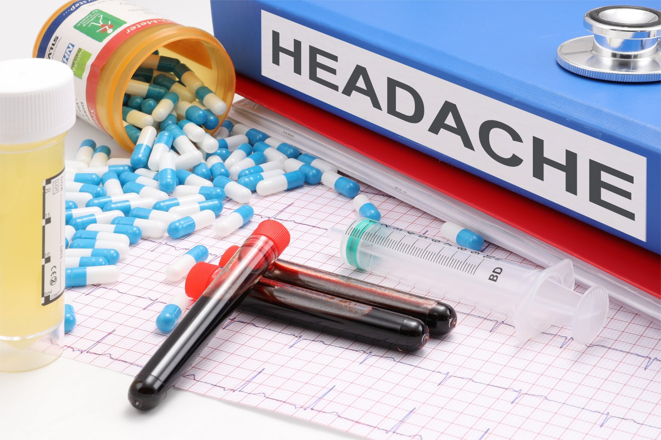
Medication Overuse Headache (MOH)
Acute headache medications are beneficial in relieving headaches but may also worsen a pre-existing headache if taken too frequently
Image 13

Slide 24
Review: Criteria for MOH
Headache occurs ≥ 15 days per month
Regular overuse for >3 months of one or more drugs used for acute and/or symptomatic treatment:
> 9 days/month: triptans, DHE, opioids, barbiturates
> 14 days/month: NSAIDs, acetaminophen
Not better explained by another diagnosis

Slide 25
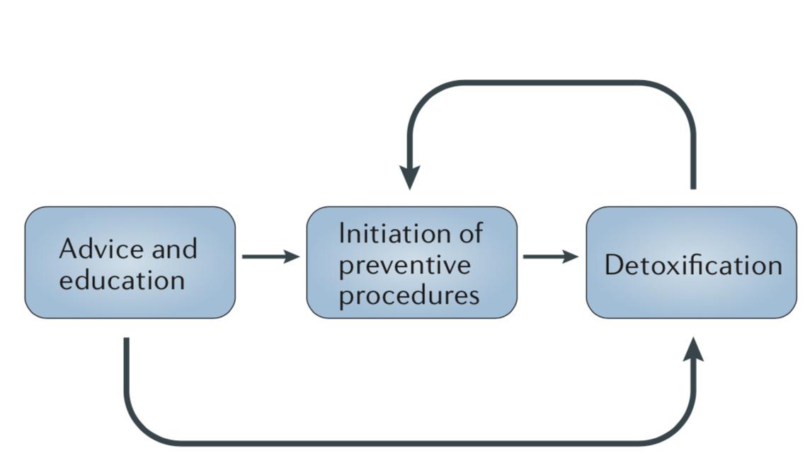
MOH Treatment
Image 14
Notes:
Some patients might only need advice and education to stop medication overuse, whereas others need a structured, pharmacologically supported detoxification program. In the majority of these patients, initiation of a preventive pharmacological treatment before detoxification is advised.
Evidence is conflicting whether pharmacologic prophylaxis for the primary headache type (e.g., a beta-blocker for migraine) should be implemented before or after withdrawal of the offending medication; this must be assessed on a case-by-case basis.
When medication overuse is stopped, headache may worsen temporarily and you may experience other withdrawal symptoms:
Some medications require tapering (opioids)
Unknown if best to taper or stop cold-turkey
Preventative therapies may become more effective
Many will experience a long-term reduction in headache frequency after medication overuse is stopped.

Slide 26
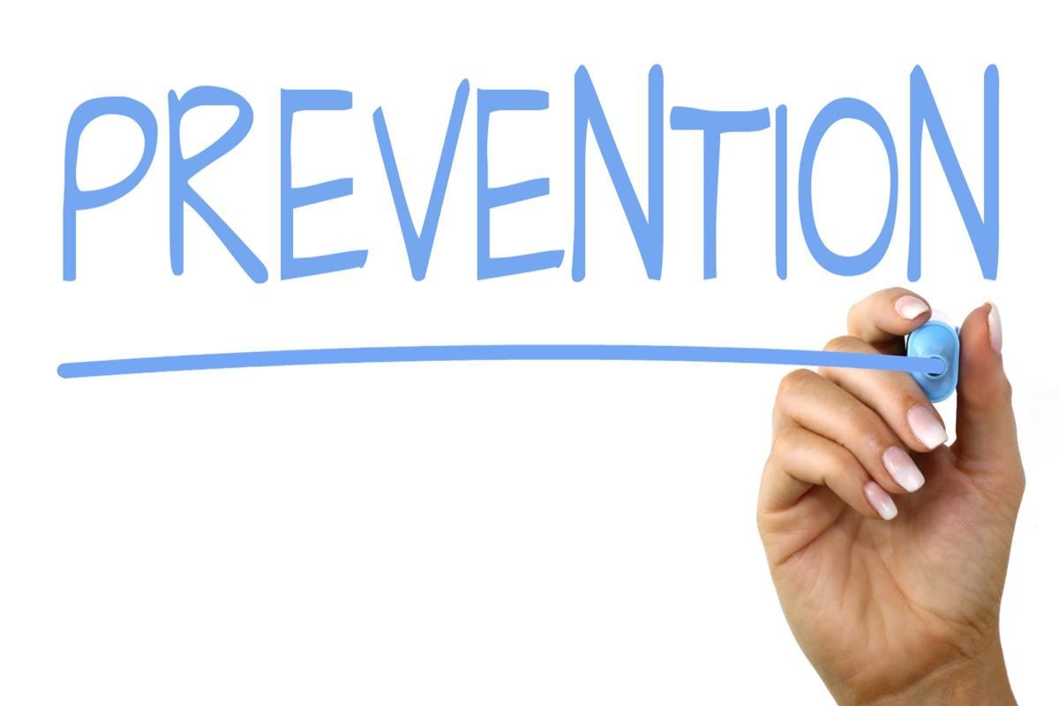
Image 15

Slide 27
Preventative Treatment
Optimize non-drug treatments first
Several indications (patient specific)
Notes:
Indications:
Recurrent headaches that interfere with daily routine despite acute treatment
Contraindication to acute therapy
≥ 3 moderate to severe headache days per month
Failure or overuse of acute therapy
Intolerable side effects from acute therapy
Patient preference

Slide 28
Goals of Preventative Treatment
Reduce the frequency, severity and duration of attacks
Improve the response to treatment of acute attacks
Improve function and reducing disability
Avoid medication overuse headache

Slide 29
Selection of Preventative Treatment
Efficacy of medication
Side effects and contraindications
Co-existing medical conditions and treatments
Notes:
All of these medications are options for preventative treatment of migraines. We used different types of drugs: blood pressure medication, anti-seizure medications, and anti-depressants. We don’t really know why they work, but we use them and they are efficacious for the prevention of migraines.
Selection is based on other co-existing medical conditions.

Slide 30
FYI: Preventative Treatment
Typically considered effective if medication can reduce migraine attack frequency by 50%
Often reduce severity and acute medications work better
Notes:
Need to be tried for 2 months at target or optimal dose before considering this drug ineffective.
Doses start low and increased slowly over time.
It can take up to 4-8 weeks to see benefit.
Discontinuation of preventative medications may be considered after 6-12 months if goals have been met.

Slide 31
Beta-Blockers
Drug | Propranolol, Metoprolol, Timolol
Other Uses | Heart disease High blood pressure Atrial fibrillation
Side Effects | Fatigue, low blood pressure, cold extremities, slow heart rate, depression
Contraindications | Asthma, slow heart rate, peripheral vascular disease
Notes:
Bottom line:
Beta-blockers are one of the first-line agents used for preventative therapy of migraines. The doses of these medications can be pushed quite high; however, side effects can be challenging particularly low blood pressure, cold extremities, and exercise-induced fatigue. Beta-blockers are typically chosen when an individual has more than one medical condition that can be treated with a beta-blocker including high blood pressure, or heart disease.

Slide 32
Tricyclic Antidepressants
Drug | Amitriptyline, Nortriptyline
Other Uses | Anxiety, depression, insomnia Chronic pain, neuropathy Tension-type headache
Side Effects | Dry mouth, constipation, weight gain, fatigue, drowsiness Fewer side effects with nortriptyline
Contraindications | Closed angle glaucoma Severe cardiac, kidney, liver, prostate, or thyroid disease Low blood pressure Seizures
Notes:
Bottom line:
Explain the term “antidepressant” → family name for the medication. TCA are used at much lower doses than when used for depression. Some people call these “anti-migraine drugs” instead.
These drugs have been used for a very long time for the preventative treatment of migraines. They are typically dosed once a day at night. Some side effects include hypotension, meaning low blood pressure, particularly when getting up after sitting or lying down.

Slide 33
Topiramate
Drug | Topamax, Topiramate
Other Uses | Obesity Seizure disorder Chronic pain syndromes
Side Effects | Tingling, prickling, or numb sensation on skin Decreased cognition and concentration Weight loss
Contraindications | Pregnancy Closed angle glaucoma History of renal stones Liver disease
Notes:
Bottom line:
Topiramate is a drug typically used for chronic pain and seizure disorders, however is also commonly used for prevention of migraines. Side effects that are associated with topiramate include weight loss, and decreased cognition/concentration.

Slide 34
Divalproex
Drug | Divalproex, Depakene, Valproic Acid
Use | Depression Seizure disorder Chronic pain syndrome
Side Effects | Nausea, tremor, hair loss, weight gain
Contraindications | Pregnant (can cause serious harm to fetus) Childbearing potential Liver disease

Slide 35
Botulinum Toxin A
Drug | Botulinum Toxin A
Use | Chronic migraine only (≥ 15 HA days/month) Injected every 3 months
Side Effects | Neck/facial pain or facial muscle weakness
Contraindications | Patients with swallowing or breathing difficulties Muscle weakness Myasthenia gravis Neuromuscular disorders
Notes:
Bottom line:
Botox injections is a newer, up and coming treatment option for chronic migraine patients who have failed other treatment options. This is a very specialized treatment that involves Botox injections around the neck/head every 3 months following a very specific protocol.

Slide 36
Tips for Preventative Treatment
There is no “best treatment” for prevention
“Start low and go slow” to avoid common pitfalls:
Not increasing dose if medication is tolerated
Not waiting long enough before abandoning a medication
Not setting realistic expectations for medications
Notes:
Need weeks to months to see effect.

Slide 37
Debrief of Today’s Session
Feedback
Homework assignment: continue maintaining Headache Diary
Notes:
Record headache occurrence, peak headache intensity, use of abortive medications, unscheduled visits for acute headache treatment.

Slide 38
Agenda for Next Session
Continuation of today’s material (new acute and preventative treatment options)
Natural health products for migraine
Group discussion-based session
Progress toward migraine management goals
Bring your questions!

Slide 39
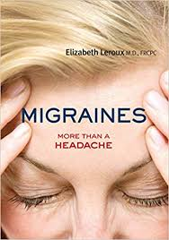
Reputable Resources
https://migrainecanada.org/
https://headachesociety.ca

Slide 40
References
Becker WJ, Findlay T, Moga C, Scott NA, Harstall C, Taenzer P. Guideline for primary care management of headache in adults. Canadian family physician. 2015 Aug 1;61(8):670-9.
CADTH Common Drug Review. Erenumab. 2019. [cited May 3 2019]. Available from: https://www.cadth.ca/erenumab.
DiPiro JT, Talbert RL, Yee GC, Matzke GR, Wells BG, Posey LM, editors. Pharmacotherapy: a pathophysiologic approach. New York: McGraw-Hill Education; 2014 Mar 22.
Headache diary. Canadian Headache Society. [cited May 3 2019] Available from: https://headachesociety.ca/for-patients/
Leroux E. CGRP antibodies: practical details on access. Migraine Canada. 2019.[cited May 3 2019]. Available from: https://migrainecanada.org/2019/04/20/cgrp-antibodies-practical-details-on-access/
Lexicomp-Drugs. Domperidone. 2019. [cited May 3 2019].
Lexicomp-Drugs. Metoclopramide. 2019. [cited May 3 2019].
Pringsheim T, Davenport WJ, Mackie G, Worthington I, Aubé M, Christie SN, Gladstone J, Becker W. Canadian headache society guideline for migraine prophylaxis. Canadian Journal of Neurological Sciences. 2012; 39: Suppl. 2 – S1-S2.
RxFiles. Migraines. October 2018.
Toward Optimized Practice (TOP) Headache Working Group. Primary care management of headache in adults: clinical practice guideline: 2nd edition. Edmonton AB: Toward Optimized Practice. September 2016. [cited May 2 2019] Available from: http://www.topalbertadoctors.org/cpgs/10065.

Slide 41
Image References
Image 1: freepik, 2023 Image 2: Canadian Headache Society, 2022 Image 3: Image 3 by Unknown author is licensed under CC BY-SA. Image 4: Image 4 by Unknown author is licensed under CC BY-SA-NC. Image 5: Image 5 by Unknown author is licensed under CC BY. Image 6: Amazon, 2023 Image 7: Image 7 by Unknown author is licensed under CC BY-SA. Image 8: Image 8 by Unknown author is licensed under CC BY.​ Image 9: HaleonHealthPartner, 2023 Image 10: Image 10 by Unknown Author is licensed under CC BY-SA Image 11: Tylenol, 2023 Image 12: Image 12 by Unknown Author is licensed under CC BY-NC | Image 13: Image 13by Unknown Author is licensed under CC BY-SA Image 14: Diener et al., 2016 Image 15: Image 15by Unknown Author is licensed under CC BY-SA

Slide 42
Thank you!

