Slide 1
Session 3: New Treatments and Natural Health Products
Facilitator: [INSERT NAME HERE]
[INSERT DATE & TIME HERE]
NOTICE: This slide deck intended for educational purposes only and you are encouraged to adapt this slide deck to suit your clinic, services and community.
This slide deck was created in 2019 at the UBC Pharmacists Clinic by Dr. Jillian Reardon, BSc (Pharm), ACPR, PharmD, RPh, with the help of Caitlin Chew (PY3) and adapted in June 2023 by Dr. Nikki Domanski, BSc, PharmD, RPh, ACPR and Carmen Leung (PY3).

Slide 2
Land Acknowledgement
[We invite you to create a land acknowledgement to recognize the traditional, ancestral, and unceded land that your office/clinic is located on]

Slide 3
Introduction
Future option:
1:1 appointments with a pharmacist at [CLINIC]
Session 1
[DATE]
[60 mins]
Session 2
[DATE]
[60 mins]
Session 3
[DATE]
[60 mins]

Slide 4
Session Outline
What’s New in Migraine Therapy
CGRPs
Gepants
Coming soon
Natural Health Products
Group discussion & Debrief

Slide 5
Quick Check-in
In 1 word: What kind of a day have you had so far today?

Slide 6
CGRP Antibodies
Drug | Erenumab | Galcanezumab | Fremanezumab | Eptinezumab
Brand name | Aimovig® | Emgality® | Ajovy® | Vyepti®
Target | CGRP receptor | CGRP | CGRP | CGRP
Migraine Types | Episodic Chronic | Episodic Chronic Cluster | Episodic Chronic | Episodic Chronic Cluster
Route of Administration | Injection under the skin (monthly) | Injection under the skin (monthly) | Injection under the skin (monthly or every 3 months) | 30 min IV infusion (every 3 months)
Micromedex Drug Product Database 2019.
Notes:
Note: Eptinezumab (Vyepti) must be done in a clinic. Patients cannot do it themselves.

Slide 7
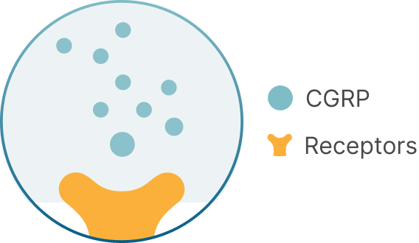
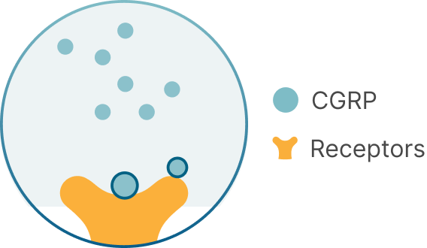
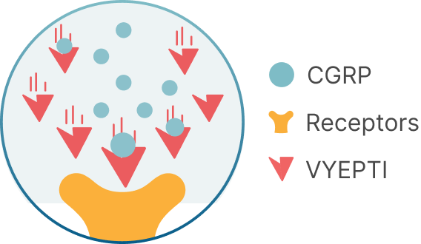
How CGRP Antibodies Work
Binding of CGRP to the receptor = MIGRAINE
CGRP Antibodies (block binding)
Image 1
Notes:
How do they work?
CGRP, or calcitonin gene-related peptide, is a protein that is released in the brain and can cause inflammation in the brain coverings, leading to migraine pain. The new drugs designed to treat migraines work by targeting CGRP, either by creating antibodies against CGRP or its receptor. These antibodies are called monoclonal antibodies and are too large to cross into the brain, so they must be injected into the system to be effective.
The first one that came out on the market (erenumab; Aimovig) directly blocked the receptor, whereas the following CGRP antibodies that came to market (galcanezumab, fremanezumab and eptinezumab) work to directly attach to the CGRP ligand and prevent binding at the receptor (as pictured here)
Source: Migraine Canada

Slide 8
CGRP Antibodies
Drug | Erenumab, Galcanezumab, Fremanezumab, Eptinezumab
Use | For chronic migraine (>8 days/month), episodic migraine (>4 days/month) and cluster* headaches *galcanezumab, fremanezumab
Side Effects | Constipation, pain or itching at injection site, flu-like symptoms, fatigue
Caution | Allergy Pregnancy or trying to conceive
Notes:
Bottom line:
CGRP antibodies are the newest form of therapy targeted towards migraine treatment. They require injections once a month and are targeted towards individuals with ≥ 4 migraines/month who have failed/intolerant to more than 2 other migraine therapies
Episodic migraine: Migraine headaches on at least 4 days per month and less than 15 headache days per month for more than 3 months.
Chronic migraine: Migraine headaches on at least 8 days per month and headaches for at least 15 days per month for more than 3 months.

Slide 9
Cost and Access
Drug | Erenumab | Galcanezumab | Fremanezumab | Eptinezumab
Brand name | Aimovig® | Emgality® | Ajovy® | Vyepti®
Available in Canada | ✓ | ✓ | ✓ | ✓
PharmaCare Benefit | ✘ | Special Authority | Special Authority | ✘
Patient Support Program | ✘ | ✘ | AJOVY Teva Support Solutions | Vyepti Today
Cost ($) per month | $500-700 | $600-700 | $540 | $600
Notes:
Special Authority Criteria (APPROVAL PERIOD: 6 month)
Source: BC Pharmacare
Initial:
The patient has a confirmed diagnosis of episodic or chronic migraine defined as:
Episodic migraine: Migraine headaches on at least 4 days per month and less than 15 headache days per month for more than 3 months.
Chronic migraine: Migraine headaches on at least 8 days per month and headaches for at least 15 days per month for more than 3 months.
AND
The patient has experienced an inadequate response for a minimum three months trial at optimal dosing or intolerance to at least two oral prophylactic migraine medications from two different therapeutic classes. Required details of trial include names, doses and durations of the previously tried prophylactic migraine medications. In cases of intolerance, also include details regarding the nature and severity of the intolerance(s) experienced.
AND
The baseline number of headache and migraine days per month* at the time of initial request is provided.
Which CGRP antibody is the most effective?
CGRP antibodies have not been compared head-to-head to one another. They all have shown effectiveness in the prevention of episodic and chronic migraine in separate studies. There is a lot of variability in migraine in general. NO ONE SIZE FITS ALL! For example, the response to triptans varies from one person to the other. Likely some people will respond to one antibody, some to another, some to all and some to none.

Slide 10
Gepants
Drug | Atogepant (Qulipta®), Ubrogepant (Ubrelvy®)
Use | Oral medications Ubrogepant: acute treatment of migraine (as needed) Atogepant: prevention of migraine (taken daily)
Side Effects | Nausea, drowsiness, fatigue, dry mouth, constipation
Cautions | Allergy, pregnancy Interacts with certain medications (i.e, antifungals) Less caution with heart disease (unlike triptans)
Available in Canada? | Yes - as of March and April this year!
Cost ($) per month | ~$50 - $150 per tablet (depending on brand and strength)
Migraine Canada: Gepants: preventives AND an acute treatment for migraine
Notes:
Who benefits from gepants?
Those who failed treatment on triptans (eg, sumatriptan, rizatriptan, zolmitriptan), or for whom a gepant will be added as an alternative to the patient’s triptan regimen
Those unable to tolerate triptans
Those with significant cardiac or cerebrovascular risk factors (gepants do not constrict cardiac or cranial arteries)
Are gepants safe?
One advantage of gepants is that they do NOT constrict arteries. That means they could be used by people with cardiovascular disease (history of heart disease or stroke) or vascular risk factors (diabetes, hypertension, etc.)
Source: https://migrainecanada.org/posts/the-migraine-tree/branches/acute-treatments/gepants-preventives-and-an-acute-treatments-for-migraine/

Slide 11
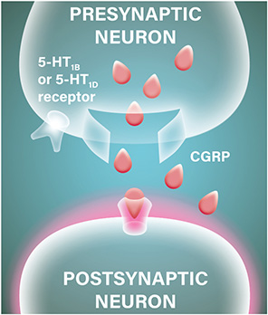
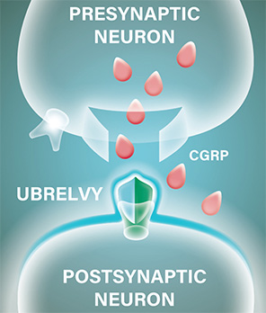
How Gepants work
Image 2
Notes:
How do gepants work? Very similar to CGRP mechanism
Gepants are drugs that work by blocking the CGRP receptor in our bodies, which is a protein involved in migraine according to robust scientific research. By blocking this protein, gepants prevent the mechanisms that cause migraines, hence why they are known as CGRP antagonists or blockers.

Slide 12
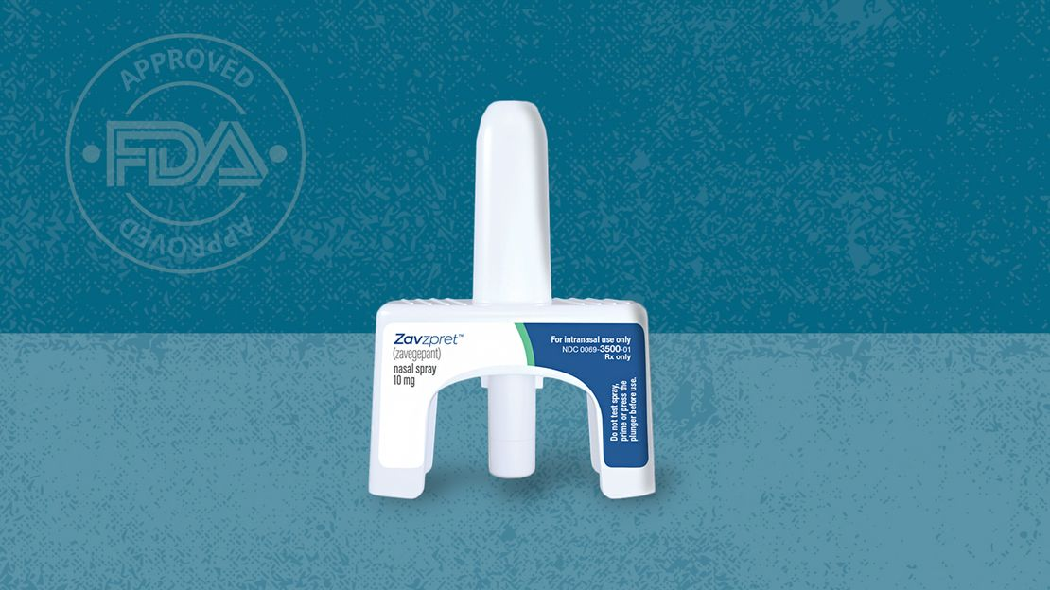
Coming Soon
Drug Class | Gepants | Gepants
Examples | Rimegepant | Zavegepant
Types | Acute treatment or prevention (works for both) | Acute treatment
Administration | Sublingual (under tongue) | Nasal spray
Benefits | Alternative for triptans No medication overuse headache Safer option in heart disease, diabetes, hypertension | Fast acting Safe for heart disease, diabetes, hypertension
Approval Status | Health Canada → under review Likely coming soon | Recently approved in the US Status to market unknown
Image 3

Slide 13
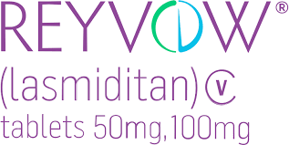
Coming Soon
Drug Class | Ditans
Example | Lasmiditan (Reyvow)
Target | Serotonin receptor activator
Use | Acute treatment of migraine attacks
Administration | Oral tablet
Benefit | Alternative for triptans Possibly safe for heart disease, diabetes, hypertension
Approval Status | Recently approved in the US Status to market unknown
Notes:
REYVOW (lasmiditan) is the first and only FDA-approved ditan—a high-affinity 5-HT1F receptor agonist
REYVOW presumably exerts its therapeutic effects by activating the 5-HT1F receptor; however, the exact mechanism of action is unknown.
5-HT1F receptors, involved in modulating pain signaling, are present in both the peripheral and central pain pathways.
Based on the location of 5-HT1F receptors, REYVOW is believed to act both centrally and peripherally.
Source: REYVOW

Slide 14
Questions
Notes:
Pause for questions before moving on to the final section - NHPs

Slide 15
Natural Health Products
Image 4

Slide 16
True/False
All natural health products for the treatment of migraines are safe and have no side effects
FALSE
Notes:
Please note this slide is animated and TRUE / FALSE will show on click
False. Do have less side effects from some drug therapies however they do have contraindications/side effects

Slide 17
Natural Health Products
Vitamins, minerals and herbal compounds can also be used for migraine prevention:
Riboflavin
Magnesium citrate
Co-enzyme Q10
Butterbur
May be less effective than prescription drug therapy but often have fewer side effects

Slide 18
Group Discussion
Q: Do you currently use any? Do you find them effective for your headache? What’s your experience with them?

Slide 19
Riboflavin (Vitamin B2)
Side effects | Benign yellow discolouration of urine
When to avoid | No contraindications
Dosing | 400 mg/day
Images 5- 6

Slide 20
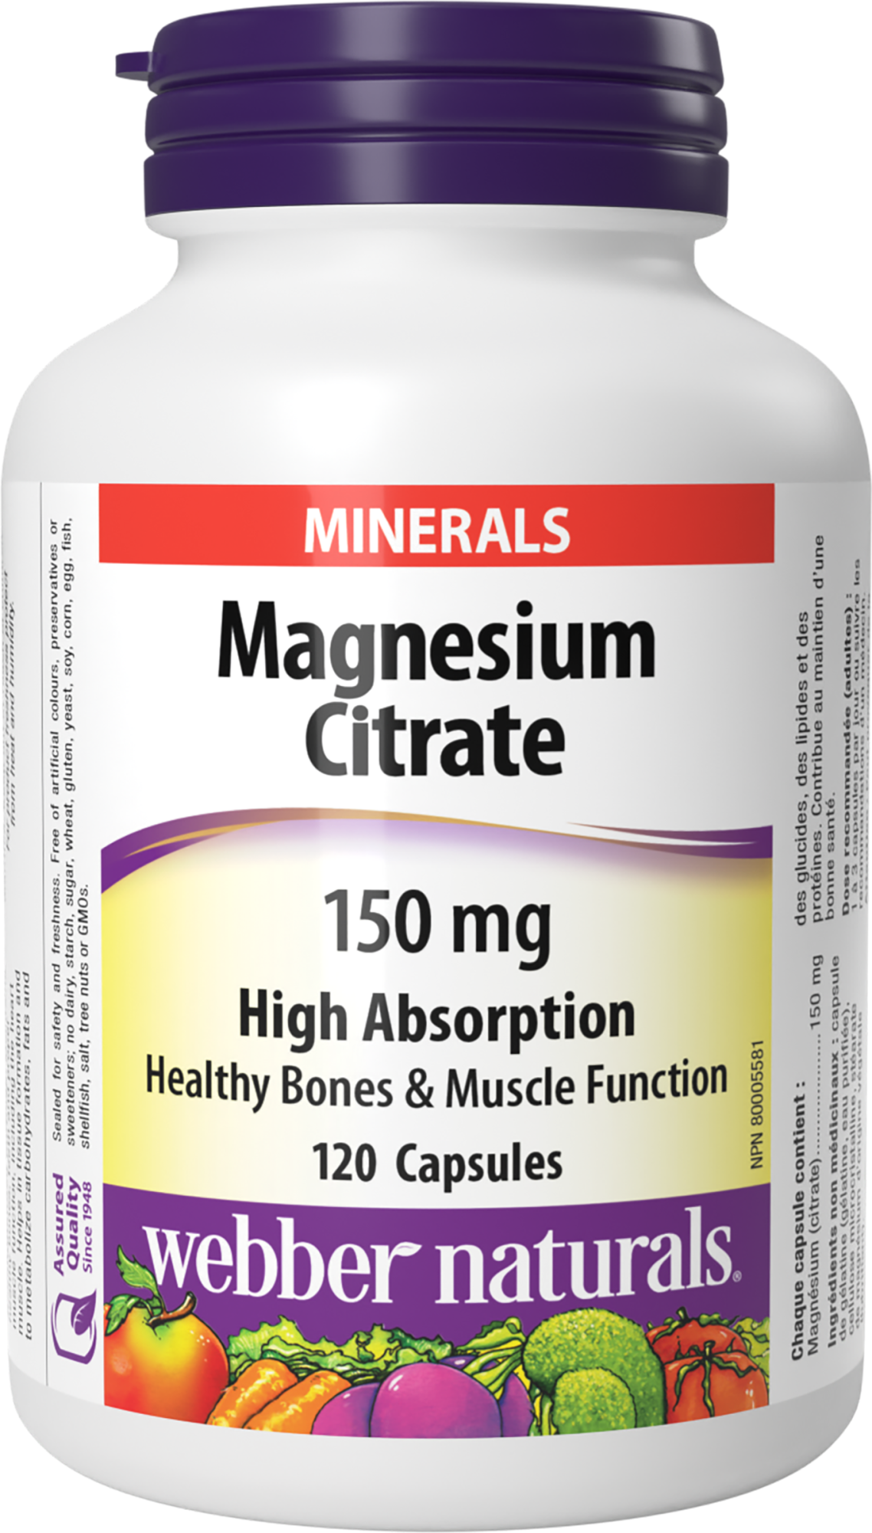
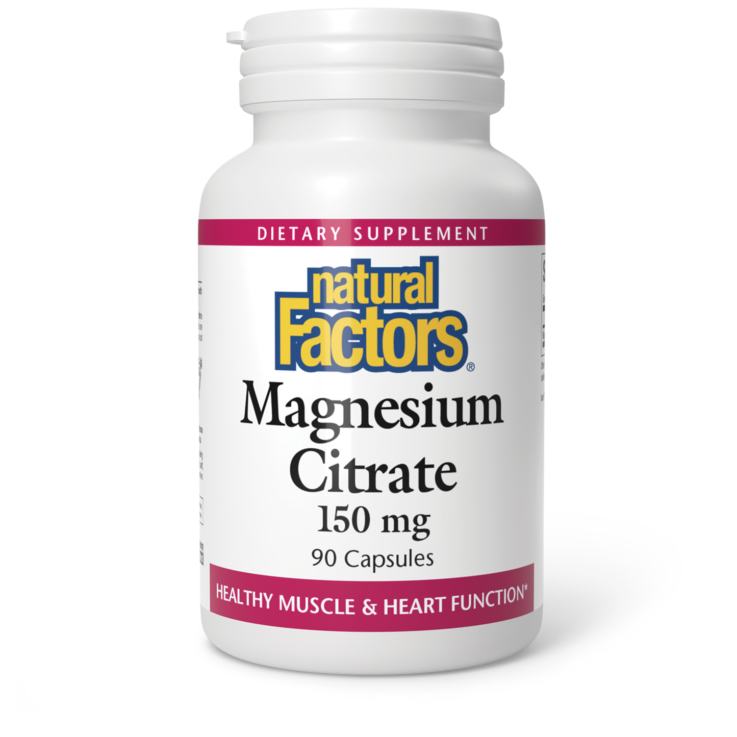
Magnesium
Preferred in patients with | Constipation
Side effects | Diarrhea Stomach upset
When to avoid | Kidney failure Diarrhea
Dosing | 300 mg twice daily
Images 7-8
Notes:
Can mention magnesium glycinate/bisglycinate is preferred – easier on the stomach

Slide 21
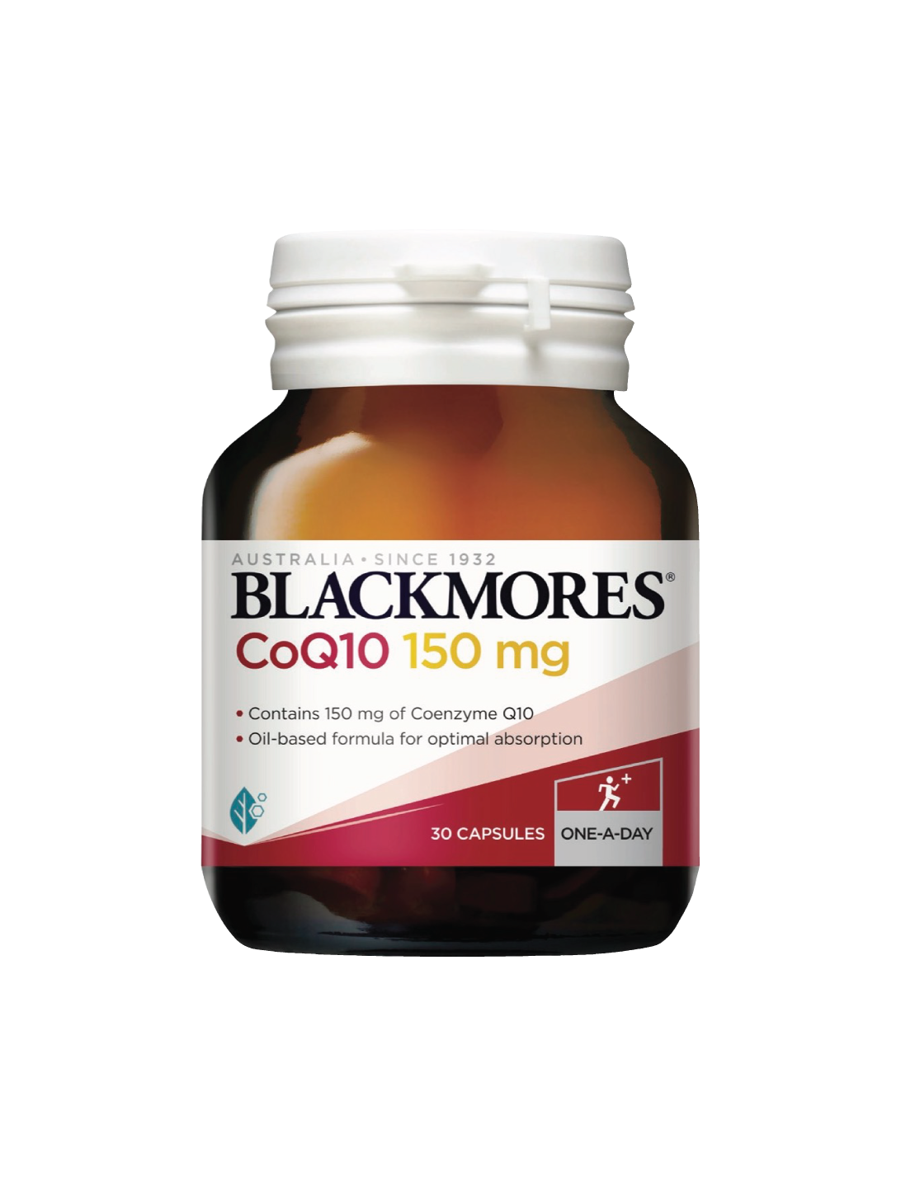
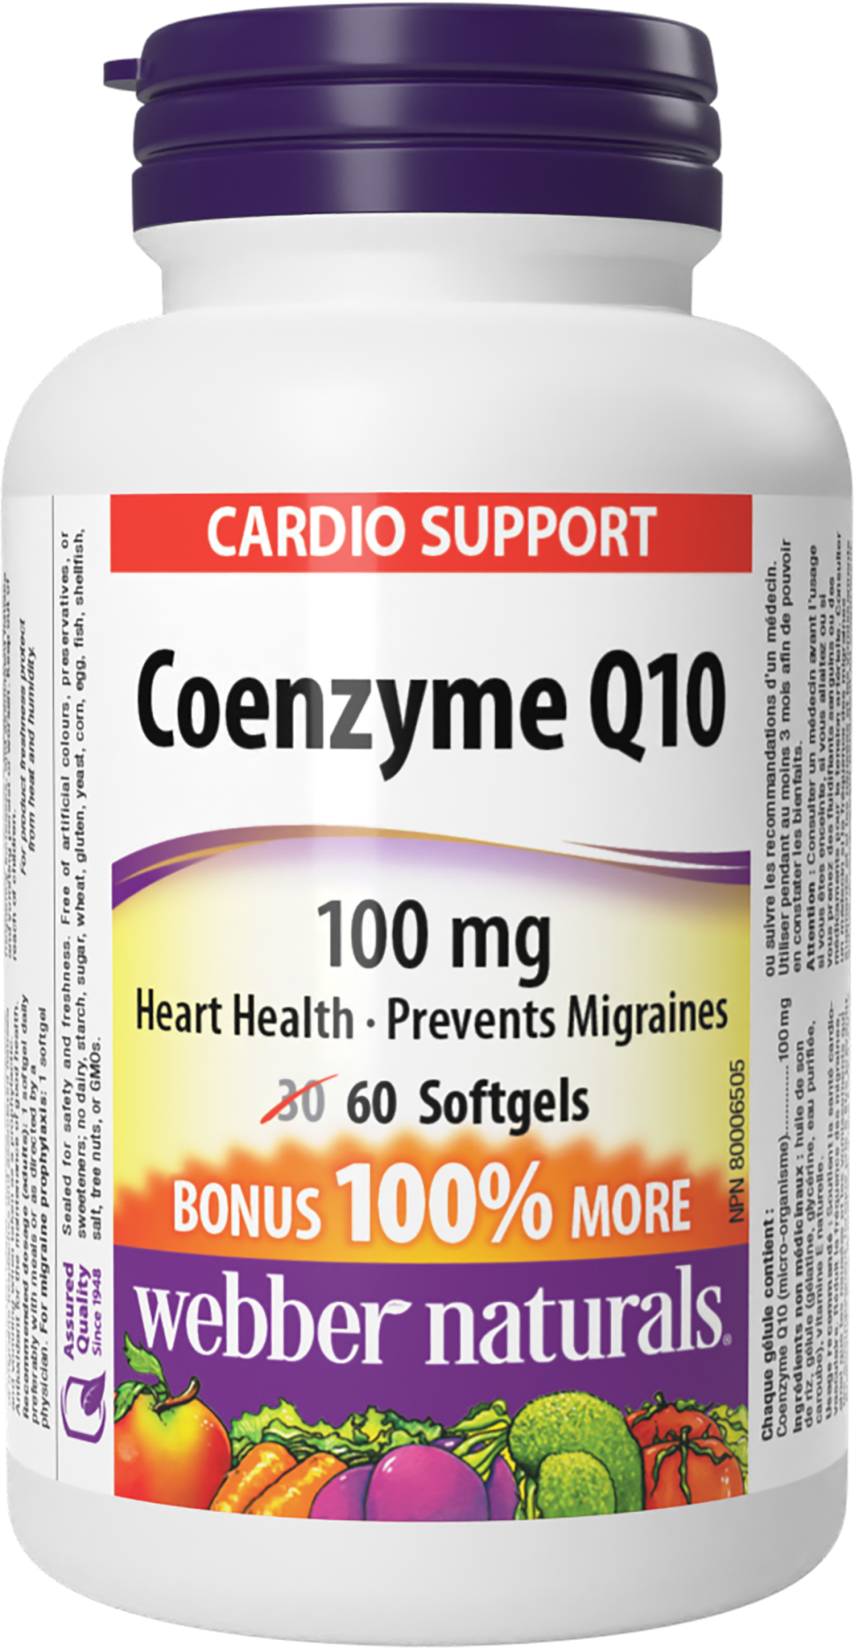
Co-Enzyme Q10
Preferred in patients with | High blood pressure
Side effects | Stomach upset
When to avoid | Low blood pressure
Dosing | 100 mg three times daily
Image 9-10

Slide 22
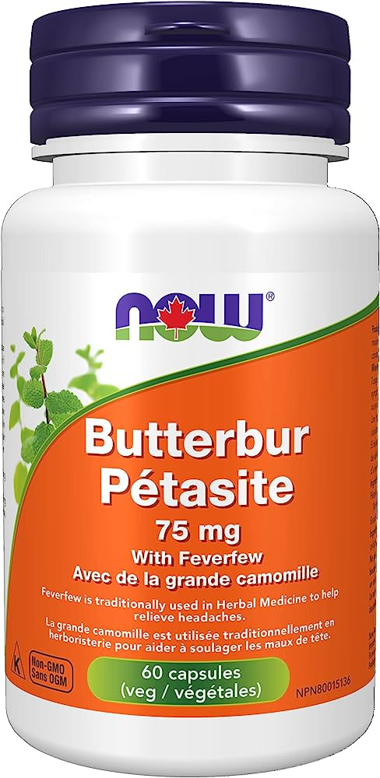
Butterbur
Side effects | Stomach upset (burping)
When to avoid | No contraindications
Dosing | 75 mg twice daily
Image 11
Notes:
Slide for FYI only if patients have questions
Consider omitting slide as this NHP is not routinely recommended (poor quality evidence and poor tolerability)

Slide 23
Reflection Questions
How has your outlook on your migraine treatment changed over the past 3 months?
What are some goals that you have set for yourself, and have they changed since we first met?
Have you noticed any trends, patterns, or triggers that you were previously unaware of?
Notes:
If larger group: ask participants to reflect on one question and share with the group

Slide 24
Take Home Messages
Keep using Headache Diary to track changes, headache occurrence, intensity, use of abortive medications, patterns or triggers
Use non-pharmacological methods (good sleep hygiene, lessen stress load, regular exercise)
Have someone to talk to/support system
Finding the right medication takes time

Slide 25
Patient Resources
https://migrainecanada.org/
https://headachesociety.ca
http://app.migrainebuddy.com/
https://www.mychronicmigraine.ca/

Slide 26
References
Becker WJ, Findlay T, Moga C, Scott NA, Harstall C, Taenzer P. Guideline for primary care management of headache in adults. Canadian family physician. 2015 Aug 1;61(8):670-9.
DiPiro JT, Talbert RL, Yee GC, Matzke GR, Wells BG, Posey LM, editors. Pharmacotherapy: a pathophysiologic approach. New York: McGraw-Hill Education; 2014 Mar 22.
Pringsheim T, Davenport WJ, Mackie G, Worthington I, Aubé M, Christie SN, Gladstone J, Becker W. Canadian headache society guideline for migraine prophylaxis. Canadian Journal of Neurological Sciences. 2012; 39: Suppl. 2 – S1-S2.
RxFiles. Migraines. October 2018.
Toward Optimized Practice (TOP) Headache Working Group. 2016 September. Primary care management of headache in adults: clinical practice guideline: 2nd edition. Edmonton AB: Toward Optimized Practice. [cited May 2 2019] Available from: http://www.topalbertadoctors.org/cpgs/10065.

Slide 27
Image References
Image 1: Vyepti, 2023 Image 2: Ubrelvy, 2023 Image 3: EveryDayHealth, 2023 Image 4: Image 4 by Unknown Author is licensed under CC BY-SA Image 5: Walmart, 2023 Image 6: EVitamins, 2023 Image 7: Webber Naturals, 2023 Image 8: Natural Factors, 2023​ Image 9: Webber Naturals, 2023 Image 10: BlackMores, 2018 Image 11: Amazon, 2023

Slide 28
Next Steps
Future option:
1:1 appointments with a pharmacist at [CLINIC]
Session 1
[DATE]
[60 mins]
Session 2
[DATE]
[60 mins]
Session 3
[DATE]
[60 mins]
Notes:
Offer to book a follow-up appointment to discuss patient specific treatment options and provide more individualize education if needed

Slide 29
[INSERT INFORMATION ABOUT YOUR CLINIC/OFFICE AND SERVICES OFFERED]

Slide 30
Thank you!

