Slide 1
Session 1: Introduction to Chronic Non-Cancer Pain
Facilitator: [INSERT NAME HERE]
[INSERT DATE & TIME HERE]
NOTICE: This slide deck intended for educational purposes only and you are encouraged to adapt this slide deck to suit your clinic, services and community.
This slide deck was created in 2022 at the UBC Pharmacists Clinic by Dr. Tiana Tilli, PharmD, RPh, ACPR with the help of Rebecca Leung E2P PharmD 2023

Slide 2
Land Acknowledgement
[We invite you to create a land acknowledgement to recognize the traditional, ancestral, and unceded land that your office/clinic is located on]

Slide 3
Welcome!
What are Pharmacist-led Chronic Pain Appointments?
What can you expect at each session?
Notes:
Group Appointments: appointments for up to 10 people experiencing similar health conditions facilitated by a pharmacist with experience in this clinical area. Appointments take place monthly for three months. They focus on provide education related to condition management (including medication management).
What to Expect: Sessions aren't meant to be lectures but instead they're meant to be sharing and learning sessions where attendees learn from and with each other.
We ask everyone to leave their cameras on to foster relationship building and connection.

Slide 4
Introduction
Session 1
Today
Introduction,
Lifestyle Management
[60 mins]
Session 2
Non-Opioid Medications
[60 mins]
Session 3
Opioids Medications
[60 mins]
Notes:
There are three sessions within our group appointment.
Session 1: focuses on lifestyle management and natural health products
Session 2: focuses on medication options so that you know what other alternatives exist that you may want to try now or in the future and what side effects to watch out for
Session 3: reviews the potential role for opioids (aka narcotics) in pain and how to promote safe use of opioids

Slide 5
Agenda
Chronic Pain
Pain Management
Non-Drug Measures
Natural Health Products
"Homework“

Slide 6
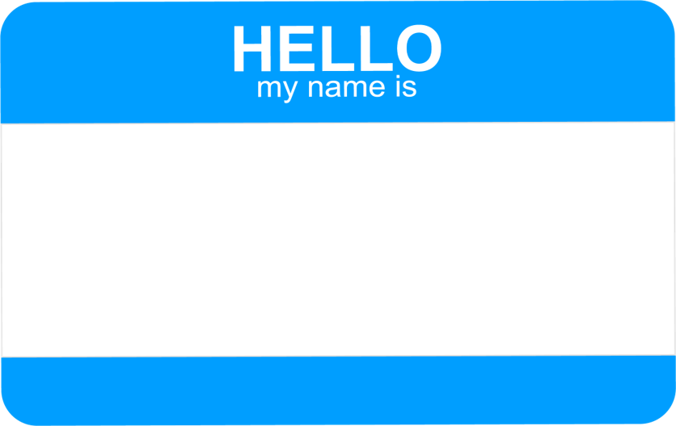
Image 1
Notes:
Go around and introduce yourselves:
Name
What you hope to gain from these group appointments

Slide 7
Ground Rules
Image 2
Notes:
Now we’ll move onto setting some ground rules for the rest of this session today. I’ll write our first one on the whiteboard/piece of paper here but feel free to call them out as you think of them. As rule #1
Facilitator is allowed to park individual-specific questions
out of respect to other members of the group - some questions may be too specific and should be reserved for one-on-one appointments/a later time. (to ensure that the conversation doesn’t go off on tangents)
Other examples:
No talking over others
Allow everyone the opportunity to contribute and speak
Confidentiality
Cell phones off

Slide 8
Zoom Features
Turn mic on/off
Share Screen
Turn video on/off
Chat box
Raise Hand
Leave
meeting

Slide 9
Chronic Pain

Slide 10
Types of Pain¹
Chronic non-cancer pain can be divided into two categories:
Nociceptive Pain
E.g. Arthritis, sport injuries (fractures, sprains)
Sharp pain, dull ache, throbbing pain
Burning, prickling, shooting, tingling pain
E.g., Diabetic neuropathic pain, pain after a stroke or shingles
Notes:
Pain can be divided into two categories:
-Nociceptive Pain: described as sharp pain, dull ache, throbbing pain
-Neuropathic Pain (aka nerve pain): described as burning, prickling, shooting, tingling pain
Note these aren't mutually exclusive meaning it's not necessarily one vs. the other - you can have both
It's helpful to identify which type(s) you have as treatments used are different depending on the type of pain

Slide 11
Nociceptive Pain
Nociceptors: specialized cells that detect and send pain information along a pathway¹
Nociceptors can become sensitized leading to feeling¹:
More pain than usual
Pain to nonpainful stimulus
Image 3
Notes:
Nociceptive Pain: sharp, aching, throbbing
Nociceptors are specialized cells located in the skin, joints, and muscles and can send pain information along a pathway to the brain
When these specialized cells become "sensitized" people experience more pain than usual (e.g., stubbing toe more painful than usual) or pain to a non-painful stimulus (e.g., light touch, wearing clothes)

Slide 12
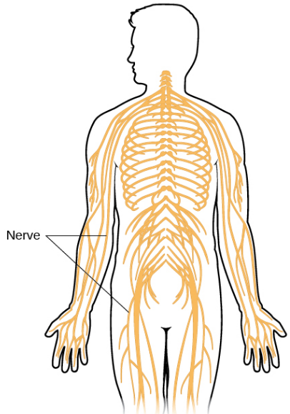
Neuropathic Pain
Sensory nerves: bundles of cells that run throughout the body to detect and send information to the brain: ²
Touch, pain, temperature, position²
Sensory nerves can be damaged through injury or disease ³
This can disrupt the normal process of perceiving sensory information ³
Image 4
Notes:
Neuropathic pain descriptors: shooting or burning pain
Sensory nerves (bundle of brain cells) that run throughout the body. Usually detect and send information about touch, pain, temperature, position but when damaged (e.g., crushed in car accident, high blood sugar in diabetes, infection like shingles) can detect and send pain information to the brain without a stimulus (or cause).

Slide 13
Chronic Pain
Acute pain – Pain from injury. Reduces as healing happens and lasts less than 3 months ⁴
Chronic pain – Pain associated with chronic disease or continuing beyond healing time (more than 3 months) ⁴
Chronic pain is complex
There are biological, psychological, and social causes ⁵
Notes:
We also have categories of pain based on how long someone has been experiencing the pain.
Acute pain: less than 3 months
Chronic pain: more than 3 months
Chronic pain can happen for many reasons and different factors may impact how we experience pain including our biology, mental health, and social environment
Chronic pain can be the result of sensitized cells or damage to nerve cells (or both)

Slide 14
Biopsychosocial Model of Pain⁵
BIOLOGICAL
Sensitized specialized cells
Damaged sensory nerves
Genetics
Age
Pre-existing conditions
PSYCHOLOGICAL
Expectations
Mood
Coping skills
Mental health (stress, anxiety, depression)
SOCIAL
Social support
Environment
Economical factors
Work situation
Notes:
Example of factors that can all influence each other and impact pain include our biology, our mental health, and our social environment.
While the same injury may be in-place, changing things like our mental health and social environment can change our pain experience and ability to cope with pain.
Lifestyle management aims to address mental health and social environment factors to manage pain.

Slide 15
Speaking about Pain
Describing your pain helps health care providers understand your pain and find best treatment options⁶
Characteristics | Example Questions
Provoke/Palliation | What makes the pain worse? What makes it better?
Quality | What does the pain feel like? Sharp? Dull? Burning?
Location | Where is the pain? Does the pain spread?
Severity | On a scale of 0-10, what do you rate your pain? (0 being no pain, 10 being the worst pain ever felt)
Time | When did the pain start? When does it happen? How long does it last?
Notes:
Let's talk about pain! Describing your pain helps health care providers understand your pain and find best treatment options
SCHOLAR
-symptoms (main and associated)
-characteristics (what are the symptoms like)
-history (what has been done before)
-onset (when did it start)
-location (where is the problem)
-aggravating factors (what makes it worse)
-remitting factors (what makes it better, how does the severity change when a medication is taken)

Slide 16
Group Discussion
What type of pain do you have?
What are 1-2 characteristics to describe it?
Notes:
Let's go around and, if you feel comfortable, share what type of pain you have. Remember the different types of categories (e.g., Acute vs. Chronic, nociceptive vs. Neuropathic)

Slide 17
Pain Management

Slide 18
General Management⁷
Assessment (Initial and Ongoing)
Treatment Options
Allied Health Team
Goals and expectations
Effectiveness: is current treatment working?
Safety: is current treatment still safe? Are there side effects?
Non-drug treatments
Non-opioid medications
+/- opioid medications
Care providers (e.g. pharmacist, occupational therapist, registered massage therapist)
Specialized pain programs
Notes:
There are many components of pain management and we repeatedly re-visit these components over time.
Assessments should happen at the beginning and regularly afterwards
-we want to set realistic goals and expectations of what medication and non-medication treatments can achieve
-we want to check in on if treatment options are still the best and if they're still working and safe (this can change as we age, as our health conditions change, as our pain changes)
Treatment Options: should always include non-drug (e.g., lifestyle management) and may also include medication management (most often non-opioid medications and less often opioid medications)
Allied Health Team: as part of non-drug management, there's a big role for different care providers beyond doctors and pain programs that people can take on their own (like this one!)
-different providers can help with different areas of pain management (e.g., pharmacists = medications, occupational therapists = adapting activities for your abilities, physiotherapist = provide exercises to strengthen and reduce injury)

Slide 19
Quiz Question: True or False?
The goal of treatment is to eliminate pain.
FALSE
Notes:
Please note this slide is animated and TRUE / FALSE will show on click
Our first quiz question touches on setting expectations (part of the initial and ongoing assessment process)…. "True/False: the goal of treatment is to eliminate pain".

Slide 20
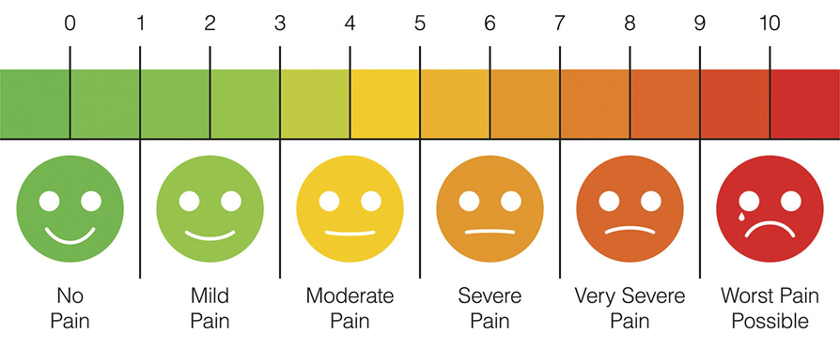
Setting Expectations
Goal is to reduce pain and improve function and coping ⁸
Lowering pain by 30% is considered a success
= Realistic goal
= Unrealistic goal
Image 5
Notes:
It's important to keep in mind that lifestyle changes and medication treatments won't be able to get rid of pain. Instead, our focus should be on lowering pain so people living with pain can complete daily activities (e.g., playing with grandchildren, returning to work with adapted activities).
When we assess if a medication worked or not, and should therefore be continued or not, we deem something a success if pain has been lowered by 30%.
-Keep in mind what a 30% reduction in pain is not necessarily 3 points on the 0-10 pain scale – it's 30% from where you start (e.g., 10 --> 7, 7--> 5, 3 --> 2) : https://pain-calculator.com/
We want to ensure realistic expectations because unrealistic expectations can lead to dissatisfaction and greater perceived pain/worsened experience

Slide 21
Setting Expectations
Set SMART Goals
Specific, Measurable, Attainable, Realistic, Timely
Examples of SMART Goals⁸:
“I want to be able to do aerobic exercises for 15 minutes a day within 1-2 months of starting treatment”
“I want to reduce my pain from 7/10 to 5/10 so I can walk my dog around my neighborhood within 2 months"
Notes:
Now that we have an understanding of expectations, let's review how to set SMART goals so we have something to work towards that would be considered a success of treatment.
These goals should include components that are:
Specific: what will you do (e.g., aerobic exercise)
Measurable: precise ways to measure (e.g., 15 minutes a day)
Attainable: visualize a path (e.g., slowly increasing)
Realistic: visualize the result (e.g., realistic goal vs. 30-60 minutes daily within 2 weeks)
Timely: timeline for goal (e.g., 1-2 months)
Focus on improving functioning. What do you enjoy doing that your pain currently limits? How can you measure success in terms of re-gaining some daily activities.

Slide 22
Group Discussion
Share an example of a SMART Goal for pain.
Note: it doesn't have to be your actual goal.
Let's first just practice coming up with SMART goals!
Notes:
Let's go around the circle (or write it in the chat) of an example of a SMART goal (specific, measurable, attainable, realistic, timely).
For example: “I want to complete reduce my pain from 8/10 to 5-6/10 so I can play boardgames with my children in the evening within 3 months"
Remember: These goals should include components that are:
Specific: what will you do (e.g., aerobic exercise)
Measurable: precise ways to measure (e.g., 15 minutes a day)
Attainable: visualize a path (e.g., slowly increasing)
Realistic: visualize the result (e.g., realistic goal vs. 30-60 minutes daily within 2 weeks)
Timely: timeline for goal (e.g., 1-2 months)

Slide 23
Non-Drug Treatments⁷
Physical Activity
Lifestyle Interventions
Physical
Therapies
Self-Management Programs
Psychological
Therapies
Notes:
Now let's shift from setting goals to lifestyle interventions to help achieve these goals! You can even create lifestyle goals to help achieve your pain goals!
Lifestyle interventions are first-line for all people with chronic pain and should be continued even if medications are added.
They include multiple components:
- physical activity
- psychological therapies
- physical therapies
- self-management programs
- lifestyle interventions

Slide 24
Physical Activity⁷
Walking
Weight Training
Pilates
Aquatic Exercises
Yoga
Tai Chi
Helps with:
= fibromyalgia
= low back pain
= arthritis
= headache
= rheumatoid arthritis
Type of activity:
= aerobic
= strength
= balance/agility
Images 6 - 11
Notes:
We've highlighted here the physical activities that have evidence for improving in chronic pain and the colour of the stars represents the type of pain that the activity has been shown to help with.
- Start with low intensity for short amounts of time and slowly increase to moderate level of intensity over longer periods of time
- Pacing: Increase physical activity duration by several minutes every few days/weeks
- There are adaptive exercises (e.g., pilates from seated position) to accommodate different accessibility needs
Examples of low-impact exercises:
More Life Seniors (run by a PT x 10-30 minutes for exercises from a seated position – whole body, stretch, balance, etc.) - https://www.youtube.com/channel/UCC4TRhL4BiA7--jpxVVXcpQ
Arthritis:
Top 10 exercises: https://arthritis.ca/AS/media/pdf/Support%20and%20Education/EN-top-10-exercises.pdf
Exercises for Hip & Knee: https://arthritis.ca/living-well/2021/exercises-for-osteoarthritis-of-the-hip-knee
Exercises for Shoulder: https://arthritis.ca/living-well/2021/exercises-for-osteoarthritis-of-the-shoulder

Slide 25
Physical Therapies⁷
Transcutaneous electrical nerve stimulation (TENS)
For: neuropathic pain, low back pain
Low level laser therapy
For: Low back pain
Manual therapy
For: Low back pain, neck pain
Images 12 - 14
Notes:
Like the role of mental health there's a role of physical health in pain experience.
The following physical therapies have evidence to support lowering pain (some for short-term pain benefit) in specific types of pain
- Manual therapy: short term relief for low back pain and chronic neck pain (in combination with exercise). Examples include physiotherapy or massages.
- TENS: reduce neuropathic pain and improve function in those with back pain. Sends electrical pulses through skin to help stop pain signals in the brain.
-Low level laser therapy: reduce low back pain. Applies light to the skin to help to promote tissue regeneration and reduce inflammation.
*Consider listing examples local clinics that offer physical therapies here

Slide 26
Psychological Therapies
Example: Cognitive-Behavioral Therapy (CBT)⁷
Can reduce pain, disability, distress, catastrophic thinking⁹
Back pain, neck pain, fibromyalgia, arthritis
Sample strategy: 3 C's of CBT ¹⁰
1) Catch your thought
Identify the thought that is leading to your emotion
2) Check your thought
Is this thought accurate or useful?
3) Change your thought
Create a more accurate and helpful thought
Notes:
Because of the important role of mental health in one's pain experience and ability to cope with pain, there's a role for psychological therapy in pain management.
These psychological therapies can help address negative emotions and feelings so that they don't turn into unhealthy coping mechanisms (e.g., staying at home, feeling hopeless) that can worsen pain.
-an example of a psychological therapy is CBT (others include mindfulness and acceptances and commitment therapy)
-studies have found improve pain outcomes using CBT in back pain, neck pain, fibromyalgia, and arthritis
-CBT helps you reframe negative thinking and develop healthy coping habits
Example of 3 C’s of CBT
Catch: “Standing for more than 1 hour is already very painful, there is no way I can go back to my job.”
Check: Ask yourself if this thought is accurate. There may be arrangements at work (i.e. more flexible work schedule, different tasks) that will allow you to return to work.
Change: “I may not be able to return to my job doing exactly what I was previously doing, but there may be other arrangements that will allow me to continue to work in a similar way”
Similarly:
1) Stop: notice your thoughts – when you notice a negative thought, stop it in its tracks and write it down.
2) Ask: ask yourself whether the thought was helpful or unhelpful
3) Choose: a new, helpful thought to replace a negative one. What effect does the negative thought have and what may a more healthy thought do instead?
Examples of sites in BC where they can find professional help:
Reduced cost counselling services: https://willowtreecounselling.ca/wp-content/uploads/2011/04/Reduced-Cost-Counselling-Options-Sep2014.pdf
https://counsellingbc.com/
https://bc-counsellors.org/
https://www.psychologists.bc.ca/

Slide 27
Self-Management Programs
Purpose: Learn strategies to help you take an active role in managing pain and improving quality of life⁷
Variety of topics and delivery:
E.g. Goal setting, managing stress, nutrition
E.g. In-person workshops, online tools
Notes:
Another important management strategy is participating in self-management programs (like this one!).
Self-management programs help compliment other therapies
e.g. RE: physical activity → self management programs help patients find appropriate exercises and form goals to help them move forward with physical activity
E.g. medications → programs help patients gain a better understanding of medications
Examples of self-management programs:
Self-management BC: https://www.selfmanagementbc.ca/
Several different self-management programs, no cost to participate
Low commitment from once a week to 3 times a week
Duration of programs can last from 6 weeks to 3 months
Pain BC: https://painbc.ca/find-help/self-management
Free of cost
Online tool, is for people to learn more about chronic pain, keep track of their symptoms, develop a plan for better pain management and connect with other individuals
Contains a variety of videos on all aspects of pain education (i.e. psychiatric conditions, nutrition, paced activities)
Tapmi: https://tapmipain.ca/patient/managing-my-pain/
Is Ontario based
Has PainU online – is a free online self management tool for patients to learn more about pain, how to improve overall quality of live
Has a lot of chronic pain self-management webinars available to be watched, but patients need to register for account to access videos

Slide 28
Lifestyle Interventions
Warm & Cold Compresses ¹¹
Apply heat 2-3 times a day for 20-30 minutes
Mobility Aids
Walkers, canes, crutches, wheelchairs
Practice Pacing ¹²
Maintain constant energy levels throughout the day
Wrap a cold pack in towel and apply for 10-20 minutes
Hip/Knee braces, orthopaedic footwear
Find a balance between work, rest, and leisure
Images 15 -17
Notes:
There are ways to adapt our daily activities and lifestyle to help managing pain as well. It's about finding which interventions work best for you.
1. Warm & cold compress (https://www.healthlinkbc.ca/health-topics/hw125087)
Can alternate with warm and cold compress → find what works best for you
Warm compresses are effective for pain and stiff joints
Cold compresses are good for reducing pain and swellings
Try doing gentle massages after doing the compresses
2. Mobility aids can help provide the body support and lower the physical toll of activities on the body. They can help you maintain energy while performing activities.
3. Pacing is a strategy used to keep constant energy levels throughout the day to avoid overexerting and worsening pain. It's about recognizing and respecting the body's limits. It involves:
-PACE: break down tasks into smaller manageable steps, use time measurement vs. Continuing until signs/symptoms, listen to your body for early signs (e.g., discomfort, tired, tingling)
-PRIORITIZE: decide on the most important task and do that first, decide on which tasks you don't have to do and ask for help when needed
-PLAN: creating a schedule lets you spread out activities over the week, add recover/rest breaks
-POSTURE: keep the work close to you (within reach), incorporate tools to help protect posture (reacher), look for ways to modify a task
-POSITIVITY: make the task more enjoyable (e.g., listen to music), use positive self-talk, compare yourself to progress last week (vs. Before injury), record and celebrate successes
Pacing: https://www.fraserhealth.ca/health-topics-a-to-z/chronic-pain/manage-chronic-pain/energy-conservation-living-with-chronic-pain
Accessing mobility aids:
Orthoses: https://www2.gov.bc.ca/gov/content/governments/policies-for-government/bcea-policy-and-procedure-manual/health-supplements-and-programs/medical-equipment-orthoses
Medical Equipment: https://www2.gov.bc.ca/gov/content/governments/policies-for-government/bcea-policy-and-procedure-manual/health-supplements-and-programs/medical-equipment-and-devices

Slide 29
Lifestyle: Sleep¹³
Avoid caffeine in the afternoon or evening
Avoid naps. Set fixed bedtime and wake-up time
Limit exposure to bright light in the evenings
Turn off electronic devices 30 minutes before bedtime
Drown out noise
(Ear plugs, white noise)
Avoid alcohol before bedtime
Notes:
Chronic pain can disrupt people's sleep which can then worsen one's pain experience.
Maintaining healthy sleep habits can improve your ability to fall asleep and stay asleep. Recommendations include:
- avoid caffeine in the afternoon or evening and alcohol or cigarettes before bedtime
- avoid naps. Set fixed bedtime and wake-up time
- limit bright lights and TV/computer/phone screens in the evening
- use meditation to promote calm and drown out noise (e.g., ear plugs, white noise)
Resources:
https://sleepeducation.org/healthy-sleep/healthy-sleep-habits/
https://mysleepwell.ca/cbti/ive-selected-my-cbti-resource/
https://www.keltyskey.com/courses/insomnia/
https://www.anxietycanada.com/sites/default/files/SleepDiary.pdf

Slide 30
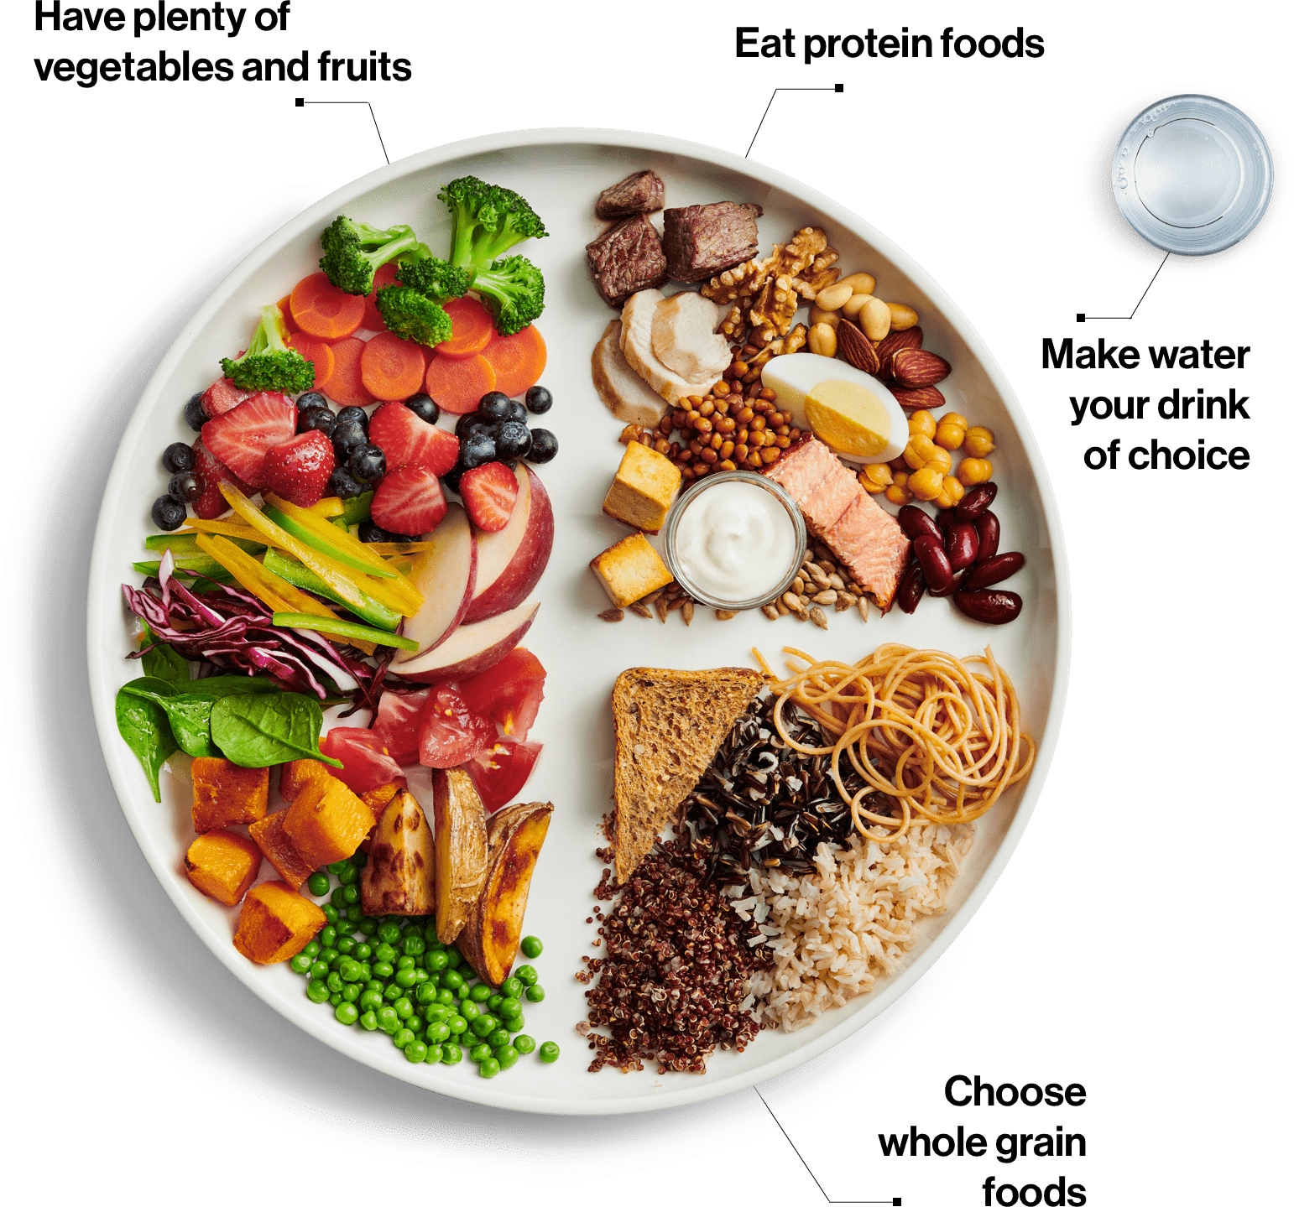
Lifestyle: Nutrition
A healthy diet can impact overall health and pain experiences¹⁴
Incorporate foods high in antioxidants and vitamins ¹⁴
Fruits and vegetables
Meat, fish, dairy
Reduce sugar, salt, fat, cholesterol, and alcohol¹⁴
Incorporate good quality fats ¹⁴
Omega-3 fats, extra virgin olive oil
Image 18
Notes:
Nutrition (the foods we wat) can also impact the bodily systems such as the nervous system and immune system, which can impact pain experiences and overall health. Healthy diet can also help with maintaining a healthy body weight, lowering load on joints and associated joint pain, and lower the risk of other chronic conditions that are associated with chronic pain (e.g., diabetes).
Antioxidant foods
Helps protect body from oxidant damage → which reduces inflammation
Vitamins
People who experience pain may also experience vitamin deficiencies such as vitamin B12
Good quality fats
Help reduce inflammation and enhance immune system
2-3 servings of oily fish
Reduce sugar, salt, fat, cholesterol, and alcohol
Processed foods can increase inflammation which can worsen pain experiences
Consuming foods high in these things can also increase the risk of chronic diseases

Slide 31
Group Discussion
Q1: What kind of non-drug measures do you find most helpful?
Q2: Are there any non-drug measures you have not tried but are now interested in?
Notes:
We have another opportunity for group discussion. These can be related to things you already do or would like to start doing!
1. What kind of non-drug measured do you find most helpful (e.g., physical activity, psychological therapy, physical therapy, self-management programs, lifestyle interventions: sleep, food, pacing)?
2. Are there any non-drug measured you have not tried but are now interested in trying?

Slide 32
Natural Health Products
Notes:
Now that we've talked about lifestyle interventions, we'll shift focus a bit to natural health products and their role in pain management.

Slide 33
Quiz Question: True or False?
Prescription medications don’t interact with natural health products
FALSE
Notes:
Please note this slide is animated and TRUE / FALSE will show on click
We'll start with another True or False question: "Prescription medications don't interact with natural health products?"
This is a common misconception that natural health products are natural and so they must be completely safe but, in reality, we still need to be careful and smart about their use because they could have side effects or drug interactions with prescription medications, over-the-counter medications, or even other natural health products!

Slide 34
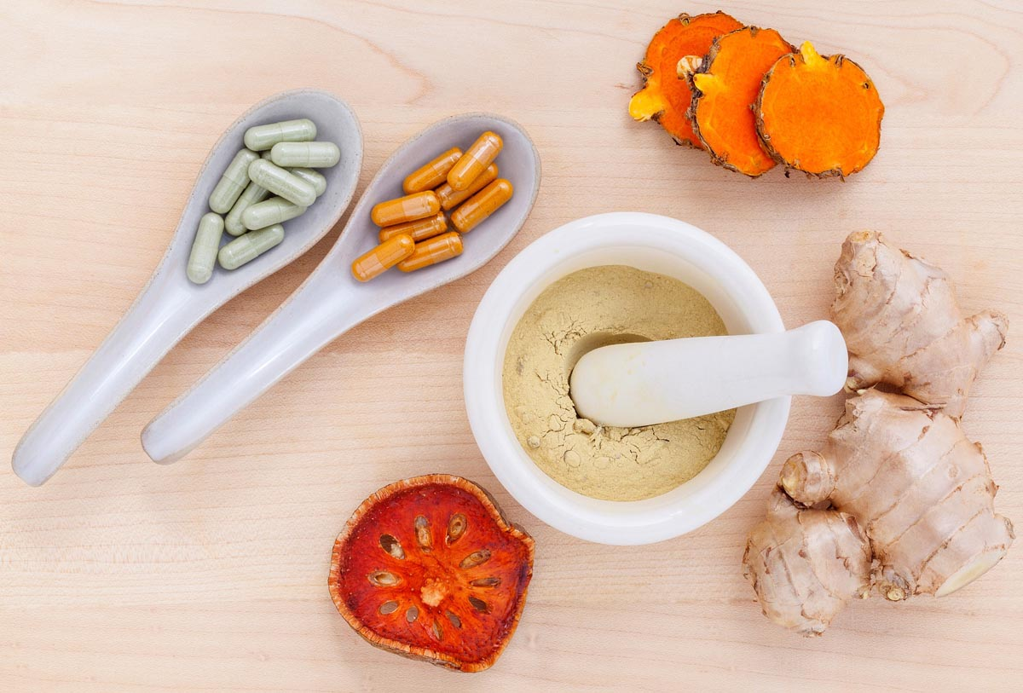
Natural Health Products (NHP)
Include vitamins, minerals, and herbal compounds¹⁵
Some can provide benefit but not risk-free¹⁵
May lack evidence for use
Can have side effects
Can interact with medications, OTC products, or other NHPs
Can be costly and contribute to pill burden
If tried, reassess benefit after a couple months
Talk to a pharmacist before starting!
Image 19

Slide 35
NHPs for Chronic Pain
Capsicum ¹⁶
Use: Neuropathic pain
Dose: 0.075% applied four times a day
Side Effects: Burning, itching, stinging, rash
Caution: Do not use on broken skin. Wash hands after applying!
Vitamin B12 ¹⁷
Use: Neuropathic pain from vitamin B12 deficiency or from shingles (postherpetic neuralgia)
Dose:
●Vitamin B12 deficiency: 500- 1000 mcg by mouth daily
●Postherpetic neuralgia: 1000 mcg injection (subcutaneous) six times weekly for 4 weeks
Images 20 - 21
Notes:
While there are a lot of natural health products available, there two are ones we more commonly see used and more commonly recommend as they have evidence that they may help with specific types of pain. Remember to check with your pharmacist first about potential drug interactions and to re-assess if you've noticed benefit after 1-2 months. If you haven't, then we recommend stopping it.
1. Capsicum cream
-Use: neuropathic pain (e.g., shingles)
-MOA: Makes sensory nerves less sensitive so that pain impulses in the nerve endings aren't sent to the brain
-SE: careful as it can cause burning, especially if you touch your eyes after applying it, so wash your hands after use!
2. Vitamin B12
-Use: neuropathic pain specifically in people with low Vitamin B12 levels (e.g., more common in people with diabetes) or pain from shingles
-MOA: Neuropathy can occur in those who are vitamin b12 deficient therefore supplementing can help to relieve the pain
-note the postherpetic neuralgia benefit is from Vitamin B12 injections, you can also get Vitamin B12 from your diet (fish, shellfish, meat, eggs, dairy)
-SE: extra Vitamin B12 is just peed out

Slide 36
Group Discussion
Have you used any NHPs for pain?
What was your experience with them?
Notes:
Everyone's body is different and responds to natural health products different. Has anyone tried any NHPs? What did you use them for? Did they work? Any side effects?

Slide 37
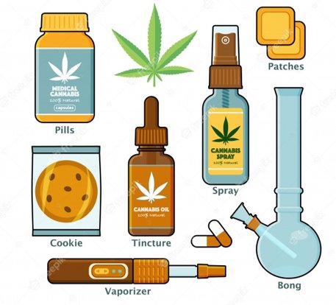
Medical Cannabis
Some evidence exists for using medical cannabis in neuropathic pain and spasms related to spinal cord injuries
Typically tried if many prescription medications have failed
Potential use: neuropathic pain, spinal cord injury ^{18,19}
Side effects: dizziness, tired, paranoia, hunger, nausea^{18,19}
Caution: THC can cause anxiety and psychosis. Smoking cannabis can damage lungs. ¹⁹
Dose: Individualized. Start low. Limit THC to help prevent psychoactivity.¹⁹
Image 22
Notes:
Many people ask about cannabis for pain. Unfortunately, it's still an evolving area of research and the best evidence for helping pain is in specific types of pain (neuropathic pain, spinal cord injury). It's recommended to be used only if other prescription medications haven't worked. Every person's dose is different but we recommend starting at a low dose, limiting THC, and avoiding smoking to protect the lungs. Watch out for side effects like dizziness, feeling tired, paranoia or increased anxiety.
Cannabis Access: https://cannabis.shoppersdrugmart.ca/en_CA
- can access medical consult with a healthcare provider (to obtain medical document – similar to a prescription) at no cost
- portal for ordering medical cannabis (different strains (indica vs. Sativa), forms (tinctures, gummies, capsules), cannabinoid levels (CBD, THC), etc.)

Slide 38
Key Take-Aways
Chronic non cancer pain can be classified as nociceptive and/or neuropathic
Biological, psychological and social factors can impact pain
Set realistic goals and expectations about pain management
Non-drug measures are available
Natural health products can be considered but consult a pharmacist before starting
Notes:
We've reviewed a lot of information today: some may be new while other pieces may have been refreshers. WeFor now, here's a summary of key things we reviewed together.

Slide 39
Debrief of Today’s Session
Feedback
Any requests for future sessions?
"Homework" assignment
Goal setting
Notes:
Before we wrap-up: would anybody like to share feedback so we can incorporate and improve for our next session in a month?
Our next session will focus on:
Non-opioid medications for managing chronic pain
1st line options
Alternative therapies to consider for more benefit or if first-line options don't work
Managing side effects of medications
For homework, I'll as you to set a goal (using the SMART goal setting techniques we reviewed today)

Slide 40
“Homework”
Goal setting: What are some of your expectations/goals you hope to achieve?
Write three down and keep them in mind for our next sessions
Notes:
Specifically, write down three goals you hope to achieve through the group appointments or for your pain management? Write them down and bring them to our next session.
For example:
1. Related to pain goals
2. Implement lifestyle intervention
Pain Goal Example: “I want to complete reduce my pain from 8/10 to 5-6/10 so I can play boardgames with my children in the evening within 3 months"
Lifestyle Intervention: "I want to increase physical activity to help with pain experience by incorporating 15 minutes of yoga into my daily routine there times a week within 1 month"
Remember: These goals should include components that are:
Specific: what will you do (e.g., aerobic exercise)
Measurable: precise ways to measure (e.g., 15 minutes a day)
Attainable: visualize a path (e.g., slowly increasing)
Realistic: visualize the result (e.g., realistic goal vs. 30-60 minutes daily within 2 weeks)
Timely: timeline for goal (e.g., 1-2 months)

Slide 41
Resources
Physical Activity
More Life Seniors (seated): https://www.youtube.com/channel/UCC4TRhL4BiA7--jpxVVXcpQ
Arthritis Society
Top 10 Exercises: https://arthritis.ca/AS/media/pdf/Support%20and%20Education/EN-top-10-exercises.pdf
Hip & Knee Exercises: https://arthritis.ca/living-well/2021/exercises-for-osteoarthritis-of-the-hip-knee
PainBC: https://www.painbc.ca/gentle-movement-at-home
YMCA Gentle Fit Playlist: https://www.youtube.com/watch?v=Cz7oYNqYCcc&list=PLA2C6WTfk7jXt74ZTc6DktqypvmiyCMR4&index=4
Notes:
Here are some resources available to support incorporating non-drug interventions.

Slide 42
Resources
Psychological Therapies
Self-Guided CBT: https://wa.kaiserpermanente.org/kbase/topic.jhtml?docId=abo3945#abo3946
Reduced Cost Counselling: https://willowtreecounselling.ca/wp-content/uploads/2011/04/Reduced-Cost-Counselling-Options-Sep2014.pdf
Chronic Pain Support Groups + Self-Management
PainBC Support Groups: https://painbc.ca/about/programs/pain-support-wellness-groups
Self-Management BC: https://www.selfmanagementbc.ca/chronicpainprogram
PainBC Self-Management: https://painbc.ca/find-help/self-management
TAPMi PainU: https://tapmipain.ca/patient/managing-my-pain/
Lifestyle Resources
Pacing: https://www.fraserhealth.ca/health-topics-a-to-z/chronic-pain/manage-chronic-pain/energy-conservation-living-with-chronic-pain
Diet: https://www.healthyfamiliesbc.ca/eating
Sleep: https://mysleepwell.ca/cbti/ , https://www.anxietycanada.com/sites/default/files/SleepDiary.pdf
Sleep Guided Meditations: https://www.uclahealth.org/marc/body.cfm?id=22&iirf_redirect=1
Notes:
Cannabis Resources
Arthritis Society: https://arthritis.ca/treatment/medication/medical-cannabis
FYI: Cannabis Resources – arthritis society link isn’t only for people with arthritis! The site has an online module that teaches patients more about cannabis and the different forms available.
RxFiles: https://www.rxfiles.ca/rxfiles/uploads/documents/Cannabis-Medical-Patient-Booklet.pdf
Government of Canada: https://www.canada.ca/en/services/health/campaigns/cannabis/education-resources.html

Slide 43
Thank You!

Slide 44
References
Scholz. Mechanisms of chronic pain. Mol Pain. 2014;10(Suppl 1):O15.
Koop LK, Tadi P. Neuroanatomy, Sensory Nerves. StatPearls Publishing; 2021.
Colloca L, Ludman T, Bouhassira D, Baron R, Dickenson AH, Yarnitsky D, et al. Neuropathic pain. Nat Rev Dis Primers. 2017;3:17002.
Grichnik KP, Ferrante FM. The difference between acute and chronic pain. Mt Sinai J Med. 1991 May;58(3):217-20.
Meints SM, Edwards RR. Evaluating psychosocial contributions to chronic pain outcomes. Prog Neuropsychopharmacol Biol Psychiatry. 2018 Dec 20;87(Pt B):168-182.
CrozerHealth. PQRST Pain Assessment Method [Internet]. [cited 2021 Sept 18]. Available from: https://www.crozerhealth.org/nurses/pqrst/
Centre for Effective Practice. Management of Chronic Non-Cancer Pain (CNCP). Toronto (ON): Centre for Effective Practice; 2018.
Centre for Effective Practice. SMART Goals for pain management. Toronto (ON): Centre for Effective Practice.
Williams AC, Eccleston C, Morley S. Psychological therapies for the management of chronic pain (excluding headache) in adults. Cochrane Database Syst Rev. 2012 Nov 14;11(11):CD007407.
Nicholl T. Anxiety Disorders: Pharmacology, Diagnosis and therapeutics. [PowerPoint Slides]. [cited 2021 Sept 19]
Healthwise Inc. Osteoarthritis: Heat and Cold Therapy [Internet]. [Updated 2019 Dec, cited 2021 Sept 19]. Available from: https://www.healthlinkbc.ca/health-topics/hw125087
Fraser Health. Energy Conservation – Living with Chronic Pain [Internet]. [cited 2021 Sept 19]. Available from: https://www.fraserhealth.ca/health-topics-a-to-z/chronic-pain/manage-chronic-pain/energy-conservation-living-with-chronic-pain#.YUgwb7hKiUl
American Academy of Sleep Medicine. Healthy Sleep Habits [Internet]. [updated 2020 Aug, cited 2021 Sept 19]. Available from: https://sleepeducation.org/healthy-sleep/healthy-sleep-habits/
International Association for the Study of Pain. Nutrition and Chronic Pain [Internet]. [cited 2021 Sept 19]. Available from: https://www.fraserhealth.ca/-/media/Project/FraserHealth/FraserHealth/Health-Topics/Chronic-Pain/Fact_Sheet_6_Nutrition_and_Chronic_Pain.pdf?la=en&rev=96a2b3ab366e45198df15c0d68569cb6&hash=956A276A23A0C04A4AA57B8DBA7B79B70ACF4BB8
Government of Canada. Natural and Non-prescription Health Products Directorate [Internet]. [cited 2021 Jul 29]. Available from: https://www.canada.ca/en/health-canada/corporate/about-health-canada/branches-agencies/health-products-food-branch/natural-non-prescription-health-products-directorate.html
Capsicum. In: Natural Medicines [database on the Internet]. Somerville (MA): therapeutic Research Center; 2021 [cited 2021 Sept 19]. Available from: https://naturalmedicines.therapeuticresearch.com
Vitamin B12. In: Natural Medicines [database on the Internet]. Somerville (MA): therapeutic Research Center; 2020 [cited 2021 Sept 19]. Available from: https://naturalmedicines.therapeuticresearch.com
Government of Canada. Information for Health Care Professionals: Cannabis (marihuana, marijuana) and the cannabinoids [Internet]. [cited 2021 July 29]. Available from: https://www.canada.ca/en/health-canada/services/drugs-medication/cannabis/information-medical-practitioners/information-health-care-professionals-cannabis-cannabinoids.html#a4.9.1.3
Cannabis. In: Natural Medicines [database on the Internet]. Somerville (MA): therapeutic Research Center; 2020 [cited 2021 Sept 19]. Available from: https://naturalmedicines.therapeuticresearch.com
Ginger. In: Natural Medicines [database on the Internet]. Somerville (MA): therapeutic Research Center; 2020 [cited 2021 Sept 19]. Available from: https://naturalmedicines.therapeuticresearch.com
Turmeric. In: Natural Medicines [database on the Internet]. Somerville (MA): therapeutic Research Center; 2020 [cited 2021 Sept 19]. Available from: https://naturalmedicines.therapeuticresearch.com
Thunder God Vine. In: Natural Medicines [database on the Internet]. Somerville (MA): therapeutic Research Center; 2020 [cited 2021 Sept 19]. Available from: https://naturalmedicines.therapeuticresearch.com
Feverfew. In: Natural Medicines [database on the Internet]. Somerville (MA): therapeutic Research Center; 2020 [cited 2021 Sept 19]. Available from: https://naturalmedicines.therapeuticresearch.com
Willow Bark. In: Natural Medicines [database on the Internet]. Somerville (MA): therapeutic Research Center; 2020 [cited 2021 Sept 19]. Available from: https://naturalmedicines.therapeuticresearch.com
Glucosamine. In: Natural Medicines [database on the Internet]. Somerville (MA): therapeutic Research Center; 2020 [cited 2022 Jan 14]. Available from: https://naturalmedicines.therapeuticresearch.com
Chondroitin. In: Natural Medicines [database on the Internet]. Somerville (MA): therapeutic Research Center; 2020 [cited 2022 Jan 14]. Available from: https://naturalmedicines.therapeuticresearch.com

Slide 45
Image References
Image 1: pngkit, 2018
Image 2: Image 2 by Unknown author is licensed under CC BY-NC.
Image 3: National Vulvodynia Association, 2023
Image 4: Medium, 2017
Image 5: Harvard Health Publishing, 2018
Image 6: Image 6 by Unknown Author is licensed under CC BY-NC-ND
Image 7: Image 7 by Unknown Author is licensed under CC BY
Image 8: Image 8 by Unknown Author is licensed under CC BY
Image 9: Image 9 by Unknown Author is licensed under CC BY-SA-NC
Image 10: Image 10 by Unknown Author is licensed under CC BY-NC-ND
Image 11: Image 11 by Unknown Author is licensed under CC BY-NC-ND
Image 12: Image 12 by Unknown Author is licensed under CC BY
Image 13: Image 13 by Unknown Author is licensed under CC BY-NC-ND
Image 14: Physiomed Vancouver, 2023
Image 15: Image 15 by Unknown Author is licensed under CC BY
Image 16: Image 16 by Unknown Author is licensed under CC BY-SA
Image 17: Image 17 by Unknown Author is licensed under CC BY-NC
Image 18: Canada’s food guide, 2023
Image 19: Image 19 by Unknown Author is licensed under CC BY-ND
Image 20: Amazon, 2023
Image 21: Walmart, 2023
Image 22: freepik, 2023
Image 23: Now Foods, 2023
Image 24: Jamieson, 2023
Image 25: Image 25 by Unknown Author is licensed under CC BY-NC
Image 26: Image 26 by Unknown Author is licensed under CC BY
Image 27: Amazon, 2023
Image 28: Nature’s Way, 2023
Image 29: Now Foods, 2023

Slide 46
Appendix: Chondroitin²⁶
Use: Osteoarthritis
Side Effects: Abdominal pain, bloating, constipation
Usual dose: 800-1200 mg daily by mouth in divided or single daily doses. Often taken in combination with glucosamine
Caution: Can interact with warfarin and increase bleeding risk
Possibly effective in improving osteoarthritis pain and maintaining healthy cartilage.
Image 23
Notes:
MOA: Chondroitin is a component that is used to make cartilage (i.e. we naturally make it in our body). Taking chondroitin helps to increase cartilage production and maintain healthy cartilage and joint health.
Picture: https://www.nowfoods.com/products/supplements/chondroitin-sulfate-600-mg-capsules

Slide 47
Appendix: Glucosamine²⁵
Use: Osteoarthritis
Side effects: Bloating, constipation, cramps
Usual dose: 1500 mg daily by mouth in single or divided daily doses. Often taken in combination with chondroitin.
Caution: Might worsen asthma. Talk to a health care provider if you have a shellfish allergy.
Possibly effective in improving osteoarthritis pain and maintaining healthy cartilage.
Image 24
Notes:
MOA: Glucosamine is a component that is used to make cartilage (i.e. we naturally make it in our body). Taking glucosamine helps to increase cartilage production and maintain healthy cartilage and joint health.
Shellfish allergy:
Some products may say to avoid taking glucosamine if you are allergic to shellfish. Glucosamine is derived from the shells of shellfish while most people with shellfish allergies are allergic to the meat of shellfish. Double check with your health care provider regarding the safety of glucosamine if you have a shellfish allergy.
Picture: https://www.jamiesonvitamins.com/products/glucosamine-capsules
Reference: Natural med

Slide 48
Appendix: Ginger²⁰
Use: Osteoarthritis
Side Effects: heartburn, diarrhea
Usual dose: 500 -1000 mg daily by mouth
Caution: May increase bleeding risk
Possibly effective in improving osteoarthritis pain
Image 25
Notes:
MOA: prevents the formation of a substance that is involved in the inflammatory and pain mechanisms
Bottom line: Ginger is likely safe in those who don’t already have an increased bleeding risk. It is possibly effective in improving pain in those with osteoarthritis however it is important to note that Ginger has a long onset of action (several weeks --> 3-12 weeks).
://www.ncbi.nlm.nih.gov/pmc/articles/PMC7918078/

Slide 49
Appendix: Turmeric²¹
Use: Osteoarthritis
Side Effects: nausea, vomiting, diarrhea
Usual dose: 500 mg twice daily or 1500 mg once daily by mouth
Caution: May increase bleeding risk
Possibly effective in improving knee pain and functioning in osteoarthritis
Image 26
Notes:
MOA: The mechanism is unclear but turmeric may potentially help reduce the hypersensitivity that occurs in nerves. Duration: 6-12 weeks.
Bottom line: Turmeric is a likely safe NHP for patients who are using this for short term (up to 2 months) and do not have an increased bleeding risk. It is possibly effective in reducing pain associated with knee osteoarthritis
(It also is suggested to have anti-inflammatory properties but its role in managing rheumatoid arthritis is unclear)

Slide 50
Appendix: Thunder God Vine²²
Use: Rheumatoid arthritis
Side Effects: stomach upset, nausea, diarrhea
Usual dose: 30 – 60 mg daily by mouth in 3-4 divided doses
Caution: Not safe in pregnancy.
Can cause kidney and liver problems, heart arrhythmias, decreased male fertility, and impact blood cells
Possibly effective in reducing rheumatoid arthritis pain, when used with prescription medication (DMARDs), but there is a risk of serious side effects
Image 27
Notes:
MOA: Thunder god vine reduces some constituents in the inflammatory pathway, helping to reduce inflammation in rheumatoid arthritis.
Bottom line: Thunder God Vine is possibly effective in reducing pain associated with rheumatoid arthritis. However, it is noted as being “possibly safe” to use for short term use and considering the adverse effect of the product, it is likely the risks outweigh the benefits and should not be recommended.

Slide 51
Appendix: Feverfew²³
Use: Rheumatoid Arthritis
Side effects: abdominal pain, bloating, constipation
Usual dose: 70 – 86 mg daily by mouth
Caution: May increase bleeding risk. Has potential for many drug interactions.
Not enough evidence for effectiveness in non-migraine pain
Image 28
Notes:
MOA: Feverfew inhibits constituents of the inflammatory pathway to help reduce inflammation
Bottom line: There is insufficient reliable evidence to evaluate the effectiveness of feverfew on rheumatoid arthritis or other chronic non cancer pain conditions therefore it should not be recommended. It did not refuce pain, stiffness, or improve grip strength vs. Placebo.
Note: It is possibly effective for migraine headaches (but there is a different group appointment for that)
Dose in migraines: 50-150 mg once daily
Safety profile:
Inhibits platelet and aggregation
Strong inhibitor of CYP3A4

Slide 52
Appendix: Willow Bark²⁴
Use: Back pain
Side effects: diarrhea, heartburn, vomiting
Dose: 120-240 mg of salicin daily
Caution: Do not use if allergic to aspirin or pregnant. Can increase bleeding risk and worsen kidney function.
Possibly effective in reducing back pain
Image 29
Notes:
MOA: Willow bark may inhibit the formation of constituents of the pain and inflammatory pathway to help reduce pain and inflammation
Bottom Line: Willow bark is possibly effective in reducing back pain. It is possibly safe in those using willow bark for up to 12 weeks and trials have shown that people may experience a benefit after using it daily for 4 weeks. Therefore willow bark may be a potential therapeutic option for those who have not experienced any benefit from other therapeutic options and do not have an increased risk of bleed.
However, the long term safety profile is unknown therefore patients should be refrained from taking it longer than 12 weeks.
Willow bark extracts are standardized to salicin content
High-dose more effective than low-dose. May see benefit within 1 week of high-dose.

