Slide 1
Session 2: Non-Opioid Medications
Facilitator: [INSERT NAME HERE]
[INSERT DATE & TIME HERE]
NOTICE: This slide deck intended for educational purposes only and you are encouraged to adapt this slide deck to suit your clinic, services and community.
This slide deck was created in 2022 at the UBC Pharmacists Clinic by Dr. Tiana Tilli, PharmD, RPh, ACPR with the help of Rebecca Leung E2P PharmD 2023

Slide 2
Land Acknowledgement
[We invite you to create a land acknowledgement to recognize the traditional, ancestral, and unceded land that your office/clinic is located on]

Slide 3
Introduction
Session 1
Introduction,
Lifestyle Management
[60 mins]
Session 2
Today
Non-Opioid Medications
[60 mins]
Session 3
Opioid Medications
[60 mins]
Notes:
As you may remember, last session we focused on an introduction to pain and lifestyle managements that should be started and continued regardless of if medications are added or not.
Today, we’ll move forward with medication options to consider. Next session we’ll also talk about opioid medications and where they may have a later-line in therapy as well as how to reduce risks associated with their use.

Slide 4
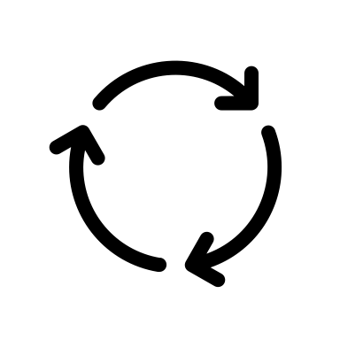
Recap from Last Session
Pain may be nociceptive and/or neuropathic
Goals of pain treatment are centered around improving functioning and on reducing pain (by 30%)
There is an important role for non-drug treatments:
Physical activity
Psychological and physical therapies
Self-management programs
Lifestyle interventions (pacing, mobility aids, sleep, nutrition)
Check with a pharmacist before starting natural health products (NHPs)
Notes:
As a refresher,
Pain can be nociceptive (sharp, dull ache, throbbing pain that happens more commonly with muscles) or neuropathic (burning, prickling, shooting, tingling pain along the nerves)
Goals of pain are centered on improving functioning (increased ability to do certain activities that are important to you) and to a lesser extend to reduce pain (with 30% reduction considered a success)
There is an important role for non-drug treatments and so these should be continued even if medications are started
Different NHPs may have evidence to support their use in specific pain types but they’re not without risks so check with your pharmacist before starting one (they can see if there are drug interactions or side effects to monitor for!)

Slide 5
Group Discussion
What was the most interesting or surprising thing you learned from our last session?
Notes:
Before we get started with today’s content, I want to ask the group: what was the most interesting or surprising thing you learned from our last session? Have you tried incorporating anything you learned from last session? How did it go?

Slide 6
Agenda
1. Medication Considerations
2. Medications for Pain
Over-the-Counter (OTC)
Prescription Medications
3. Managing Side Effects
4. "Homework"
Notes:
Our focus today will be on medication options for pain.
We’ll start with medication considerations for you to keep in mind as you explore medication options (either as new medications to start/switch to or add on).
Then we’ll discuss specific medications with evidence to support their use in pain (both OTC and prescription options)
Then we’ll discuss how to identify and address side effects so they’re more tolerable and don’t limit your medication options as much

Slide 7
Medication Considerations

Slide 8
Medication Considerations
When starting new medications, continue using non-drug treatments for the most benefit¹
Pain medications can be categorized into:
Non-Opioids
Opioids (aka narcotics)
Pain medications can be taken:
Regularly to prevent pain – a best practice for chronic pain
Only when needed to treat pain
Notes:
As mentioned, even if you decide to start medication therapy to help manage your chronic pain it’s best to continue non-drug treatments to get the most benefit.
As you consider medications, we tend to break them up into two categories:
1. Non-Opioids – which are recommended to be tried earlier in therapy
OTCs: Acetaminophen, Ibuprofen
Prescription: TCAs, SNRIs, Gabapentinoids
2. Opioids (aka narcotics) – which have less evidence for benefit and more risk of harm so we reserve them only if other options aren’t possible/effective
E.g., Codeine, Morphine, Hydromorphone, Oxycodone
In terms of addressing chronic pain, the best benefit from non-opioid medications tends to come from taking medications regularly so there’s a steady level in the body to prevent pain vs. just taking it when needed. If we just take the medications when we feel pain, this is reactive (chasing our tails) and doesn’t give the medication time to work to it’s maximum (sometimes they can take a couple weeks to months to impact the pain messaging pathways)

Slide 9
Trying a New Medication
Different people respond differently to medications
Time to notice a benefit
Amount of benefit
Side effects experienced
Time for side effects to become better tolerated
Appropriate trial length ranges
Depending on the medication
Once at target dose, can be up to 8 weeks ²
Notes:
Keep in mind that what works for one person may not work for another as everyone responds to medications differently. Some people may find a medication helps more or faster than others while some people may experience side effects that others don’t or that go away faster in others. Because of these differences between people, we encourage a full medication trial (8 weeks at a target dose) before deciding if a medication isn’t working. Now if a medication is causing side effects, we can try to manage them and see if they go away in 1-2 weeks. If they don’t then another trial may be needed.
Trial Lengths:
Acetaminophen: Allow up to 4 weeks to assess benefit/tolerability (Reference: RxFiles 13th edition)
NSAIDs: Allow for 1-2 weeks for full effect (Reference: CEP)
SNRI: Allow 1 week at each dose to assess tolerability. Then allow for 2 or more weeks to assess benefit. Dose will increase if tolerable to achieve an effective dose. An adequate trial can take up to 8 weeks or more (RxFiles mentions >12 weeks)
Gabapentinoids: Allow 1-2 weeks to assess benefit and tolerability and then increase dose as tolerated. Adequate trial is typically 3-4 weeks. (Reference: RxFiles 13th edition)
TCAs: Allow 1 week at each dose to assess tolerability. Then allow for 2 or more weeks to assess benefit. Dose will increase if tolerable to achieve an effective dose. An adequate trial will take more than 4 weeks (Reference: RxFiles)
Carbamazepine: Will be increasing dose every 2-3 days until you experience an effect. Some resources have said that it can take up to 1-2 weeks to experience an effect. (Reference: https://www.nhs.uk/medicines/carbamazepine/#:~:text=It%20can%20take%201%20to%202%20weeks%20for%20carbamazepine%20to%20work%20properly. )

Slide 10
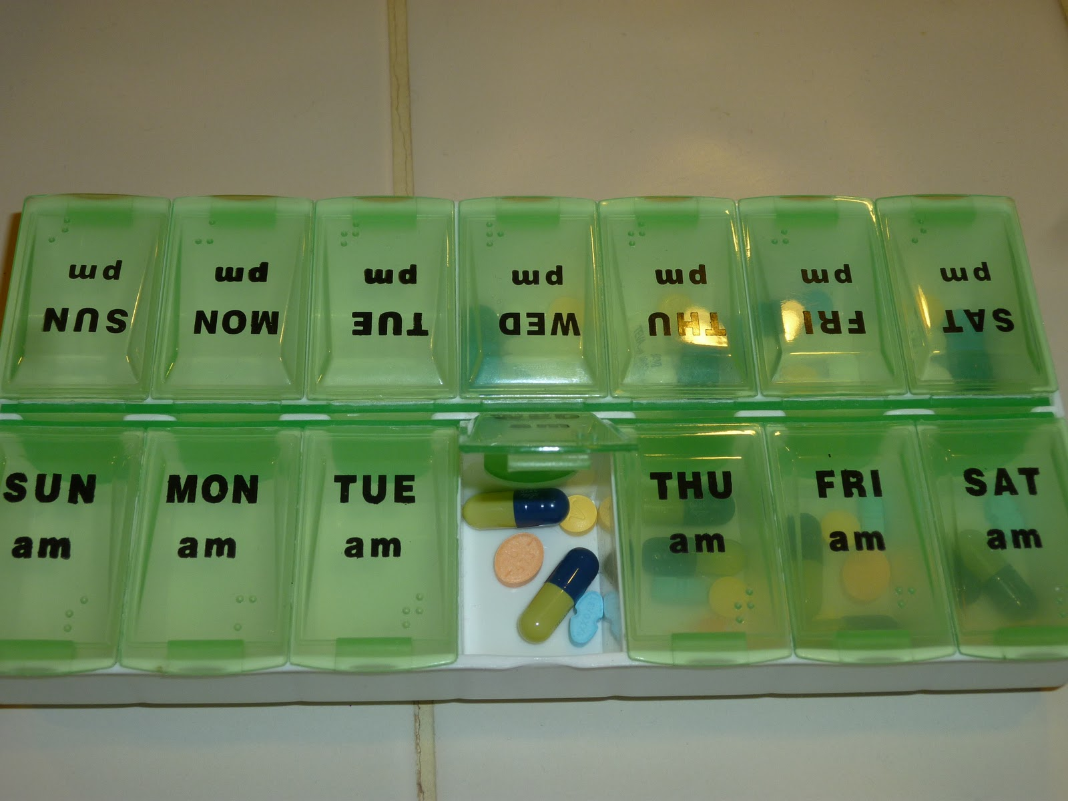
Number of Medications
More than one class of medication may be needed as they can complement each other working different ways
Want to make sure all medications taken are needed
Routinely review if medications are still needed*
If a medication isn't working, it should be stopped before another medication is added on*
*Review with your healthcare provider (e.g., pharmacist) before making changes
Image 1
Notes:
There are many different pain medications available and many work different ways. Many people with chronic pain need multiple medications that work through different pathways for the most benefit together.
That being said, we only want to continue taking medications if you still need them (pain changes over time) and you’ve found benefit from taking them (functioning and coping improved). It’s good to check-in eveyr 6-12 months to see if medications are still needed and try to reduce/stop medications that aren’t providing benefit or that may be causing more harm than benefit (this benefit harm ratio can change as people age and become more likely to experience side effects).
Don’t stop a medication suddenly! Check with your healthcare provider (like a pharmacist) on how to reduce then stop to prevent withdrawal symptoms and close monitoring to avoid increased pain (sometimes we don’t realize medications are working until we reduce/stop them and notice increased pain).

Slide 11
Medications for Pain
Notes:
For different types of pain, we have different medication approaches.
The first medication step includes a few different medications and we wouldn’t move past step one before all of the other appropriate medications (which may be different depending on each person and their other health conditions) have been tried.
While opioids may be in “step 2” keep in mind that this is after many different medications. It doesn’t mean it’s the second medication or medication class to be tried. Often they’re only tried after 3+ medications have been tried.

Slide 12
Medications for Nociceptive Pain³
Nerve Block, Epidurals, Neurolytic Block Therapy
Strong Opioids
Methadone
STEP 1
Opioids
(Tramadol, Codeine Buprenorphine)
Non-Opioids
(Acetaminophen, NSAIDs, Duloxetine)
Non-medication therapies (e.g., exercise, physical therapy) should be continued
Consider add-ons (e.g., steroid injections) at each step
Notes:
For nociceptive pain (the sharp, dull, throbbing pain from sports injury, arthritis, etc.) the first-line therapies are non-opioids. These have the best evidence for benefit (e.g., more people found meaningful impact on their pain/functioning). This can include acetaminophen, non-steroidal inflammatory drugs (e.g., naproxen, ibuprofen), and duloxetine and can be added on to each other before trying other medications that are associated with less benefit. We want to continue the non-medication therapies and may consider add-ons like steroid injections if certain areas are impacted (e.g., knees).
https://www.swrwoundcareprogram.ca/uploads/contentdocuments/whopainladder.pdf
Adapted from: https://www.cfp.ca/content/56/6/514/F2

Slide 13
Medications for Neuropathic Pain⁴
Botox, Methadone, Lamotrigine
Cannabinoids
STEP 1
Opioids
SNRIs, TCAs, Gabapentinoids
Non-medication therapies (e.g., cognitive behavioural therapy) should be continued
TCA: tricyclic antidepressants
SNRI: serotonin-norepinephrine reuptake inhibitor
Notes:
For neuropathic pain (the burning, tingling, prickling pain from nerves) the first-line therapies are also non-opioids. These have the best evidence for benefit (e.g., more people found meaningful impact on their pain/functioning). This can include gabapentinoids (e.g., pregabalin, gabapentin), serotonin-norepinephrine reuptake inhibitors (e.g., duloxetine), and tricyclic antidepressants (e.g., amitriptyline) and can be added on to each other before trying other medications that are associated with less benefit. We want to continue the non-medication therapies (e.g., cognitive behavioural therapies).

Slide 14
Over-the-Counter (OTC)
Notes:
Well now dive a bit deeper into each of the “step 1” medications starting with the OTC options available.
OTC options, as you saw, are especially helpful for nociceptive pain (arthritis, sports injuries). Sometimes when we use higher doses of these medications, they become prescription strength.

Slide 15
Acetaminophen^{1,5,6}
Drugs | Tylenol®, Tylenol Arthritis®
Use | Osteoarthritis (hip or knee)
How it Works | Enhances the body's pain-relieving mechanisms
Usual Dose | Usual dose: 500 mg – 1,000 mg every 4-6 hours Maximum dose: 3,000 mg – 4,000 mg daily
Benefit | Lower cost and can be combined with NSAIDs
Side Effects | Well tolerated
Caution | Avoid using more than the max dose (increases risk of liver injury) Watch the acetaminophen from all sources (e.g., cold products)
Tips | Can be used on a regular basis to help prevent pain Tylenol Arthritis® lasts up to 8 hours so can provide longer relief
Notes:
Acetaminophen:
MOA: decrease the production of prostaglandins (which can cause swelling and pain) in the central nervous system. It also potentially activates serotonin pathways (chemical messenger) in the central nervous system which helps to lower pain. (ref: Reference: https://www-ncbi-nlm-nih-gov.ezproxy.library.ubc.ca/books/NBK482369/ )
Dose:
Watch acetaminophen content from all sources (e.g., acetaminophen, cold products, Tylenol No.1-3, Percocet), staying within daily limits keeps your liver safe
Can be used regularly (e.g., every 6 hours) to proactively address pain vs. chasing it, if you have pain caused by specific triggers you can use this 30 minutes before the trigger
Tylenol arthritis is formulated to last longer (8 hours)
Benefits: many people don’t realize that acetaminophen can be taken with NSAIDs (e.g., alternating)
Acetaminophen: Allow up to 4 weeks to assess benefit/tolerability (Reference: RxFiles 13th edition)

Slide 16
NSAIDs^{1,2,8}
Drugs | Ibuprofen (Advil®), Naproxen (Aleve®), Aspirin
Use | Low back pain, osteoarthritis
How it Works | Works on enzymes (COX) to prevents the formation of a substance released during swelling
Usual Dose | Ibuprofen usual dose: 200 mg – 800 mg every 6-8 hours Max dose: 1200 mg daily (OTC) or 2400 mg daily (prescription) Naproxen usual dose: 220 mg – 500 mg every 8-12 hours Max dose: 440 mg daily (OTC) or 1500 mg daily (prescription) Aspirin: 325-650 mg every 4-6 hours as needed Maximum dose: 4,000 mg/day
Benefit | Lower cost
Side Effects | Stomach upset, increased blood pressure and bleeding risk, can worsen kidney function
Avoid/Caution With: | Heart or kidney conditions History of ulcers or bleeds or on medications that increase bleed risk
Tips | Take with food to prevent stomach upset Regularly monitor your blood pressure and for signs of bleeding
Notes:
Acetaminophen:
MOA: : Inhibits enzymes that are involved in making prostaglandins which are normally released during swelling and play a role in pain
Dose:
Avoid taking more than one NSAID at a time because it can increase risk of side effects (e.g., bleeding risk, stomach upset, increased blood pressure, impact on kidney)
Managing side effects:
Take a lower dose and with food
Some formulations have an NSAID and stomach protector (e.g., vimovo: naproxen/esomeprazole)
Monitor your blood pressure at home or at a community pharmacy
Monitor for signs of bleed (e.g., bruising, nose/gum bleeds that take a while to stop, blood when you use the washroom)
NSAIDs: Allow for 1-2 weeks for full effect (Reference: CEP)

Slide 17
NSAIDs Continued^{2,9}
Drugs | Celecoxib (Celebrex®)
Use | Osteoarthritis, rheumatoid arthritis, ankylosing spondylitis
How it Works | Works on a specific enzyme (COX-2) to prevents the formation of a substance released during swelling
Usual Dose | 100mg twice daily or 200mg once daily Max: 200mg/day
Benefit | Less stomach upset, can take with or without food
Side Effects | Stomach upset, increased blood pressure and bleeding risk, can worsen kidney function
Avoid/Caution with: | Heart or kidney conditions History of ulcers or bleeds or on medications that increase bleed risk
Tips | Regularly monitor your blood pressure and for signs of bleeding
Notes:
Another, more selective NSAID, is celecoxib. Because it works specifically on the COX-2 enzyme (vs. COX-1 and COX-2 like the other NSAIDs) it may be associated with less stomach side effects (but still possible)
NSAIDs: Allow for 1-2 weeks for full effect (Reference: CEP)

Slide 18
Topicals^{1,2,7}
Drugs | Topical NSAID - Diclofenac (Voltaren Emulgel®) Topical Anesthetics - Lidocaine (Deep Relief ®)
Use | For localized pain Topical NSAID: Osteoarthritis, musculoskeletal pain Topical Anesthetics: Neuropathic pain
How it Works | Topical NSAID: see last slide Topical Anesthetics: numbs the pain
Usual Dose | Diclofenac: Apply 1-2 g (i.e. 2-4 cm) 3 to 4 times daily Lidocaine: Varies. Follow package instructions
Benefit | Low risk of body-wide side effects
Side Effects | Skin irritation, burning, itchiness
Caution | Do not apply on open skin wounds
Tips | Wash your hands before and after applying
Notes:
For the lowest risk of body-wide side effects, topicals (medications that you apply to the skin) can be used. There are topical NSAIDs available to lower the risk of stomach upset, bleeds, and impact on heart and kidneys. There are also topical numbing agents (anesthetics).
These medications tend to work for shorter amounts of time (e.g., 15-60 minutes) and the need to apply them may limit their use (e.g., to a specific areas like the knee/leg/shoulder/back vs. body-wide).
Topical NSAIDs like diclofenac are available as OTC medications (e.g., voltaren) or prescription medications (e.g., Pennsaid).
Make sure to not apply to any open wound and wash your hands before and after applying!

Slide 19
Prescription: Non-Opioid Medications
Notes:
Now we’ll move into non-opioid prescription medications involved in first-line (or step 1) of therapy. Note that there are other non-opioid medication options but they tend to be specific to the type of pain you’re experiencing and other health conditions/side effects you’ve experienced so it’s best to book a one-on-one appointment to review these extra options.

Slide 20
Serotonin-Norepinephrine Reuptake Inhibitors (SNRI)^{1,2,10,11}
Drugs | Duloxetine (Cymbalta®), Venlafaxine XR (Effexor®)
Use | Back pain, osteoarthritis, neuropathic pain, fibromyalgia
How it Works | Increases the amount of chemicals (serotonin, norepinephrine) in your brain to help lower pain signals
Usual Dose | Duloxetine: 60 mg daily Venlafaxine XR: 75-150 mg daily
Side Effects | Stomach upset, trouble sleeping or feeling tired or drowsy, agitation
Caution | Do not stop suddenly Avoid use with SSRIs (selective serotonin reuptake inhibitors)
Tips | Take in evening if it makes you tired or morning if trouble sleeping Can also help with mood Can take up to 8 weeks to see effect
Notes:
SNRI:
MOA: serotonin and norepinephrine are chemical messengers that play a role in the pain pathways in the nervous system. These medications help to increase the amount of serotonin and norepinephrine in your brain, to lower the pain signals. These medications can also be used in anxiety/depression (which is helpful as we know mental health can impact pain experience).
Dose:
It’s best to start these medications at a starting dose (e.g., duloxetine 30 mg daily or even 30 mg every other day if you’re sensitive to side effects) and increase gradually every 1-2 weeks
It can take up to 8 weeks to see benefit in pain and mood
Managing Side Effects:
Side effects may get better after 1-2 weeks so try to continue use as much as possible
Can take with bland snack if it upsets your stomach or at night if it makes you tired/in the morning if it impacts your sleep
If you experience side effects from one SNRI, we may be able to try another SNRI
Benefits: especially helpful in people whose pain may also affect their mood or who have anxiety/depression as well as chronic pain but it can’t be combined with certain other mood/anxiety medications (e.g., SSRI like citalopram or sertraline)
Caution: if you want to stop the medication, we slowly lower the dose over a few weeks (depending on how long you’ve been on the medication and the current dose) to prevent withdrawal symptoms (flu-like symptoms)
SNRI: Allow 1 week at each dose to assess tolerability. Then allow for 2 or more weeks to assess benefit. Dose will increase if tolerable to achieve an effective dose. An adequate trial can take up to 8 weeks or more (RxFiles mentions >12 weeks)

Slide 21
Tricyclic Antidepressants^{1,2,14}
Drugs | Amitriptyline (Elavil®) Nortriptyline (Aventyl®)
Use | Neuropathic pain, Fibromyalgia
How it Works | Increases the amount of chemicals in your brain to help lower pain signals
Usual Dose | Amitriptyline, Nortriptyline: 25-75 mg nightly at bedtime
Side Effects | Feeling tired, dry mouth, constipation, memory issues, confusion
Avoid/Caution | Do not stop suddenly
Tips | Can take 2-3 hours before bed to prevent morning drowsiness Nortriptyline may have less side effects Amitriptyline can be compounded to a cream for local pain relief Can also help with mood and sleep difficulties Can take 4-8 weeks to see effect
Notes:
TCAs:
MOA: serotonin and norepinephrine are chemical messengers that play a role in the pain pathways in the nervous system. These medications help to increase the amount of serotonin and norepinephrine in your brain, to lower the pain signals. They also block the action of the chemical messenger acetylcholine. These medications can also be used in people who experience trouble sleeping and can help with mood.
Dose:
It’s best to start these medications at a starting dose (e.g., amitriptyline 10 mg nightly at bedtime) and increase gradually every 1-2 weeks
It can take up to 8 weeks to see benefit in pain and mood
Managing Side Effects:
Side effects may get better after 1-2 weeks of starting the medication or increasing the dose so try to continue use as much as possible
Taken at bedtime as it can cause sleepiness or a few hours before bed to prevent morning “hangover” feeling
For dry mouth, try a lubricating mouth spray, toothpaste, or wash (e.g., Biotene), ice chips, and brushing twice daily as dry mouth can increase your risk of cavities
Caution: if you want to stop the medication, we slowly lower the dose over a few weeks (depending on how long you’ve been on the medication and the current dose) to prevent withdrawal symptoms (flu-like symptoms)
TCAs: Allow 1 week at each dose to assess tolerability. Then allow for 2 or more weeks to assess benefit. Dose will increase if tolerable to achieve an effective dose. An adequate trial will take more than 4 weeks (Reference: RxFiles)

Slide 22
Gabapentinoids^{1,2,12,13}
Drugs | Gabapentin (Neurontin®) Pregabalin (Lyrica®)
Use | Neuropathic pain, fibromyalgia
How it Works | Changes the way nerves send information to the brain
Usual Dose | Gabapentin: 1,800 mg divided three times daily (i.e. 600 mg three times) Pregabalin: 150 mg twice daily
Side Effects | Dizziness, drowsiness, confusion, blurred or double vision
Caution | Do not stop suddenly
Tips | Gabapentin can be compounded to a cream for local pain relief Can take 3-4 weeks to see effect
Notes:
Gabapentinoids:
MOA: lowers the amount of chemical messengers released that are associated with sending pain information to the brain, helps make the nervous system less excitable and sensitive to pain signals
Dose:
It’s best to start these medications at a starting dose (e.g., gabapentin 300 mg nightly) and increase gradually every 1-2 weeks
Doses above the ones on this slide tend to have higher risk of side effects without much extra benefit in pain
Pregabalin may also help with anxiety
Some people find the medication wears off faster than others so they may dose the medication more often (e.g., pregabalin three times daily with the same total dose spread out into more administration times)
Managing Side Effects:
Side effects may get better after 1-2 weeks of starting the medication or increasing the dose so try to continue use as much as possible
For dry mouth, try a lubricating mouth spray, toothpaste, or wash (e.g., Biotene), ice chips, and brushing twice daily as dry mouth can increase your risk of cavities
Caution: if you want to stop the medication, we slowly lower the dose over a few weeks (depending on how long you’ve been on the medication and the current dose) to prevent withdrawal symptoms
Gabapentinoids: Allow 1-2 weeks to assess benefit and tolerability and then increase dose as tolerated. Adequate trial is typically 3-4 weeks. (Reference: RxFiles 13th edition)

Slide 23
Group Discussion
Q1: Have you tried any of these medications? How did you respond to them?
Q2: Did you learn anything about medications that you didn’t know?

Slide 24
Managing Side Effects
Notes:
As you saw, most of the first-line medication options can be associated with side effects. Before deciding a medication isn’t right for you, we’ll want to see if we can manage the side effects so that we don’t run out of options that could work for you. In the next few slides, we’ll review specific common side effects and how to help manage them.

Slide 25
Drowsiness
SNRIs, TCAs, Gabapentinoids
Recommendations:
Lifestyle
Avoid substances that can cause drowsiness like alcohol and cannabis
Exercise and stay busy
Set a consistent wake-up and sleep schedule
Medications
Try lower doses of medications and increase more slowly
Take medications at night
Switch to a medication with lower risk of side effects in the same family ¹⁴
Take 2-3 hours before bed to prevent morning drowsiness
Listen to upbeat music, brighten up the room
Stay cool (splash cold water, turn on a fan)
Notes:
Side effect: drowsiness
Common with: SNRIs, TCAs, Gabapentinoids
See slide for lifestyle and medication management strategies

Slide 26
Nausea & Vomiting
SNRIs, Gabapentinoids, TCAs
Recommendations
Lifestyle
Take medications with a light snack, bland foods or a meal¹⁵
Do not mix hot and cold foods together
Avoid activity within 30 minutes of eating
Eat and drink slowly. Have smaller meals more frequently ¹⁵
Medications
Try lower doses of medications and increase more slowly
OTC¹⁶
If vomiting take electrolyte replacement (e.g., Pedialyte®, Hydralyte®)
Can take anti-nausea medication (e.g., Gravol®, Gravol Ginger®)
Notes:
Side effect: nausea and vomiting
Common with: SNRIs, TCAs, Gabapentinoids
See slide for lifestyle and medication management strategies
Prescription medications to address nausea/vomiting are available but we want to be careful not to go down the path of prescribing many medications to treat side effects of other medications if we don’t have to

Slide 27
Dry Mouth¹⁶
SNRIs, TCAs
Recommendations
Lifestyle
Avoid caffeine, tobacco, cannabis and alcohol
Maintain good oral hygiene (e.g., brush twice daily, floss)
Stay well hydrated (e.g., sip water)
Suck on sugar-free candy or ice chips
Medications
OTC: saliva substitutes
Biotene ® (Mouth wash, oral gel)
Moi-Stir ® (Mouth spray)
Images 2 - 3
Notes:
Side effect: dry mouth
Common with: SNRIs, TCAs
See slide for lifestyle and medication management strategies

Slide 28
Constipation¹⁷
SNRIs, TCAs
Recommendations
Lifestyle
Drink water and fluids
e.g. 8 cups of water daily
25-38 g of soluble fibre (e.g. bran, lentils, beans)
Physical activity
e.g. walk 15-20 minutes once to twice daily
Add more fiber and fruits to diet
Incorporate apples, pears, prunes
Medications
OTC: laxatives, bulking agents, stimulants
Notes:
Side effect: constipation
Common with: SNRIs, TCAs
See slide for lifestyle and medication management strategies
Medications (more details on next slide):
Laxative: PEG
Bulking agent: psyllium fibre
Stimulant: bisacodyl

Slide 29
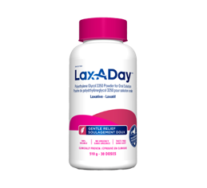
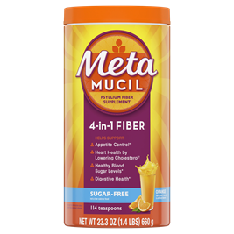
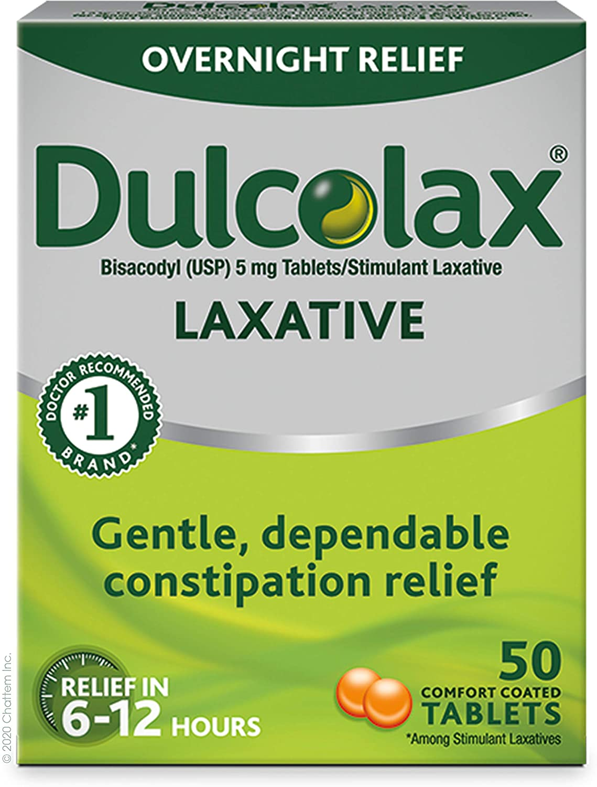
Medications for Constipation¹⁷
 | Laxatives | Bulking Agent | Stimulant
Example | PEG 3350 | Psyllium fiber | Bisacodyl
Dose | 17 g (capful) once daily | 3.4 g one to three times a day | 5 – 10 mg daily at bedtime
Onset | 2-4 days | 12-72 hours | 6-12 hours
Side Effects | Bloating, stomach upset, diarrhea | Bloating, stomach discomfort | Stomach pain, cramps, diarrhea
Images 4 - 6
Notes:
Laxatives MOA: Poorly absorbed sugars that draw fluid into the intestines or rectum which will help to increase the volume and fluidity of the stools, helping to stimulate bowel movement
Bulking agent MOA: These are indigestible fibers that help absorb water in your digestive tract, helping to increase stool weight stimulate bowel movement
Stimulant MOA: directly stimulates the intestinal muscles to stimulate bowel movement

Slide 30
Group Discussion
Q1: Are you currently or have you in the past experienced side effects from medications?
Q2: What lifestyle and medication measures have you tried for medication side effects? Are there any you may try after this session?

Slide 31
Key Take-Aways
Non-opioids are first-line medications for pain
The choice of non-opioid medication depends on your pain type and other conditions you have
Medications can take up to 8 weeks to work
More than one medication are often needed
Many common side effects can be addressed with lifestyle and/or medication interventions
Notes:
To conclude today’s session, I’ll highlight some key take-aways to remember:
We start medication therapy with non-opioid options and there are many medications within “step 1” of medication management to try or try adding
The choice of medication depends on what time of may you have and what other conditions you have that could put you at risk of side effects or make you likely to benefit for other reasons too (e.g., difficulty sleeping, low mood)
Medications can take up to 8 weeks, at a therapeutic dose, to work so continue with the trial for this long if tolerated
Oftentimes we’ll need 2-3 medications from different classes to approach the pain different ways
While side effects are common, they tend to get better after 1-2 weeks of starting or increasing a medication and many lifestyle or medication interventions can be used to make them better

Slide 32
Debrief of Today’s Session
Feedback
Any requests for future sessions?
"Homework" assignment
Pain diary
Notes:
Agenda for Next Session:
Considering Opioids: Benefits vs Harms
Managing Opioid-related Side Effects
Opioid Harm Reduction
Take Home Messages

Slide 33
“Homework”: Pain Diary
Pain diary:
Keep track of your pain and response to pain management
Find factors that influence (help or worsen) your pain
Use a pain diary daily for 1 week
Notes:
Your homework this month is to try to use a pain diary daily for a week before our next group appointment. We’ll provide a template you can print and use but you can choose to use your own template/journal as well.
The idea is that you reflect on your pain and your pain management to help you and your healthcare providers find out what influences pain and what can be done to help it.
The pain diaries include areas to document:
Pain scale rating: low-moderate-high
Medicine and dose: What medications and what dose of them did you take today?
Medicine side effects: What side effects did you experience today (if any)? Any that were quite impactful?
What made the pain better? Did the medication or non-medication measures help? Did any activities help?
What made the pain worse? Did anything make the pain worse?
Diaries:
-American Cancer Society: https://www.cancer.org/content/dam/cancer-org/cancer-control/en/worksheets/pain-diary.pdf
-NPS Medicine Wise (free for pt use): https://www.guild.org.au/__data/assets/pdf_file/0023/5945/patient-resource-my-pain-diary-nps-medicinewise.pdf

Slide 34
Additional Resources
Comparing Treatment Options for Pain:
Neuropathic Pain: https://pain-calculator.com/calculators/neuropathic-pain/
Low Back Pain: https://pain-calculator.com/calculators/low-back-pain/
Osteoarthritis Pain: https://pain-calculator.com/calculators/osteoarthritis-pain/
Medication Overviews – Hamilton Health Sciences: https://www.hamiltonhealthsciences.ca/areas-of-care/medicine-and-complex-care/clinics/pain-clinic/resources/
Pain Diaries:
App: Manage My Pain, Chronic Pain Tracker, CareClinic
Paper Copy: American Cancer Society, National Prescribing Service Medicinewise
Medication Management Phone Applications (Free on Apple and Android)
MyTherapy: Medication Tracker – Provides a platform to track your medications and health numbers (i.e. blood pressure, heart rate, etc.)
Notes:
Apps:
- https://managemypainapp.com/
- https://chronicpaintracker.com/
- https://careclinic.io/
Paper copies of pain diaries:
- https://www.healthlinkbc.ca/sites/default/files/healthwise/documents/form_abg7017.pdf
- https://www.cancer.org/content/dam/cancer-org/cancer-control/en/worksheets/pain-diary.pdf
- https://www.guild.org.au/__data/assets/pdf_file/0023/5945/patient-resource-my-pain-diary-nps-medicinewise.pdf
Resources: https://pharmacy-nutrition.usask.ca/mac/patients/mac-iops-chronic-pain-toolkit.php
MyTherapy: Medication tracker: https://www.mytherapyapp.com/
MediSafe: https://www.medisafeapp.com/

Slide 35
Thank You!

Slide 36
References
Centre for Effective Practice. Management of Chronic Non-Cancer Pain (CNCP). Toronto (ON): Centre for Effective Practice; 2018.
RxFiles Drug Comparison Charts – 13th Edition. Editors Brent Jensen, Loren Regier. Sasakatoon, SK: Saskatoon Health Region; 2021. Available from www.RxFiles.ca
Vargas-Schaffer G, Cogan J. Patient therapeutic education: placing the patient at the centre of the WHO analgesic ladder. Can Fam Physician. 2014;60(3):235-241.
Mu A, Weinberg E, Moulin DE, Clarke H. Pharmacologic management of chronic neuropathic pain: Review of the Canadian Pain Society consensus statement. Can Fam Physician. 2017 Nov;63(11):844-852.
CPS [Internet]. Ottawa (ON): Canadian Pharmacists Association; c2016 [updated 2016 Nov 01; cited 2021 Sept 19].Acetaminophen [product monograph]. Available from: http://www.e-therapeutics.ca. Also available in paper copy from the publisher.​
Kolasinski SL, Neogi T, Hochberg MC, Oatis C, Guyatt G, Block J, et al. 2019 American College of Rheumatology/Arthritis Foundation Guideline for the Management of Osteoarthritis of the Hand, Hip, and Knee. Arthritis Care Res (Hoboken). 2020 Feb;72(2):149-162.
CPS [Internet]. Ottawa (ON): Canadian Pharmacists Association; c2016 [updated 2020 Dec 02; cited 2021 Sept 19].Nonsteroidal Anti-inflammatory Drugs [product monograph]. Available from: http://www.e-therapeutics.ca. Also available in paper copy from the publisher.​
CPS [Internet]. Ottawa (ON): Canadian Pharmacists Association; c2016 [updated 2020 Feb 1; cited 2021 Oct 29]. ASA [product monograph]. Available from: http://www.e-therapeutics.ca. Also available in paper copy from the publisher.
CPS [Internet]. Ottawa (ON): Canadian Pharmacists Association; c2016 [updated 2017 May 31; cited 2021 Oct 29]. Celebrex [product monograph]. Available from: http://www.e-therapeutics.ca. Also available in paper copy from the publisher.
CPS [Internet]. Ottawa (ON): Canadian Pharmacists Association; c2016 [updated 2020 Mar 11; cited 2021 Sept 19]. Cymbalta [product monograph]. Available from: http://www.e-therapeutics.ca. Also available in paper copy from the publisher.
CPS [Internet]. Ottawa (ON): Canadian Pharmacists Association; c2016 [updated 2018 Feb 18; cited 2021 Sept 19]. Effexor [product monograph]. Available from: http://www.e-therapeutics.ca. Also available in paper copy from the publisher.
CPS [Internet]. Ottawa (ON): Canadian Pharmacists Association; c2016 [updated 2018 Feb 22; cited 2021 Sept 19]. Neurontin [product monograph]. Available from: http://www.e-therapeutics.ca. Also available in paper copy from the publisher.
CPS [Internet]. Ottawa (ON): Canadian Pharmacists Association; c2016 [updated 2016 Dec 22; cited 2021 Sept 19]. Lyrica [product monograph]. Available from: http://www.e-therapeutics.ca. Also available in paper copy from the publisher.
CPS [Internet]. Ottawa (ON): Canadian Pharmacists Association; c2016 [updated 2018 Nov 12; cited 2021 Sept 19]. Tricyclic Antidepressants [product monograph]. Available from: http://www.e-therapeutics.ca. Also available in paper copy from the publisher.
Hughes C. Nausea and Vomiting. In: Therapeutics [Internet]. Ottawa (ON): Canadian Pharmacists Association; c2016 [updated 2021 Apr 14; cited 2021 Sept 19]. Available from: http://www.myrxtx.ca. Also available in paper copy from the publisher.
Kletas V. Dry Mouth. In: Therapeutics [Internet]. Ottawa (ON): Canadian Pharmacists Association; c2016 [updated 2020 Nov 04; cited 2021 Sept 19]. Available from: http://www.myrxtx.ca. Also available in paper copy from the publisher.
Chaun H, Andrews AN, Woo M. Constipation in Adults. In: Therapeutics [Internet]. Ottawa (ON): Canadian Pharmacists Association; c2016 [updated 2021 Apr 14; cited 2021 Sept 19]. Available from: http://www.myrxtx.ca. Also available in paper copy from the publisher. ​

Slide 37
Image References
Image 1: Image 1 by Unknown author is licensed under CC BY-NC-ND.
Image 2: Amazon, 2023
Image 3: Well, 2023
Image 4: Walmart, 2023
Image 5: Amazon, 2023
Image 6: Amazon, 2023

