Slide 1
Session 3: Opioid Medications
Facilitator: [INSERT NAME HERE]
[INSERT DATE & TIME HERE]
NOTICE: This slide deck intended for educational purposes only and you are encouraged to adapt this slide deck to suit your clinic, services and community.
This slide deck was created in 2022 at the UBC Pharmacists Clinic by Dr. Tiana Tilli, PharmD, RPh, ACPR with the help of Rebecca Leung E2P PharmD 2023
Notes:
Slides created by: Tiana Tilli, PharmD, RPh, ACPR and Rebecca Leung, E2P harmD 2023

Slide 2
Land Acknowledgement
[We invite you to create a land acknowledgement to recognize the traditional, ancestral, and unceded land that your office/clinic is located on]

Slide 3
Timeline
Session 1
Introduction,
Lifestyle Management
[60 mins]
Session 2
Non-Opioid Medications
[60 mins]
Session 3
Today
Opioid Medications
[60 mins]
Notes:
As you may remember, last session we focused on non-opioid medications for managing chronic pain which would be continued in addition to the lifestyle management techniques we reviewed in our first session.
Today, we’ll move forward with considerations surrounding the use of opioid medications for pain. Keep in mind that they should be used as a later-line in therapy, after several medications that we reviewed last session have been unsuccessful, and that we should routinely re-visit if they are still needed, working, and at a safe dose.

Slide 4
Recap from Last Session
Non-opioid medications, with non-drug therapies, are first-line for chronic pain
Many non-opioid medications are available. They can be used in combination for more benefit.
Your treatment(s) should be tailored to your type of pain, other health conditions, and response.
Side effects can be managed through lifestyle or medication changes. Talk to your pharmacist!
Notes:
As a refresher,
Non-opioid medications (e.g., OTC medications like acetaminophen or NSAIDs or topicals or Prescription Medications like the SNRIs, TCAs, and Gabapentinoids) are first-line for chronic pain and should be used as add-ons to non-drug therapies
Many non-opioid medications are available from different medication families that work differently. They can be used in combination (added them on top of one another) for more benefit.
Your treatments should be tailored to your type of pain (e.g., nociceptive or neuropathic), health condition (e.g., osteoarthritis, fibromyalgia, back pain), other health conditions (e.g., sleep difficulties, low mood, restless leg syndrome), and response (if a medication isn’t working after an appropriate trial, it should be stopped vs. continued forever)
Side effects can be common but can often be managed through lifestyle or medication changes rather than needing to stop the medication altogether. Because we have a limited number of pain medications, we want to do what we can not to rule something out without a fair trial. Talk to your pharmacist!

Slide 5
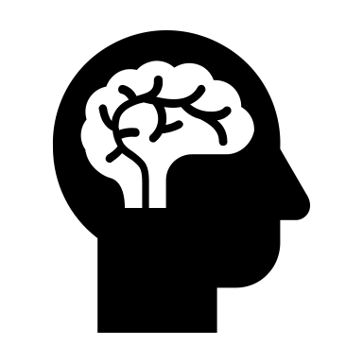
Reflection Question
Q1: Pain Diary: Were you able to keep a pain diary? What did you learn?
Q2: Have you used any recommendations from last session to manage side effects? Did it help?
Notes:
Now the homework last session was to keep a pain diary for 1 week to what your pain was like, what made it worse/better, what time of days was it worse/better. This can help us see if medications and lifestyle interventions are helping and how to adjust them.
Were you able to keep a pain diary? What did you learn?
Some people may also have used their pain diary to track changes they made from last session or even side effects experienced. If so
Have you used any recommendations from last session to manage side effects? Did it help?

Slide 6
Agenda
Opioid Overview
Opioid Side Effects
Opioid Safety
Notes:
Our focus today will be on education around the use of opioid medications for pain.
We’ll start with an overview of opioids (what they are, how/how well they work, dosing considerations)
Then we’ll discuss possible side effects to monitor for and how to treat/address them and how to reduce risks associated with opioid use

Slide 7
Opioid Overview

Slide 8
Discussion Question
Q: What comes to mind when you hear the word ‘opioid’?
Notes:
Before we talk about opioids, I want to recognize that there’s been so much talk (and sometimes stigma) about opioids in the news these past few years. Let’s open up the floor for a discussion question:
What comes to mind when you hear the word “opioid”?
Okay, let’s see if we can provide some helpful facts about opioids to help you be knowledgeable and informed about them when making decisions about whether to include them in your pain management plan or not.

Slide 9
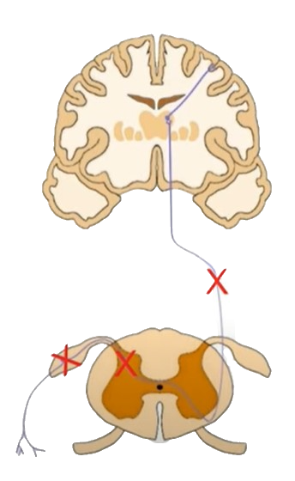
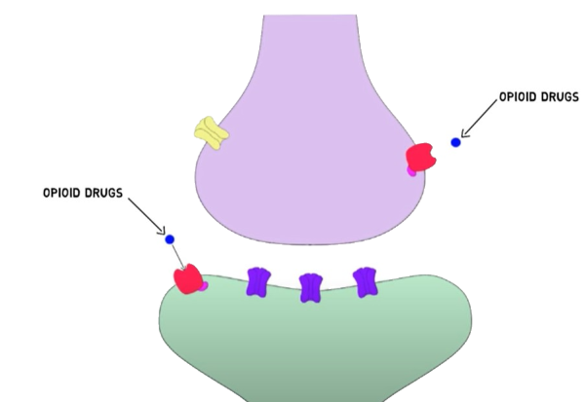
Opioids^{1,2}
Attach to receptors on cells throughout the body to block pain messages from being sent to the brain
Can be used to lower pain messages but have risks
Image 1
Notes:
Opioids, which you may hear called ”narcotics” are medications that can be used to block pain messages from being sent from the body to the brain to lower the pain experience.
This is done by the opioid (blue circle in image) attaching to receptors (red squares) on nerve cells in the brain, spinal cord, gut, and other parts of the body. When this happens, the opioid stuck to the receptor blocks pain messages from being sent from the body through the spinal cord and to the brain. Without the message, less pain may be felt.
While they may help lower pain, there are risks from the effect of the opioids attaching to receptors around the body involved in other messaging pathways (e.g., breathing).

Slide 10
Opioid Considerations^{1,3}
It is important to weigh the potential benefits and risks of opioids before deciding if an opioid should be tried
Potential Benefits | Potential Harms
Pain improvement Improved function | Side effects Tolerance Dependence Withdrawal Poisoning
Notes:
Because opioids can cause both good and bad things to happen, it’s important to be aware of this and weigh the benefits vs. harm for you specifically.
The potential benefits include reduced pain (but not elimination) and better function
The potential risks include side effects (e.g., constipation, slow reaction times), tolerance (e.g., needing higher doses over time), dependence (e.g., body needs the medication or goes into withdrawal, mind craves the medication, start taking the medication in different ways than prescribed), withdrawal (e.g., uncomfortable feeling when the opioid is stopped), or even poisoning (e.g., fatal or non-fatal where people’s breathing may be impacted).
It’s not to say we can’t use opioids, but we have to regularly check-in to make sure the benefits still outweigh the risks as these risks can change over time (e.g., as we get older).

Slide 11
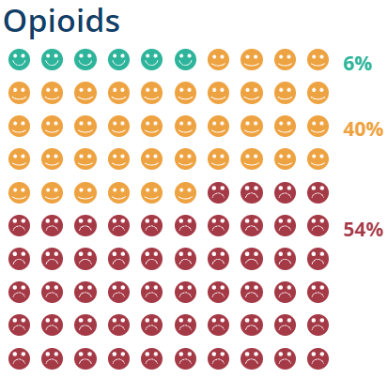
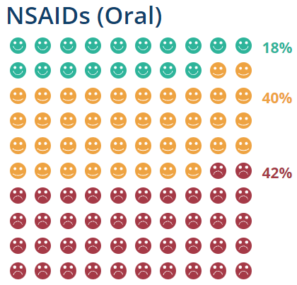
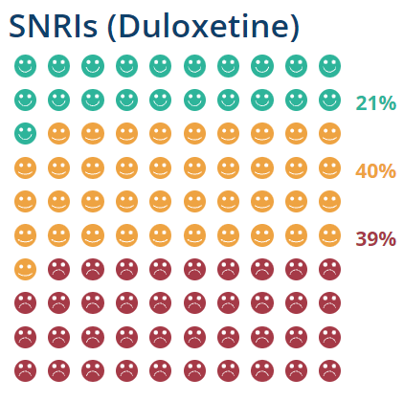
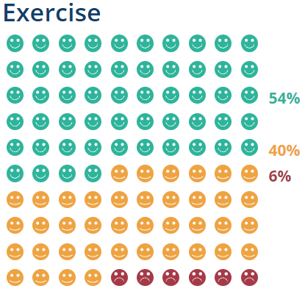
Potential Benefits^{1,3}
Some people may experience reduced pain when taking opioids, but many people do not experience benefit
Opioids can be less effective than non-opioid and non-drug treatments. For example, with osteoarthritis:
Improve with treatment
Improve with placebo
No improvement
Image 2
Notes:
When weighing the benefit and harm, it’s important to keep in mind how much potential benefit opioids can bring as oftentimes this can be overestimated.
While some people may experience lowered pain levels and improved function, many people don’t experience a noticeable difference and most would benefit more from other medications.
Here we have an example of people treated with different medications compared to placebo (sugar pill/pill without medical ingredients) for osteoarthritis. The green faces are people with improved with the treatment in question, yellow faces are people who improved with the placebo, and red are people who didn’t improve.
With opioids, only 6% of people who received opioids had their pain improve whereas with NSAIDs (like naproxen, ibuprofen) and SNRIs (like duloxetine) about 20% of people improved and with exercise 54% of people improved! In all cases, about 40% of people improve just because of the effect of the thought that something is being done. With opioids, we see the largest number of people who had no improvement (54%).
So overall, it’s quite a low percent of people who see benefit from taking opioids with better odds of seeing benefit with other medications/lifestyle changes. This is part of the reason why we reserve opioids to later lines, because they’re less likely to work.

Slide 12
Potential Harms
Tolerance^{4, 5}
Body gets used to a dose of opioid
Higher doses are needed for the same effect
Dependence⁶
Physical: Stopping opioid causes withdrawal symptoms
Withdrawal⁷
Uncomfortable symptoms that happen when opioids are suddenly stopped or greatly lowered
Psychological: A craving or compulsion to take opioids
Opioid Poisoning⁸
A potentially life threatening complication that happens from opioids slowing down breathing
Notes:
Now to balance the potential benefit, we have to keep in mind the potential harms. Here are some definitions associated with potential harms from opioids. Not everyone will experience these but some people experience them even when taking the medication for pain and exactly as prescribed.
Withdrawal:
-72 hours: physical symptoms peak (chills, fever, body aches, diarrhea, insomnia, muscle pain, nausea, dilated pupils)
-1 week: tiredness, sweating, body aches, anxiety, irritability, nausea
-2 week: depression, anxiety, irritability, restlessness, trouble sleeping
-1 month: cravings, depression

Slide 13
Quiz Question
Who is more likely to develop opioid dependence?
Anyone taking opioids can develop dependence
Kevin
70 year old male
Osteoarthritis for 20 years
Shreya
30 year old female
Fibromyalgia for 10 years
Morphine SR 15mg twice daily
Oxycodone 5mg every 6 hours
Taking opioids for 15 years
Taking opioids for 3 months
Notes:
Please note this slide is animated and correct answer will show on click.
Opioid dependence (physical or psychological) can happen to anyone. There are some questions that may be used to screen if you’re experiencing opioid dependence (called the COMM: current opioid misuse measure: Current Opioid Misuse Measure https://www.jpain.org/article/S1526-5900(08)00831-6/fulltext) that include:
Taking medications differently from how they are prescribed
Taking more of your medication than prescribed
Using pain medicine for symptoms other than for pain (e.g. help sleep, relieve stress, etc.)
Spending a lot of time thinking about your medications (e.g. having enough of them, taking them, etc.)

Slide 14
Quiz Question: True or False
10 mg of hydromorphone
is equivalent to
10 mg of morphine
----------
50 mg
FALSE
Notes:
Please note this slide is animated and TRUE / FALSE will show on click
They aren't equivalent – a smaller dose of hydromorphone is equivalent to a bigger dose of morphine
When started an opioid for the first time, the total daily dose (amount taken in a day form all opioids) should be more than 50 mg morphine (which is only 10 mg hydromorphone!).

Slide 15
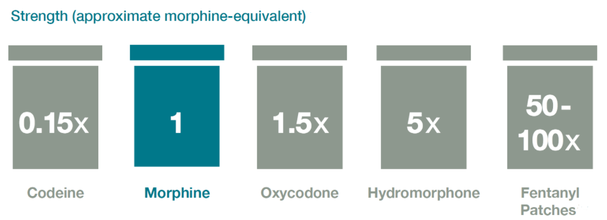
Opioid Dose⁹
Different opioids have different relative strengths
While a dose may look small, it can be quite strong
We calculate the morphine equivalent to help compare doses and determine the relative strength
Image 3
Notes:
To lower the risks associated with opioid use, we use the lowest possible dose for the shortest amount of time. When comparing doses between opioids (e.g., codeine, morphine, hydromorphone) we need to be mindful that they’re not equal. This means the dose (or number) may look bigger or smaller but represent the same effect.
Healthcare providers will calculate how much opioid in morphine equivalent you are taking to help calculate the dose that would be the same for a different opioid
For example:
5 mg morphine = 1 mg hydromorphone

Slide 16
Opioid Equivalence
Example: 100 mg morphine is equivalent* to…
Codeine 667 mg
Hydromorphone 20 mg
Oxycodone
67 mg
*When switching between opioids, we calculate the equivalent dose for the new opioid and then lower it to take into account that the body had tolerance to the original opioid but not the new one.
Image 4
Notes:
Because of equivalence, what looks like a small dose can actually be quite large!
Here’s an example of what 100 mg morphine looks like in other opioids:
-Codeine (Tylenol 3): 667 mg = 22 tablets
-Oxycodone: 67 mg
-Hydromorphone: 20 mg
An important note when switching from one opioid to another is that because of tolerance, we can’t just switch to the equivalent dose. Instead we have to calculate the equivalent dose and then lower it to address the fact that your body doesn’t have tolerance to the new medications and so a lower dose can work the same and be safer.

Slide 17
Opioid Dosage Forms^{4,10}
 | Immediate Release (Shorter Acting) | Sustained Release (Longer Acting)
Use | Treat pain Acute or inconsistent pain | Prevent pain Chronic or continuous pain
Length of Effect | Varies (1 - 6 hours) | Varies (8-24 hours)
Advantages | May help with: Acute pain Adjusting doses | Fewer pills to take Consistent pain control Prevention vs. chasing pain
Disadvantages | Fluctuations (pain, withdrawal) | Cannot break or chew
Notes:
On top of selecting an appropriate opioid dose, it’s important to pick an appropriate dosage form. Two dosage forms that exist are immediate release (shorter acting) or sustained release (longer acting).
Longer Acting usually have a special release formulation (e.g., outer coating that dissolves slowly over time, beads within a capsule where some are coated to release later and others release more quickly) whereas shorter acting don’t have this formulation and so they release and are absorbed by the body more quickly and thus last for shorter amounts of time.
Both formulations have potential uses, but it’s about using one that is appropriate for your situation.
Immediate Release:
-Depending on the specific medication, tend to last 1 – 6 hours
-Helpful when starting opioids to find the most appropriate dose (allows for adjusting the dose without being left with the effects for long periods of time)
-If pain is specifically triggered by an activity (e.g., severe with exercise but lower at rest), can be used when about to engage in activity
-Disadvantages are that because the effects are short-term, some people get “inter-dose withdrawal” where they experience withdrawal symptoms between doses (e.g., taking every 6 hours and by hour 4-6, they experience withdrawal symptoms of nausea/diarrhea/muscle pains)
Sustained Release
-Depending on the specific medication, tend to last 8 – 24 hours
-Helpful once the total daily dose of opioid needed has been identified
-Helps to prevent pain vs. treating it (being reactive and waiting for it to get back to take medication)
-Benefits are that it lowers the number of medications and relationship with pill-taking behaviour (feeling like you need to take pills)
-Provides more consistent pain control vs. fluctuations
-Disadvantages are that the doses they come in can be more limited and we can’t break/chew the pills so it can be more challenging to use the specific dose needed or to lower a dose

Slide 18
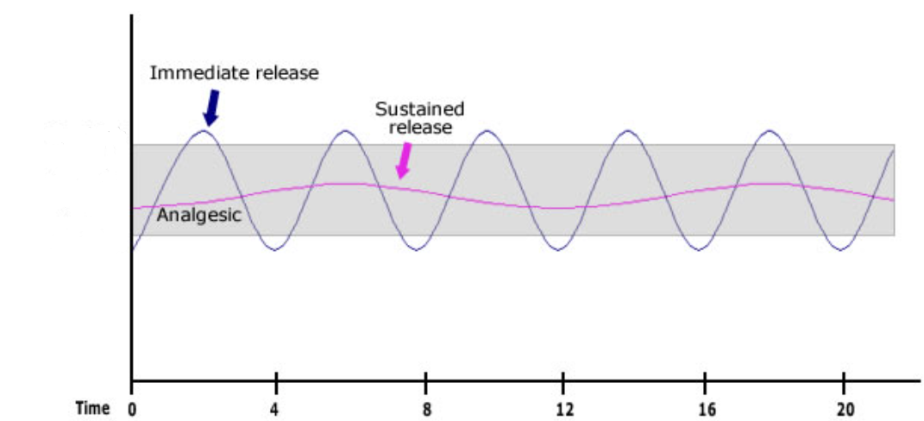
Opioid Dosage Forms^{4,10}
Too High
Pain Relief
Too Low
Image 5
Notes:
Here’s an example of what the opioid levels in the body may look like with immediate release vs. sustained release formulations:
-immediate release: quicker rises and falls in medication levels
-sustained release: more consistent level with less inter-dose withdrawal

Slide 19
Starting an Opioid^{3,4}
Continue non-drug and non-opioid therapies
Set expectations and SMART goals
Follow-up about how well the opioid is working and side effects experienced
Regularly check-in to see if the opioid is still needed and if the dose is still right for you
Notes:
Now that we’ve reviewed information on weighing the benefit with the harm and differences between opioid doses and dosage forms, here are some things to consider if you do decide to start an opioid:
As we mentioned, continue non-drug and non-opioid therapies for the most benefit through different ways of working
Set expectations and SMART (specific, measurable, attainable, realistic, and timely) goals. Write them down and
Follow-up to see if the opioid is helping you achieve these SMART goals. If not, and you’re not seeing a noticeable benefit in function then the opioid should be stopped. If you experience side effects, different strategies can be used to try to make them more tolerable (we’ll review this in the next section). Sometimes a dose may have to be lowered or a different opioid tried to make it safer.
Every 6-12 months, you should review with your healthcare providers if opioids are still needed, helping, and safe.

Slide 20
Opioid Side Effects
Notes:
Side effects

Slide 21
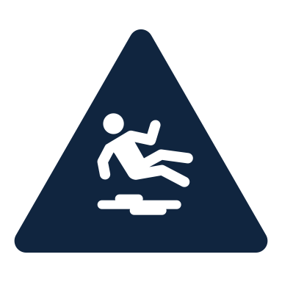
Common Opioid Side Effects⁴
Feeling Tired,
Feeling Groggy
Confusion,
Memory Difficulties
Slow Reaction Times,
Falls and Accidents
Sweating,
Itching Skin
Constipation,
Bladder Issues
Nausea,
Vomiting
Sexual Issues
Take to your pharmacist if you experiencing side effect(s).
It may be a sign to try a lower dose or different medication.
Notes:
These are examples of common side effects associated with opioids. Some important ones to be aware of:
Confusion/memory difficulties: especially important as people age and memory is impacted even without opioids
Slow reaction times (resulting in falls/accidents): this has been found to happen even when people don’t feel tired/slower
Sexual issues: can manifest as lower sex drive or difficulties having sex to completion
If you experience these, talk to your pharmacist to see how they can be managed (e.g., with lifestyle changes) or by lowering the dose or trying a different medication.
Managing side effects in general was addressed in session two. The next few slides will focus on these side effects when specifically caused by opioids.
To help answer questions that may arise:
Sweating:
-Due to opioids affecting the regulation of body temperature
Lifestyle
Wear clothing made out of breathable fabrics (e.g. cotton, linen)
Avoid wearing polyester and fleece
Avoid spicy foods and alcohol
Avoid exercising in hot weather
Medications
Antiperspirants (e.g. 12-20% aluminum chloride)
Pads with glycopyrrolate (available commercially)
Prescription: Oxybutynin
Itching:
-Due to opioids causing a chemical (i.e. histamine) release that can result in itching
-Non-drowsy anti-histamine (Claritin - loratadine), non-pharms (cut nails, fragrant free, menthol creams, lotion, cold compress, oatmeal lukewarm bath)

Slide 22
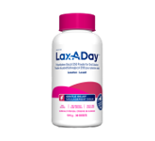
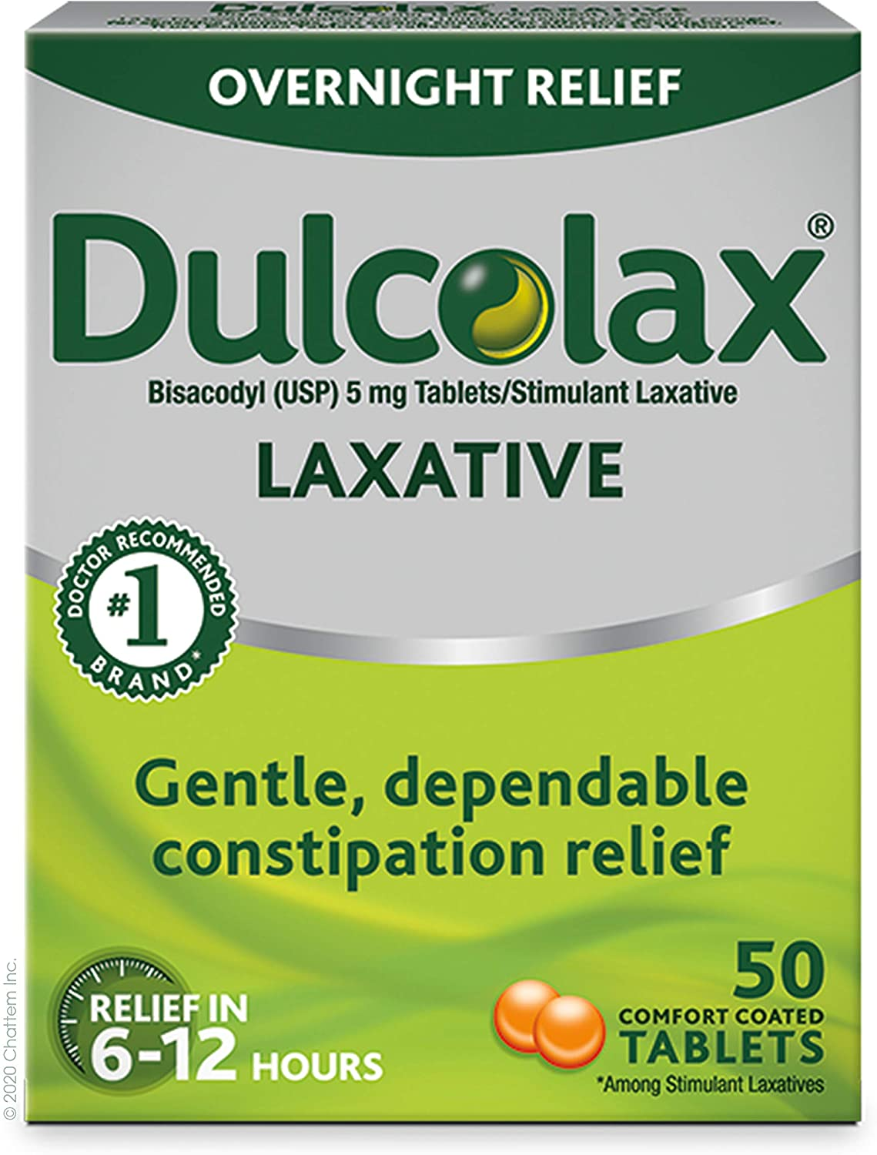
Medications for Opioid Constipation¹¹
 | Stimulants |  | Osmotic Laxatives
Example | Sennosides | Bisacodyl | PEG 3350
Dose | 2 tablets daily at bedtime | 5 – 10 mg daily at bedtime | 17 grams (capful) once daily
Onset | 6 – 12 hours |  | 2-4 days
Side Effects | Stomach pain, cramps, diarrhea, discolored urine (sennosides) |  | Bloating, stomach upset, diarrhea
Images 6 - 8
Notes:
While we’ve reviewed managing constipation in general, the specific laxatives to address opioid-related constipation are highlighted on this slide. Opioid-related constipation happens because opioids slow down the movement of the digestive tract (like how it stops messages about pain, it stops messages about intestine movements). The family of laxatives that help for opioid-related constipation are:
Stimulants: increase muscle contractions in the intestine to help bowel movements move through the body
Osmotic Laxatives: helps the intestines keep water in it so that there’s more pressure in the intestine to promote movement

Slide 23
Opioid Side Effects
Opioid-Induced Hyperalgesia¹²
Due to opioids increasing nociceptor sensitivity
Opioid-Induced Central Sensitization¹³
Increases sensitivity to pain
Due to opioids increasing nociceptor excitability
Increases sensitivity, intensity, and location of pain
Take to your pharmacist if you experiencing side effect(s).
These side effects can be addressed by lowering the opioid dose or changing the opioid
Notes:
On top of the common side effects we’ve reviewed, there are unique side effects with opioids. They’re counter-intuitive, because we think pain medications and opioids should help with pain, but sometimes (especially when used for long amounts of time or at higher doses) actually worsen pain.
Allodynia: things that don't usually cause pain now do
Opioid-induced hyperalgesia:
Analgesic and anti-inflammatory effects of opioids are subsequently associated with upregulation of compensatory pronociceptor pathways. More pathways then results in more pain signals being transmitted and increased sensitivity to pain.
Caused by opioids increasing the sensitivity on cells that detect and send pain information.
This leads to increased sensitivity to pain and feeling more pain than usual as well as pain to nonpainful stimulus
Central sensitization:
Increase of excitability of spinal cord neurons – more susceptible to peripheral inputs and respond more strongly to stimulation. This applies to the injured/inflamed region and those adjacent and remote (diffuse/widespread pain)
Caused opioids increasing how excitable the cells that detect and send pain information are.
This leads to increased intensity of pain when a painful stimulus is detected.
These side effect are often addressed by lowering the opioid dose or changing the opioid.

Slide 24
Lowering Opioid Doses ^{4,14,15}
 | By Tapering | By Rotating
What It Is | Slowly lowering the dose | Changing to a different opioid
How It’s Done | Highly individualized plan May take weeks to months | Stop current opioid, start new opioid at a lower dose because there isn’t the same tolerance
Why It’s Done | Many reasons including: Side effects Hyperalgesia Central sensitization | Many reasons including: Side effects Hyperalgesia Central sensitization Address tolerance Low benefit from current opioid
Notes:
A technique to address side effects, like hyperalgesia and central sensitization, is to lower opioid doses. This can be done in two ways:
Tapering: gradually lowering the dose over a period of time (e.g., by 10-15% every few weeks)
Rotating: changing to a different opioid which lets use lower the equivalent dose by a bigger amount (e.g., 25 – 50%) because of the lack of tolerance to the new medication
Some people see rotating opioids as a “Head start” on tapering regimen
As you switch to a new opioid, you are able to more quickly lower the equivalent dose so there can be less tapering involved later

Slide 25
Opioid Safety
Notes:
While still related to opioid side effects, we’ll now focus on the side effects that can be especially harmful and how to lower risk of harm

Slide 26
Tips to Improve Opioid Safety
Use the lowest effective dose
Keep an eye on increasing doses
Only use opioids prescribed to you at that time
Store opioids out of reach and return unused opioids
Ensure you have a naloxone kit
Consider therapy if you notice signs of dependence
OAT = Opioid Agonist Therapy
Notes:
To improve opioid safety, the following techniques can be used:
Use the lowest effective dose
Remember that lowering pain by 30% is what we consider effective so we wouldn’t increase the dose further. If the opioid isn’t achieving this, consider stopping it
Keep an eye on increasing doses
This can be a sign of tolerance and while tolerance builds to pain benefit, higher doses increase the risk of side effects like trouble breathing and opioid poisoning
Only use opioids prescribed to you at that time
In the future, if you have pain it’s important that a healthcare provider see you to assess the reason for pain and what treatment is most appropriate vs. using existing opioids
Store opioids out of reach of kids and pets and return unused opioids to the pharmacy
There are many stories of family members with opioid use disorders starting with trying a family members opioids
Ensure you have a naloxone kit and are trained on how to use it in the event of opioid poisoning
Consider opioid agonist therapy if you notice signs of dependence (can lower cravings and help with recovery)

Slide 27
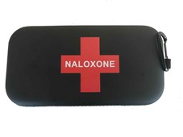
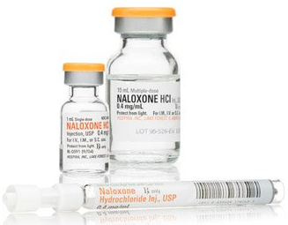
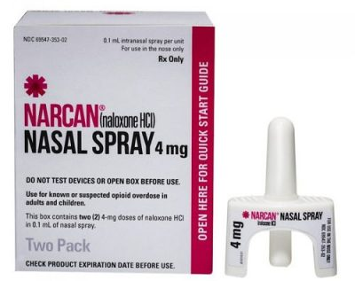
Naloxone⁴
Life-saving agent that can temporarily reverse the effects of opioid poisoning. Still need to call 911.
Everyone who takes opioids should have a naloxone kit at home and have people around them trained on use
Training and kits available at no cost and without a prescription from community pharmacies
Images 9 - 11
Notes:
As we talked about on the last slide, it’s important that everyone have a naloxone kit in case of opioid poisoning (for themselves or a loved one)/
Naloxone is a life-saving agent that reverses the effects of opioid toxicity for short amounts of time, so people can be brought to the hospital for treatment (so still call 911)
It works by competing with opioids to block it from attaching to the receptors throughout the body, including the ones involved in lowering signals for the body to breath. By kicking the opioids off the receptor, the signals to breath increase again
BC has a take home naloxone program which provides training in overdose prevention, recognition and first aid response. Visit your community pharmacy for a kit and training.

Slide 28
Opioid Poisoning^{8,16}
Opioids can slow down breathing, which can be fatal
Can happen to anyone
Risk factors change over time and include:
Age (> 65 years)
Other medications (e.g., sleeping pills)
Medical conditions (e.g., asthma/COPD/sleep apnea)
Opioid dose
Image 12
Notes:
Here’s a slide outlining when to administer naloxone – specifically when someone is experiencing opioid poisoning. A reminder that this can happen to anyone, including people taking prescription opioids exactly as prescribed or people who get confused and accidentally take more than prescribed.
There are some risk factors that increase the changes of experiencing opioid poisoning. These include:
Getting older (age over 65 years)
Taking other medications that also lower breathing rates or cause sedation (e.g., sleeping pills)
Having other medical conditions that impact breathing (e.g., asthma, COPD, sleep apnea)
Opioid doses (higher doses tend to have higher risks, especially over 90 mg morphine equivalents)
Opioid poisoning might look like:
Not moving or can’t be woken up
Slow or absent breathing, blue nails or lips
Chocking, gurgling sounds or snoring
Cold or clammy skin and tiny pupils

Slide 29
Group Discussion
Q1: Are you surprised by any of these side effects?
Q2: Do you have a naloxone kit at home?
Notes:
Let’s pause here for group discussion.
If you don’t have a naloxone kit but have someone in your household who takes opioids, I strongly recommend you visit your local community pharmacy who can train you on the use of naloxone and provide you with a free naloxone kit

Slide 30
Key Take-Aways
Opioids should be tried after non-drug and non-opioid treatments have been tried
Opioids should be used at the lowest dose possible. Use should be regularly re-evaluated
Lowering an opioid dose or changing to a new opioid can address side effects and ongoing pain
Everyone taking opioids should have naloxone
Notes:
To wrap-up today’s session, here are some key take-aways:
Opioids should only be tried after non-drug and non-opioid treatments have been exhausted
Opioids should be used at the lowest dose possible, use should be re-evaluated every 6-12 months to make sure the benefits still outweigh the harms, and they should be stopped if not
Side effects are common with opioids and can include hyperalgesia (being more sensitive to pain signals) or central sensitization (experiencing more intense pain signals). Talk to your pharmacist if side effects happen as it may mean it’s time to change to another medication (opioid or non-opioid) or to try lowering the opioid dose (by tapering or rotating)
Everyone who takes opioids (including those who take prescription opioids as prescribed) should have naloxone kits and be trained on how to use them (and have people around them trained)

Slide 31
Debrief of Today’s Session
Feedback
Any suggestions for future group appointments?
Notes:
That’s the last bit of our content for today and for our sessions! Feel free to share any suggestions for future group appointments.

Slide 32
[INSERT INFORMATION ABOUT YOUR CLINIC/OFFICE AND SERVICES OFFERED]

Slide 33
Reflection Questions
Q1: What's one thing you learned or will take-away from the group appointments?
Q2: How has your outlook on chronic pain changed over the past 3 sessions?
Notes:
Before you go, here are two questions to reflect on. You can share your responses or keep them for your mind to think about.

Slide 34
Additional Resources
Resources about opioids (e.g. common questions answered, risks and benefits of opioids)
Dr. Mike Evans' Best Advice for People Taking Opioid Medication (11 min video) : https://www.youtube.com/watch?v=7Na2m7lx-hU
CAMH Prescription Opioids: https://www.camh.ca/-/media/files/guides-and-publications/dyk-prescription-opioids.pdf
CDC: https://www.cdc.gov/opioids/patients/index.html
ISMP (click “Patients and Families”): https://www.ismp-canada.org/opioid_stewardship/
Naloxone
Learn how to administer: https://towardtheheart.com/naloxone-lesson/
Find a site that offers naloxone kits: https://towardtheheart.com/site-finder
Learn about naloxone nasal spray: https://www.narcan.com/patients/patient-resources
Patient stories
CDC: https://www.cdc.gov/rxawareness/stories/index.html
Liftthelabel: https://liftthelabel.org/
Resources and support for opioid use disorders
Government of BC: https://www2.gov.bc.ca/gov/content/mental-health-support-in-bc/addictions-alcohol-and-other-substances
CAMH OAT: https://www.camh.ca/-/media/files/oat-info-for-clients.pdf
Notes:
Here are some resources about opioids and related side effects. Let me know if you would like me to email any to you.

Slide 35
References
Centre for Addiction and Mental Health. Prescription Opioid Policy Framework. Toronto (ON): Centre for Addiction and Mental health; 2016.
American Society of Anesthesiologists. What are opioids [Internet]. [Cited 2021 Oct 13]. Available from: https://www.asahq.org/madeforthismoment/pain-management/opioid-treatment/what-are-opioids/
Centre for Effective Practice. Management of Chronic Non-Cancer Pain (CNCP). Toronto (ON): Centre for Effective Practice; 2018.
RxFiles Drug Comparison Charts – 13th Edition. Editors Brent Jensen, Loren Regier. Sasakatoon, SK: Saskatoon Health Region; 2021. Available from www.RxFiles.ca
Center for Substance Abuse Treatment. Managing Chronic Pain in Adults With or in Recovery From Substance Use Disorders. Rockville (MD): Substance Abuse and Mental Health Services Administration (US); 2012. (Treatment Improvement Protocol (TIP) Series, No. 54.) 3, Chronic Pain Management. Available from: https://www-ncbi-nlm-nih-gov.ezproxy.library.ubc.ca/books/NBK92054/
Centre for Addiction and Mental Health. Opioids and addiction – A primer for journalists. Toronto (ON): Centre for Addiction and Mental Health; 2016.
Shah M, Huecker MR. Opioid Withdrawal. [Updated 2021 May 21]. In: StatPearls [Internet]. Treasure Island (FL): StatPearls Publishing; 2021 Jan-. Available from: https://www-ncbi-nlm-nih-gov.ezproxy.library.ubc.ca/books/NBK526012/
World Health Organization. Opioid overdose [Internet]. [Updated 2021 Aug 04, cited 2021 sept 25]. Available from: https://www.who.int/news-room/fact-sheets/detail/opioid-overdose
Health Quality Ontario. Opioid Prescribing [Internet]. [Cited 2021 Oct 13]. Available from: https://opioidprescribing.hqontario.ca/
Fine PG, Mahajan G, McPherson ML. Long-acting opioids and short-acting opioids: appropriate use in chronic pain management. Pain Med. 2009 Jul;10 Suppl 2:S79-88.
Chaun H, Andrews AN, Woo M. Constipation in Adults. In: Therapeutics [Internet]. Ottawa (ON): Canadian Pharmacists Association; c2016 [updated 2021 Apr 14; cited 2021 Sept 19]. Available from: http://www.myrxtx.ca. Also available in paper copy from the publisher.
Lee M, Silverman SM, Hansen H, Patel VB, Manchikanti L. A comprehensive review of opioid-induced hyperalgesia. Pain Physician. 2011 Mar-Apr;14(2):145-61.
Schaible HG and Richter F. Pathophysiology of pain. Langenbecks Arch Surg. 2004;389:237-243.
Centre for Effective Practice. Opioid Manager.. Toronto (ON): Centre for Effective Practice; 2017.
Bhatnagar M, Pruskowski J. Opioid Equivalency. [Updated 2021 Sep 14]. In: StatPearls [Internet]. Treasure Island (FL): StatPearls Publishing; 2021 Jan-. Available from: https://www-ncbi-nlm-nih-gov.ezproxy.library.ubc.ca/books/NBK535402/
Centers for Disease control and Prevention. Preventing an opioid overdose[Internet[]. Atlanta (GA): Centers for Disease control and Prevention. [Cited 2021 Sept 19]. Available from: https://www.cdc.gov/drugoverdose/pdf/patients/Preventing-an-Opioid-Overdose-Tip-Card-a.pdf
Centre for Addiction and Mental Health. Making the choice, Making it work – Treatment for Opioid Addiction. Toronto (ON): Centre for Addiction and Mental health; 2016

Slide 36
Image References
Image 1: medicurio, 2019
Image 2: PainCalculator, 2023
Image 3: OpioidPrescribing, 2017
Image 4: RawPixel, 2023
Image 5: ChooseOpioid, 2008
Image 6: SenokotTablets, 2019
Image 7: DulcolaxLaxativeTablets, 2023
Image 8: LaxADayLaxativePowder, 2023
Image 9: Naloxone, 2019
Image 10: Hospira, 2023
Image 11: NarcanNasalSpray, 2023
Image 12: NaloxoneBrochure, 2023
Image 13: Methadose, 2021
Image 14: AAP, 2017
Image 15: Suboxone101, 2018

Slide 37
Thank You!

Slide 38
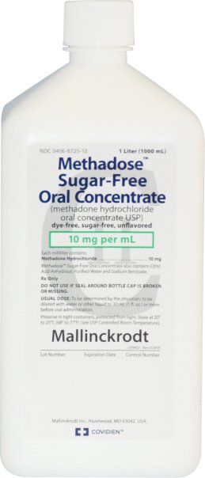
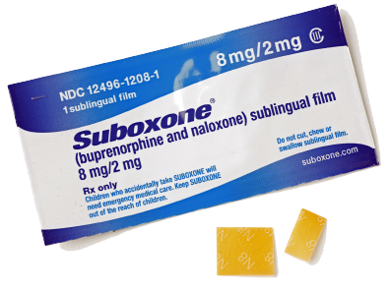
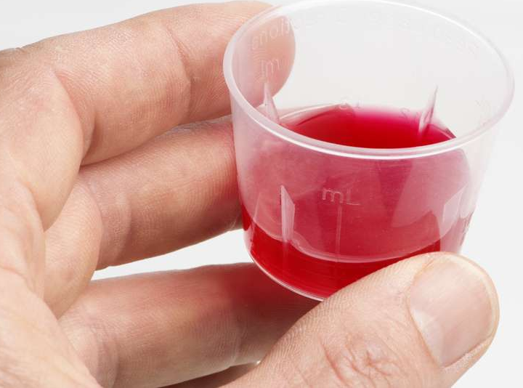
Appendix: Opioid Agonist Therapy (OAT)¹⁷
Can help if opioid dependence develops
Prevents physical and psychological withdrawal from opioids to help with stopping them and lowering risks
Medications may also be used for pain management
Methadose® (Methadone)
Suboxone® (Buprenorphine/Naloxone)
Images 13- 15
Notes:
https://www.camh.ca/-/media/files/oat-info-for-clients.pdf
https://www.camh.ca/-/media/files/guides-and-publications/making-choice-en.pdf
Treatment for opioid dependence:
- These are longer acting opioid drugs used to replace shorter-acting opioids

Slide 39
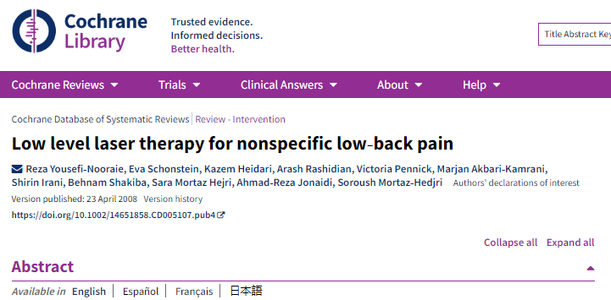
Questions from Past Sessions
Evidence evaluating low level laser therapy
Lowered pain level on a scale but didn't provide meaningful pain relief
Wasn't better than exercise alone for lowering pain or disability
No side effects reports
Very small study sizes, methods of studies limited
Notes:
Question: low level laser therapy for low-back pain and in osteoarthritis
Providers: can't speak to quality
1. https://www.vancouverphysiotherapyhub.com/sports-physiotherapy/low-level-laser/?campaignid=18082033147&adgroupid=&keyword=&device=c&gclid=CjwKCAiAvK2bBhB8EiwAZUbP1P28qYzqVuA2YT86xqiwAkfGp0-T9U3Qp3UY3PYEy12oGzGR4VFduBoCDH8QAvD_BwE
2. https://acubalance.ca/low-level-laser-therapy/?matchtype=p&keyword=cold%20laser%20therapy%20vancouver&device=c&adposition=&network=g&gclid=CjwKCAiAvK2bBhB8EiwAZUbP1P8DVN3PSbG5m-LEzADwoari8MMsAxp3HflSp5sRwQ-JSo1AqGgAuxoCMIsQAvD_BwE
Very small studies that didn't find clinically important differences in low back pain – benefit likely more from exercise than low level laser therapy but well tolerated – or osteoarthritis (no effect on pain)
Evaluations/evidence specific to low back pain
Low level light therapy in low-back pain:
-statistically significant but clinically unimportant pain relief compared for chronic low back pain at short term and intermediate term follow up (up to six months).
-in one study LLLT was more effective than sham at reducing disability in the short term
-LLLT or the addition of LLLT to exercise was not better than exercise alone, with or without sham in reducing pain or disability in the short term.
-the relapse rate in the LLLT group was significantly lower than in the control group at the six-month follow up. No side effects were reported.
In osteoarthritis and RA:
-https://pubmed.ncbi.nlm.nih.gov/10955339/
-may provide short term reflief of pain and morning stiffness in RA
-conflicting results in OA, pooled estimate found no effect on pain
-effectiveness of LLLT is affected by 4 factors: wavelength, treatment duration of LLLT, dosage, and site of application over nerves instead of joints

Slide 40
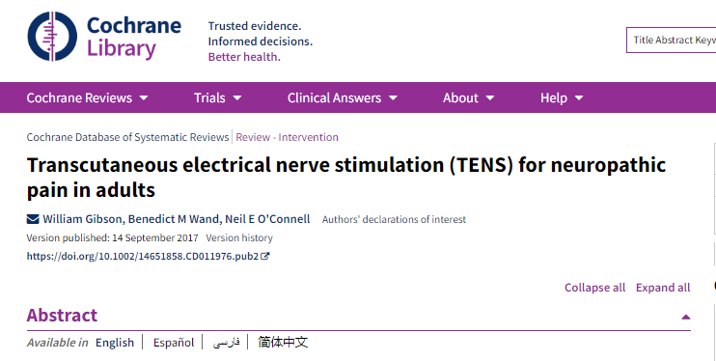
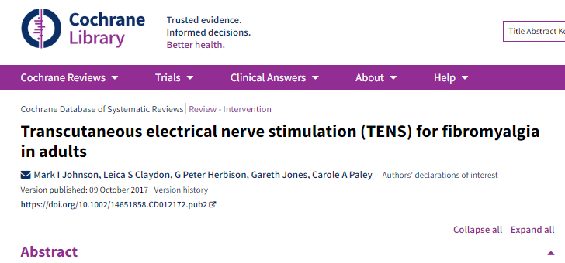
Questions from Past Sessions
Evidence evaluating TENS
(transcutaneous electrical nerve stimulation)
Lowered pain intensity by a noticeable difference
Five studies on impact of TENS on pain intensity
Low quality evidence, Low confidence in results
Lowered pain intensity when moving
One study found improvements in stiffness, work performance, fatigue, mood when used with exercise
Very small study sizes, Conflicting findings
Notes:
TENS:
- small battery-powered devices deliver alternating current via electrodes placed on the skin near the painful area
- MOA: reduces pain by inhibiting nerve pain signals
- pulse frequency and pulse intensity are adjustable – either low or high intensity can be used
Overall: limited studies with conflicting results but some have found meaningful lowering of pain intensity for a variety of pain types without significant safety risks
- evidence: small trials with a variety of types of patients so difficult to make any conclusive recommendation
- safety: side effects are typically minor and limited (skin irritation around the site of application, minor discomfort)
Evidence:
- low back pain: some evidence that it helps lower pain intensity but doesn't improve functioning (https://www.cochranelibrary.com/cdsr/doi/10.1002/14651858.CD005107.pub4/full)
- neck pain: appears more effective than placebo (https://www.cochranelibrary.com/cdsr/doi/10.1002/14651858.CD004251.pub5/full)
- diabetic nerve pain: may lower pain intensity
SIGN guidelines: https://www.sign.ac.uk/assets/sign136.pdf
CEP: https://tools.cep.health/tool/management-of-chronic-non-cancer-pain/#references
Reference:
-Cochrane nerve pain: https://www.cochranelibrary.com/cdsr/doi/10.1002/14651858.CD011976.pub2/full
-Cochrane fibromyalgia: https://www.cochranelibrary.com/cdsr/doi/10.1002/14651858.CD012172.pub2/full

