Slide 1
Session 1: Introduction to Parkinson’s Disease
Facilitator: [INSERT NAME HERE]
[INSERT DATE & TIME HERE]
NOTICE: This slide deck intended for educational purposes only and you are encouraged to adapt this slide deck to suit your clinic, services and community.
This slide deck was created in 2022 at the UBC Pharmacists Clinic by Dr. Tiana Tilli, PharmD, RPh, ACPR with the help of Rebecca Leung E2P PharmD 2023
Notes:
Slides created by: Tiana Tilli, PharmD, RPh, ACPR and Sonia Sharma, BSc, E2P PharmD 2024

Slide 2
Land Acknowledgement
[We invite you to create a land acknowledgement to recognize the traditional, ancestral, and unceded land that your office/clinic is located on]​

Slide 3
Welcome!
What are Pharmacist-led Parkinson’s Disease Group Appointments?
What can you expect at each session?
Notes:
Session Outline:
Introductions
Education session
Group discussion
Debrief
End-of-session "homework"

Slide 4
Timeline
Session 1
Today
Introduction
[60 mins]
Session 2
Motor Symptoms
[60 mins]
Session 3
Non-Motor Symptoms
[60 mins]

Slide 5
Agenda
Parkinson’s Disease
Symptoms & Side Effects
Non-Drug Measures
Natural Health Products
“Homework”

Slide 6

Zoom Features
Turn mic on/off
Share Screen
Turn video on/off
Chat box
Raise Hand
Leave
meeting

Slide 7

Image 1​
Notes:
Go around and introduce yourselves:
Name – tell us the history or story behind your first or last name?
What you hope to gain from these group appointments

Slide 8

Ground Rules
Image 2
Notes:
Now we’ll move onto setting some ground rules for the rest of this session today. I’ll explain the first one but feel free to call them out as you think of them. As rule #1
Facilitator is allowed to park individual-specific questions
out of respect to other members of the group - some questions may be too specific and should be reserved for one-on-one appointments/a later time. (to ensure that the conversation doesn’t go off on tangents)
Other examples:
No talking over others
Allow everyone the opportunity to contribute and speak
Confidentiality
Try to keep your camera on to create a sense of togetherness. If you need to turn off your video (e.g., step away for a moment)
Please keep yourself muted to avoid background noise, but unmute yourself when adding to the group discussion
Raise your hand if you have a question or want to respond to a group discussion point
If you ever leave the appointment by accident, you can re-join at the link provided and we'll re-admit you
The chat box is off, but we're open to questions or comments by raising hand and adding verbally

Slide 9
Parkinson’s Disease
Notes:
So, we are going to start with an overview on Parkinson’s Disease, which you might hear us abbreviate as PD from here on.

Slide 10
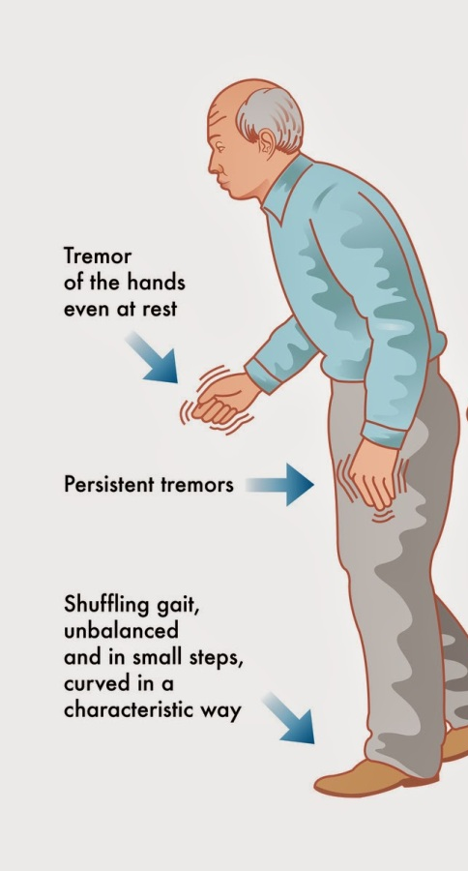
Parkinson’s Disease (PD)
What is PD?
A progressive movement disorder¹
Parts of the brain controlling movement aren’t working properly ¹
Why does this happen?
Brain cells that make dopamine, a chemical messenger, become damaged and die¹
Less dopamine in the brain leads to decreased dopamine signals and responses by the body and ultimately symptoms¹
Image 3
Notes:
Ok, so, what is Parkinson’s Disease? Well It’s a chronic and progressive movement disorder – this means that parts of the brain that control movement aren’t actually functioning properly. Presentation can be very different and each person can progress at significantly different rates
Now why does this happen? Well – brain cells make a chemical in the body called dopamine. Dopamine acts like a messenger in our bodies, kind of like how a pigeon can carry a letter or message to someone. So what dopamine does is that it takes this message and tells our body how to control movements.
With Parkinson’s, the cells that make dopamine become damaged and die, and you’re essentially left with less dopamine in the brain. This leads to less dopamine signals in the body and less response by the body ultimately leading to motor and non-motor symptoms.
With less dopamine in the brain, you’ll get less dopamine messages sent throughout the body, which leads to less movement and ultimately, this is where the motor and non-motor symptoms of PD stem from.

Slide 11
True/False
The exact cause of all cases of Parkinson’s Disease is well known.
FALSE
Notes:
Please note this slide is animated and TRUE / FALSE will show on click
So we have a quick True or False statement here – The exact cause of Parkinson’s Disease is well known. Feel free to Take a few moments to think about it this and if you would like to share your thoughts, please use the raise hand function.
The correct answer is FALSE. Research hasn’t exactly found out the exact answer as to what causes PD.
What we do know is that there may be more than 1 potential cause; these include
Genetic factors (so that means inheriting an abnormal gene from one or both parents)
Environmental factors – so having constant or long-term gradual exposure to chemicals or toxins that you might find outdoors such as pesticides
And lastly Lifestyle – probably not the first time you’ve heard this but, a lack of exercise does have an impact on your health, and we’ll covering this in more detail later on
Now just a note that these aren’t exclusive causes, because most likely, it’s a combination of these factors over time which lead to complications and SOMETIMES these factors ARE PRESENT but SOMETIMES they’re NOT

Slide 12
Symptoms & Side Effects
Notes:
Many people with PD experience symptoms and side effects that can be hard to distinguish from each other. I'll provide an overview of what common symptoms and side effects are and which could be either.
When we think about:
SYMPTOMS
Signs of a condition
Take medications to relieve symptoms
SIDE EFFECTS
Unwanted reactions to a drug
Possible with all medications
BOTH: Individual response differs

Slide 13
Symptoms of Parkinson's Disease
Motor ^{2,3,4}
Tremor
Rigidity
Slow movement
Poor balance + posture
Dystonia (muscle twisting)
Non-Motor ^{2,3,4}
Drooling, runny nose
Constipation
Muscle stiffness
Feeling tired
Sleep difficulties
Memory + mood changes
Bladder + sexual issues
Low blood pressure
Aches + pains
Restless leg syndrome
Hallucinations
Speech, swallowing issues
Notes:
With regards to Parkinson's Disease, there are two categories of symptoms (motor – those having to do with movement, and non-motor – non-movement related). We'll go into details on these and potential treatment options in session 2 and 3 but for today I'll provide a high level overview.
Motor symptoms can include:
Tremor – often a resting tremor (appears in the limb when not in motion, asymmetrical – one side of the body. Tends to be in the upper extremities – fingers, thumbs – more so). Can be described as shakiness or nervousness. Emerges with stress, anxiety, or fatigue.
Dystonia – muscle twisting
-involuntary muscle contractions that cause slow repetitive movements or abnormal postures.
Non-motor symptoms:
-can often happen even before motor symptoms happen
-large variety

Slide 14

Side Effects of Parkinson's Medications
Common Side Effects ⁵
Nausea, vomiting
Constipation
Memory + mood changes
Hallucination
Feeling tired
Sleep difficulties
Low blood pressure
Impulse control issues
Dyskinesia (involuntary movements)
Dry mouth
Image 4
Notes:
Different medications have different side effects (which we'll review in session #2), but some common side effects include (read slide)
Dyskinesia are involuntary, erratic, writhing movements of the face, arms, legs or trunk. They are often fluid and dance-like, but they may also cause rapid jerking or slow and extended muscle spasms.

Slide 15
Symptoms^{2,3,4}
Symptoms vs Side Effects
Side Effects⁵
Dystonia, Tremor
Poor balance, posture
Rigidity, stiffness
Slow movement
Aches + pains
Restless legs
Drooling, runny nose
Speech, swallowing issues
Bladder, sexual issues
Memory changes
Mood changes
Hallucinations
Feeling tired
Sleep difficulties
Low blood pressure
Constipation
Dyskinesia
Impulse control issues
Dry mouth
Nausea, vomiting
Notes:
You may have noticed, that there were some items that popped up as both symptoms and side effects – they can be both (which often makes addressing them difficult – but we'll review in a couple slides how to differentiate).
There is significant overlap (meaning it could be a symptom or side effect) for ….

Slide 16
Identifying Symptoms vs Side Effects^{6,7}
Onset:
Before starting medication
= Symptom
After new medication added
= Side effect
Timing:
Feel worse before next dose or if missed dose
= Symptom
Feel worse after administration or with higher doses
= Side effect
Progression:
Worsens over time
= Symptom
Improves over time
= Side effect
Notes:
Keep in mind that PD is a progressive condition and so new symptoms may present over time that aren't due to medications.
When trying to differentiate, it can be helpful to break the "investigation" down by onset, timing, and progression. (Read Slides)
- We’ll talk more about symptoms (motor vs non-motor) during the following sessions!

Slide 17


Dystonia vs Dyskinesia
Face →
Neck→
Limbs
Foot →
Eyes
Vocal Chords
Torso
← Head
← Arms
← Trunk
← Legs
Images 5 - 6
Notes:
Here’s an example for identifying signs vs. Symptoms.
To differentiate between Dystonia and Dyskinesia
-think about which areas of the body are being impacted
-what kind of movement it is
-Dystonia:
-eyes, face, neck, vocal chords, torso, limbs, foot
-involuntary muscle contractions that cause slow repetitive movements or abnormal postures.
-Dyskinesia:
-head, arms, trunk, legs
-rapid jerking or slow and extended muscle spasms.
Image credit: https://www.verywellhealth.com/dystonia-vs-dyskinesia-in-parkinsons-2612238
https://www.parkinson.org/Understanding-Parkinsons/Symptoms/Movement-Symptoms/Dystonia
https://www.parkinson.org/Understanding-Parkinsons/Symptoms/Movement-Symptoms/Dyskinesia

Slide 18

Group Discussion
Q1: What is a symptom you are currently experiencing or have experienced in the past?
Q2: What is a side effect you are currently experiencing or have experienced in the past?
What helped the symptom or side effect?
Image 7
Notes:
Q1
Q2: not sure if we want to keep this question here or save for next presentation.
Follow-Up questions:
Are there any similarities in your group? What about differences?

Slide 19
Non-Drug Measures
Notes:
Okay, so we are now going to talk about some things that are available to you that doesn’t include the use of medications to help manage life with Parkinson’s.

Slide 20
Allied Health Professionals
Physiotherapy
Help you stay active^{1,2,5}
Occupational therapy
Help with daily activities^{1,2,5}
Speech therapy
Help with voice and swallowing^{1,5}
Social worker
Support you throughout changes^{1,5}
Pharmacist
Help with medications and side effects^{1,2,5}
Dietician
Help you eat healthy and address symptoms^{1,5}
Images 8 - 13
Notes:
Allied Health Professionals. IN ADDITION TO your regular physician AND SPECIALIST, there are so many different professionals out there that specialize in different areas, and you might find most benefit when you see or talk to more than one.
Starting at the top left, we have physiotherapy. A physiotherapist can be helpful at all stages of PD – they specialize in coming up with exercise routines and movements help with mobility, posture, pain, balance and overall your quality of life.
Next up we have Occupational therapy – an occupational therapist is there to help you with daily activities including taking care of yourself, or helping you with other aspects of your life such as work or hobbies. Essentially, they want to help maintain your independence and they do this by identifying your life goals and designing strategies that will help you reach them.
A speech therapist works similarly – they will identify your communication goals and help you maintain a clear voice. In addition to speech, they can help manage issues with swallowing, eating or even drooling.
On the bottom left – we have a social worker – they work in all types of settings, including from the comfort of your own home. They specialize in making connections with you to help you navigate through a difficult time in your life.
One of the most accessible health care professionals is a pharmacist. A pharmacist can help you get the most out of your medications and provide reliable medical advice and recommendations– so this includes helping you identify side effects and drug interactions, and providing guidance on how to manage them.
Last up here we have a dietician. We’ll be talking about the importance of well-balanced diet shortly, but essentially a dietician is someone who can help come up with a healthy meal plan, address any symptoms associated with your diet, so like constipation for example, and identify any food related interactions with your current medications.

Slide 21
Physical Activities
Biking
Brisk Walking
Tai chi
Yoga
Dance
Pilates
Weight training
Aim to do activities from each category on 2-3 days per week for 30 minutes
Start at mild-moderate intensity and increase as you progress^{1,8,9,10,11}
= aerobic
= balance/agility
= strength
Images 14 - 20
Notes:
Here we have listed some examples of physical activities that have good evidence for benefit for people living with Parkinson’s.
Highlighted green, we have aerobic activities including biking, brisk walking and dance.
In orange, we have tai chi and yoga that are good for balance, agility or flexibility.
And in purple, we have strength-related physical activities including Pilates and weight training.
Your routine should include activities of each type, so aerobic, balance or agility and strength, and you should be aiming to do these activities on 2-3 days per week for 30 minutes or so. Usually we suggest starting slow and increasing intensity when you get more comfortable with the movements.

Slide 22
Benefits of Physical Activity
Physical benefit
Help movement, walking, balance¹⁰
Help sleep, mood, memory¹⁰
Emotional benefit
Help mood¹⁰
Feel connected
Feel support¹⁰
Medication benefit
Improve how medications work¹⁰
Help reduce side effects¹⁰
Notes:
So as I was saying, There is evidence that regular physical activity can provide benefit to people with PD.
Physical benefit includes improving motor and non-motor symptoms of PD – so things like improving how far you can walk, your balance, and even improve sleep, mood and memory
Emotional benefits include building connection with the community. – so physical activity isn’t something that you have to do alone, you can enroll in local classes, socialize and feel well supported and have fun with your peers
Regular physical activity has also shown to improve how well medications work, as well as help reduce side effects or make them more tolerable

Slide 23

Healthy Eating
Different groups help to maintain energy, protein, vitamins, fiber intake^{12,13}
Grains, vegetables, fruit help lower fat intake^{12,13}
Reduce sugar, salt, fat, cholesterol, and alcohol^{12,13}
Be mindful of protein and medication timing^{12,13}
Image 21
Notes:
Alright, now let’s talk about healthy eating.
A healthy diet should be balanced with physical activity.
This plate that we have pictured here is a good example of what you should be aiming for in terms of daily meals
Ideally, half of the plate should be fruits and veggies (so like your berries, broccoli, peas or spinach for example,
a quarter of the plate should be protein (such as lean turkey, chicken breast, beans or lentils)
and the last quarter should be whole grains, such as whole wheat pasta, rice or quinoa
These different food groups is what gives our bodies energy and the proper vitamins & nutrients we need to keep going
Some important things to keep in mind for a well-balanced meal is that you should be mindful of how much sugar, salt, fat & cholesterol there is –
Sugar doesn’t really have that many nutrients, and salt can contribute to high blood pressure
A low fat diet can help decrease the risk of heart attack and help maintain a healthy body weight so its best to reduce your intake of these
Alcohol should be kept at a minimum and water should be your drink of choice
Another important consideration is the timing of high protein meals with Parkinson’s medications like levodopa – high proteins can actually reduce how well the medication works or how long it takes to work. It’s important to be mindful of this and to space out these large protein meals, such as a chicken dinner, with the medication by at least 40-60mins (e.g., take medication 30-60 min before meal or protein-rich food such as milk, eggs, or peanut butter). Maintain a diet with steady amounts of protein and can adjust medication doses accordingly.

Slide 24

Lifestyle Measures for Brain Health^{14,15}
Physical Activity
Good Sleep
Quit Smoking
Healthy Eating
Active Mind
Notes:
One of the symptoms we talked about is that u might have memory issues, so these are some measures u can put in place to prevent your memory from getting worse and keeping your brain healthy:
Like we spoke about on the last couple of slides, physical activity and healthy eating both contribute to a healthy mind and can prevent brain symptoms such as dementia
Activities that engage the mind is a way to keep your brain functioning properly as well and can actually delay symptoms like dementia
Some activities that keep your mind active include reading, doing puzzles, learning new activities, or even learning a new language if you’re up for it
Good sleep helps the body and brain function properly as well, and proper sleep is essential for good memory too
Some recommendations for having a good sleep include making sure your bedroom is dark and quiet, turning off or removing any electronic devices from your room, and avoiding caffeine and alcohol before bedtime
You want to aim for about 7-9 hours of sleep each night and making sure you’re consistent with it
Lastly, to put it simply - smoking is not good for your brain. By quitting smoking, you can reduce the risk of developing dementia.
PHARMACISTS CAN HELP U with this - THERE ARE Medications THAT INCREASE LIKELIHOOD OF BEING SUCCESSFUL.
Again, we want to highlight that all of these lifestyle measures is something that you should be incorporating together and regularly

Slide 25
Natural Health Products

Slide 26
True/False
Prescription medications don’t interact with natural health products
Drug interactions are possible with anything you consume
FALSE
TRUE
Notes:
Please note this slide is animated and TRUE / FALSE will show on click

Slide 27
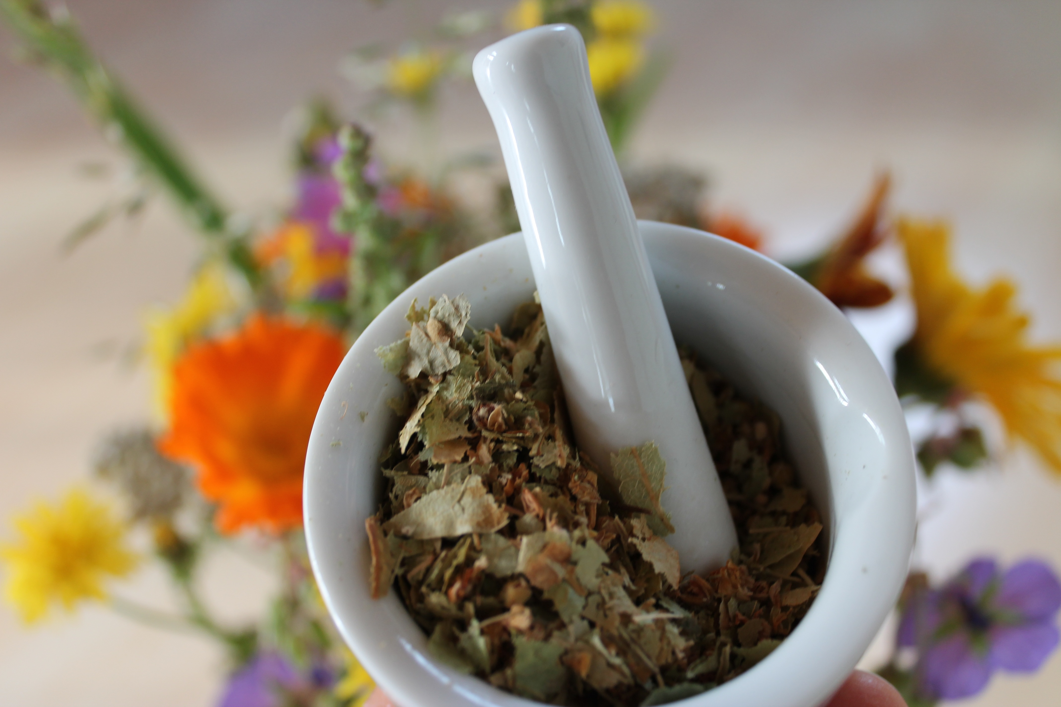
Natural Health Products (NHPs)
Include vitamins, minerals and herbal compounds¹⁶
Supplement diet for health-related reasons¹⁶
Some can provide benefit but not risk-free^{16,28}
  May lack evidence for use
  Can have side effects
  Can interact with medications, OTC products, or other NHPs
  Can be costly and contribute to pill burden
If tried, re-asses benefit after a couple months
Talk to a pharmacist before starting!
Image 22
Notes:
Patients with PD should be advised not to take OTC dietary supplements without consulting pharmacist (CMAJPDguidlines)

Slide 28
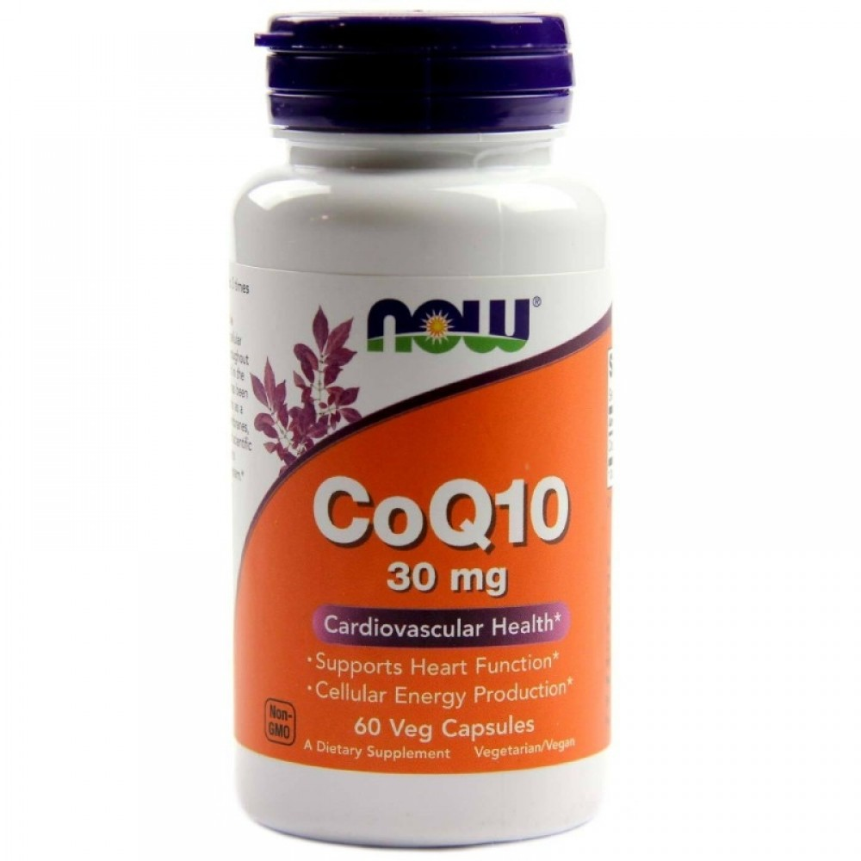
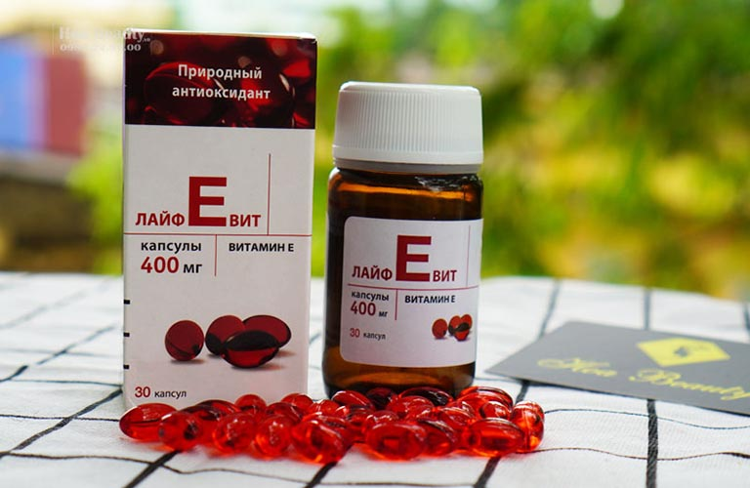
Common NHPs Lacking Evidence in PD
Coenzyme Q-10
Omega-3
Vitamin E
Not recommended to slow progression of PD due to lack of evidence for benefit.¹⁷⁻¹⁹
Images 23 - 25
Notes:
These three NHPs are often used for brain health and protection to slow the profession of PD
However, guidelines state that CoQ10 and Vitamin E should not be used for people with PD to slow progression of the disease.
Along with Omega-3, most studies fail to show benefit for people with PD and there are potential side effects and drug interactions.
2: https://www.ncbi.nlm.nih.gov/pmc/articles/PMC6747747/
Omega-3 Fatty Acids and Neurodegenerative Diseases: New Evidence in Clinical Trials
Rossella Avallone,^{1,*} Giovanni Vitale,¹ and Marco Bertolotti²
1: Reconsidering Coenzyme Q10 in Parkinson's Disease
Weighing the cost versus the benefit
By Tina Kaczor, ND, FABNO
3: https://www.ncbi.nlm.nih.gov/pmc/articles/PMC6399121/ 2016 Dietary Vitamin E as a Protective Factor for Parkinson's Disease: Clinical and Experimental Evidence
Tommaso Schirinzi,et al 2019

Slide 29
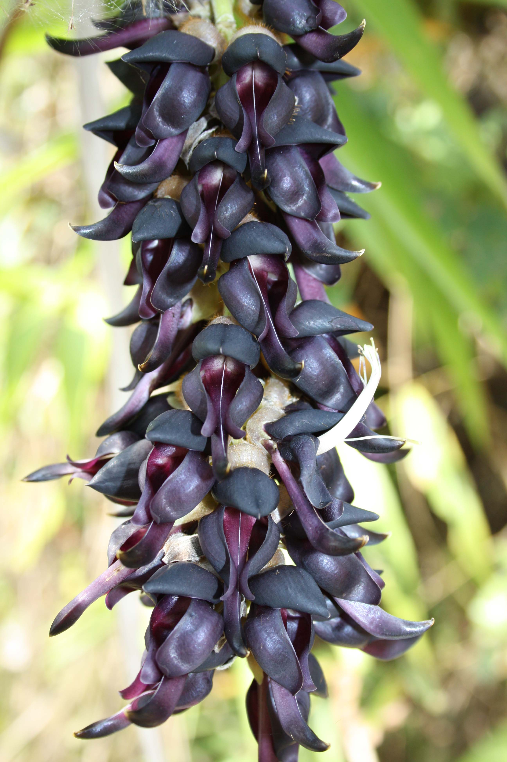
NHPs for Motor Symptoms of PD
Mucuna Pruriens (Cowhage)²⁰
Use: motor symptoms, may delay levodopa start
Dose:
Standardized powder: 23-68g in 2-5 divided doses/day
Non-standardized powder: 40-60g in 4 divided doses/day
Side Effects: Stomach upset
Caution: Use with levodopa can make it hard to assess motor symptoms
*small trials limit evidence validity
Image 26
Notes:
READ SLIDES
-Ok to take cowhage and levodopa but it can make it harder to assess motor fluctuations
-Use a consistent product as there are various concentrations and formulations (standardized and non-standardized)
-May cause stomach upset (and side effects of levodopa throughout the body – as it's not used with a medication that keeps the actions to within the brain like carbidopa does [decarboxylase inhibitor])
____________________________
Natural medicines: Cowhage professional monograph
Dose: Varies depending on form:
Standardized powder (3.3% levodopa): 23-68g in 2-5 divided doses/day
Non-standardized powder (4.5-5.5g levodopa): 40-60g in 4 divided doses/day
Roasted powder (5.7% levodopa): single dose

Slide 30
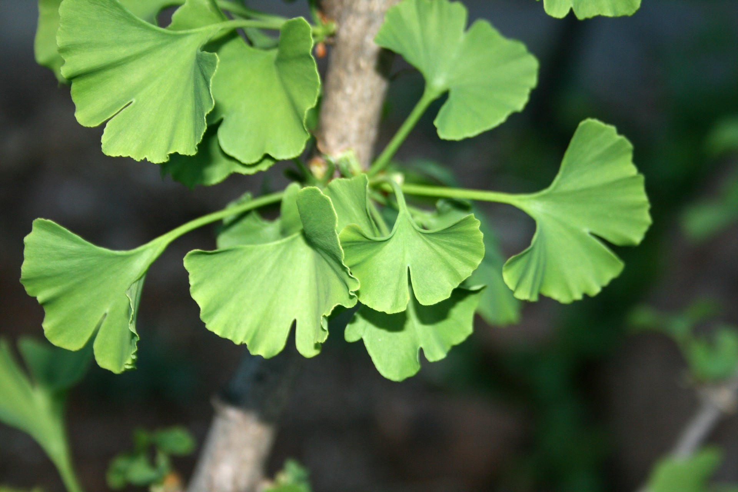
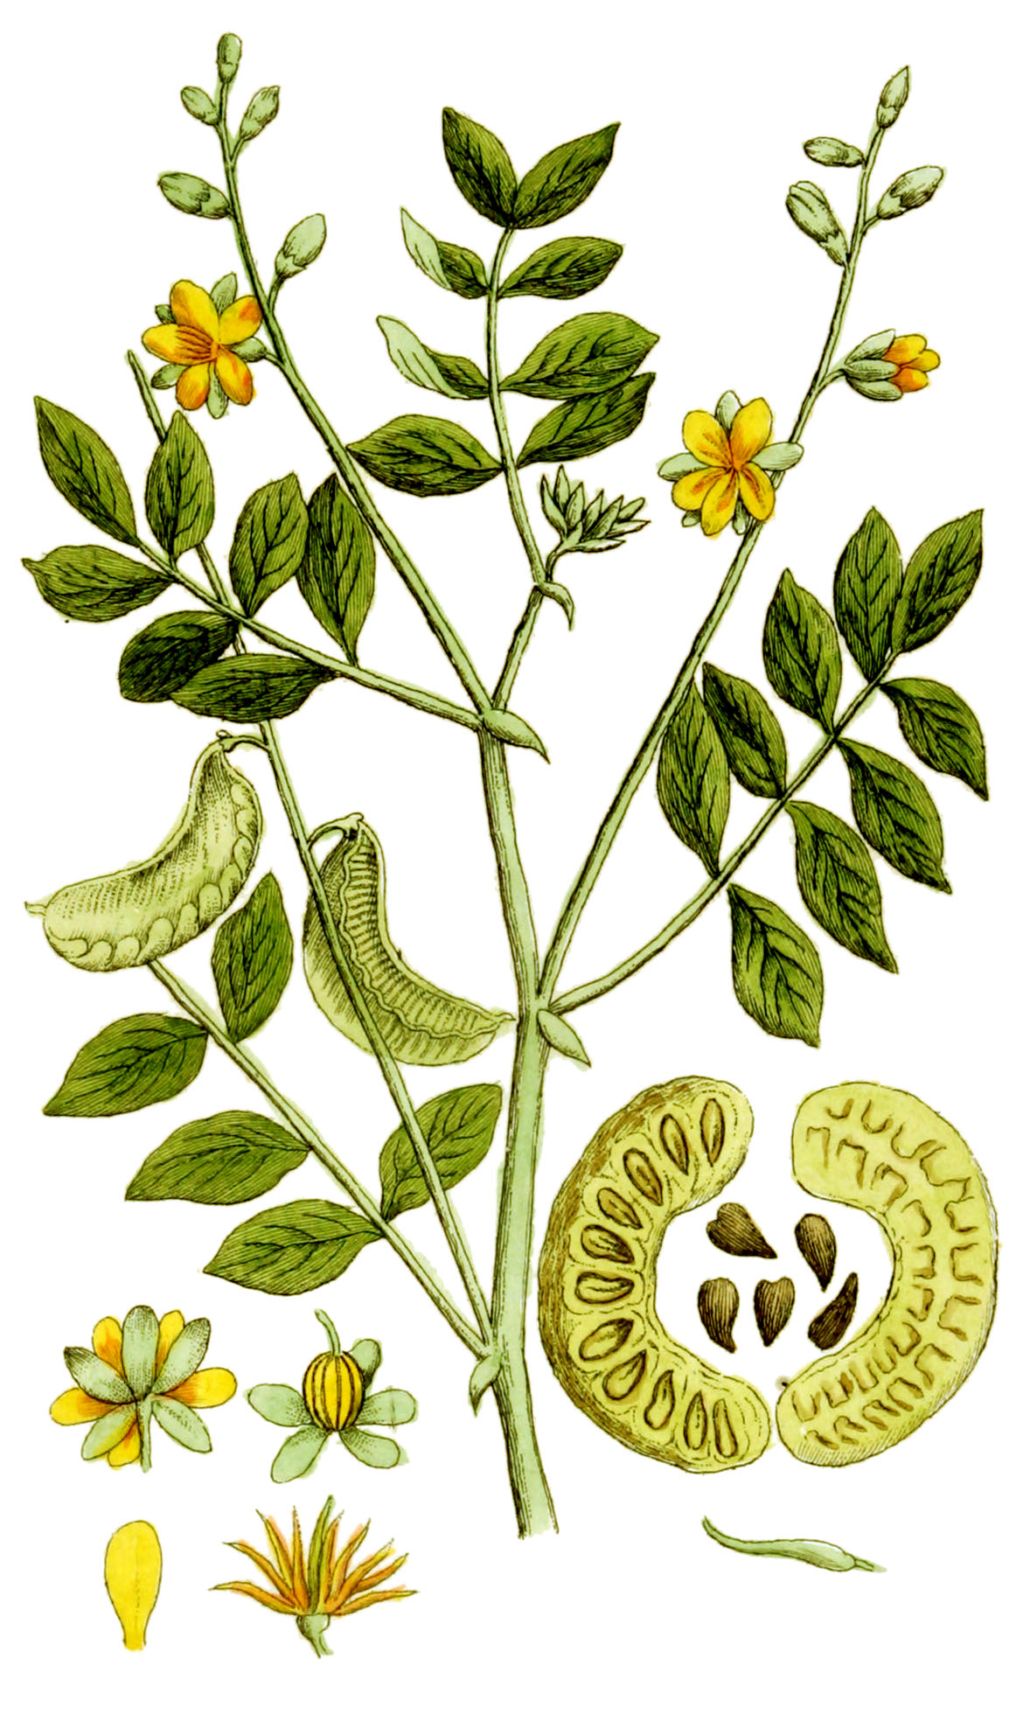
NHPs for Non-Motor Symptoms of PD
Ginkgo²¹
Use: symptoms of dementia, brain health
Dose: 240 mg once daily
Side Effects: Headache, dizziness, upset stomach, increased blood sugars
Caution: May increase bleeding risk
Sennosides²²
Use: constipation
Dose: 17.2 mg once daily
Side Effects: stomach upset, cramps, bloating, gas, diarrhea
Images 27 - 28
This Photo by Unknown Author is licensed under CC BY-SA
Notes:
Ginkgo: natural medicine: Oral ginkgo 240 mg seems to improve symptoms of various types of dementia, but lower doses are not always effective. Oral ginkgo does not seem to prevent or slow down the progression of dementia.

Slide 31
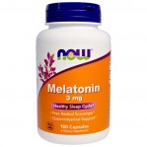

NHPs for Non-Motor Symptoms of PD
Caffeine²³
Use: daytime sleepiness
Dose: 100-600 mg/day
Side Effects: diarrhea, headache
Caution: Avoid later in the day as can cause sleep difficulties and nighttime urination
Melatonin²⁴
Use: trouble sleeping
Dose: 3-10 mg daily before bedtime
Side Effects: sleepiness, morning grogginess
Caution: Watch for morning "hangover"
Image 29 - 30
Notes:
Ginkgo: natural medicine: Oral ginkgo 240 mg seems to improve symptoms of various types of dementia, but lower doses are not always effective. Oral ginkgo does not seem to prevent or slow down the progression of dementia.
Caffeine: natural medicine: Consumption of caffeinated beverages or caffeine supplements seems to prevent a decline in alertness and cognitive capacity when consumed throughout the day. Taking caffeine 100-600 mg can improve alertness and speed following prolonged sleep deprivation but usually does not affect mental performance or accuracy. 1 cup (~237mL) brewed coffee = ~130mg caffeine, cup of tea ~40mg caffeine
Acute use of high doses, typically above 400 mg daily, has been associated with significant adverse effects such as tachyarrhythmia and sleep disturbances
Melatonin: natural medicines: In patents with insomnia, oral melatonin seems to shorten the time it takes to fall asleep by about 7-12 minutes. Melatonin does not appear to improve sleep efficiency and may only increase total sleep time by about 8 minutes. Meta-analyses of several clinical studies show that taking melatonin 3-10 mg daily improves subjective sleep quality, but not objective outcomes such as number of awakenings at night and sleep efficiency in these patients.

Slide 32
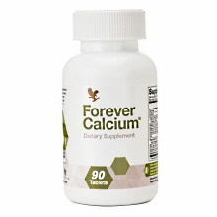
NHPs for Bone Health in PD
Vitamin D^{25,27}
Dose: 800-2000 IU daily
Side Effects: Well tolerated
Calcium^{26,27}
Dose: 1200 mg/day (from diet and supplements)
Side Effects: Constipation, upset stomach, gas, burping
Use: helps body absorb calcium for bone strength. Vitamin D deficiency is common in people with PD
Use: helps increase bone strength to prevent breaks if falls happen from motor symptoms
Caution: Do not exceed 2000-2500mg/day²
Image 31 - 32
Notes:
___________________________________________________________________
Vitamin D: https://www.healthlinkbc.ca/medications/fdb9106#fdb9106-03
2: natural medicines
3: osteoporosis.ca
Calcium: https://www.healthlinkbc.ca/medications/fdb2123
2: https://www.parkinson.org/Understanding-Parkinsons/Treatment/Over-the-Counter-and-Complementary-Therapies
3: Natural medicines: Calcium professional monograph

Slide 33
Probiotics
Contain live microorganisms^{29,30}
Different probiotic have evidence for different uses^{29,30}
Constipation
  Activia, Yakult, BioGaia²⁹
  Improved stool consistency and frequency³¹
Irritable Bowel (IBS)
  Activia, Align, UltraFlora, Bio-K+²⁹
  Reduced stomach pain, bloating, irregular stools³¹
Weight Management
  Genestra HMF Metabolic, UltraFlora²⁹
  Helped reduce body fat and slimmed the waist³⁴
Mood + Affect*
  Calm Biotic, Yakult, Probiotic Sticks²⁹
  Improved symptoms of stress, anxiety^{32,33}
*Not a substitute for standard treatment. Lower level of evidence than other uses.²⁹
Evidence for probiotics for diarrhea is mostly for infectious diarrhea.²⁹
Notes:
Well tolerated but can cause mild stomach upset
Currently, the body of evidence for probiotic interventions is growing along with popular demand for these products. There is evidence to support the use of probiotic products for a variety of indications beyond gut health, however, applications and results are strain-specific.
_____________________________
Diarrhea = antibiotic associated & C. difficile associated
http://www.probioticchart.ca/PBCIntroduction.html?utm_source=intro_pg&utm_medium=civ&utm_campaign=CDN_CHART:
1: Clinical trial: the effects of a fermented milk product containing Bifidobacterium lactis DN-173 010 on abdominal distension and gastrointestinal transit in irritable bowel syndrome with constipation by Agrawal et al. (2008) https://doi.org/10.1111/j.1365-2036.2008.03853.x
2: Beneficial psychological effects of a probiotic formulation (Lactobacillus helveticus R0052 and Bifidobacterium longum R0175) in healthy human volunteers by Messaoudi et al. (2011)
3: Assessment of psychotropic-like properties of a probiotic formulation (Lactobacillus helveticus R0052 and Bifidobacterium longum R0175) in rats and human subjects by Messaoudi et al. (2011)
4: A randomised controlled study shows supplementation of overweight and obese adults with lactobacilli and bifidobacteria reduces bodyweight and improves well-being by D.R Michael et al. (2020)

Slide 34

Medical Cannabis
In general, research is lacking to evaluate cannabis use in PD³⁵
Potential use: non-motor symptoms (e.g., sleep, mood, pain).^{36,37,38}
Side Effects: dizziness, paranoia, feeling tired, blurred vision, hunger, memory issues³⁵
Caution: High doses of THC can be associated with anxiety and psychosis. Smoking cannabis can damage the lungs.³⁵
Dose: individualized. Start low. Most people use less than 3 g dried cannabis daily.¹ Limit THC to help prevent psycho-activity.^{35,38}
Image 33
Notes:
1: https://www.parkinson.bc.ca/media/171860/cannabis-and-parkinsons.pdf
natural medicines Cannabis professional monograph
https://www.sciencedirect.com/science/article/pii/S1744388119309867?casa_token=bJCeroLCZJ0AAAAA:cg6IKtcXc1sU0f1y8dBb8gQ9wYZnDxOZ87TtZ18p1KhogknrmULXmo7mng-EffL3nQHGQ8UUlY4 (Medical cannabis as an alternative therapeutics for Parkinsons’ disease: Systematic review by AnastasiaBougea et al)
https://www.ncbi.nlm.nih.gov/pmc/articles/PMC6682376/

Slide 35

Group Discussion
Q1: What non-drug measures do you find most helpful?
Q2: Do you currently use any NHPs? What is your experience with them?
Q3: Are there any non-drug measures or NHPs you might try after this session?

Slide 36
Debrief of Today’s Session
Feedback
  Any requests for future sessions?
"Homework" assignment
  Goal Setting
Notes:
Alright, so just to summarize, we talked about what Parkinson’s is as well as the motor and non-motor symptoms associated with it, and how to differentiate these symptoms from medication side effects. We then went over some non-drug management and insight on some natural health products and cannabis.
This is a good time to use the raise your hand function if you had any outstanding questions for us or any requests for our future sessions before I introduce a short homework assignment.

Slide 37

Goal Setting
After our discussion, what are some of your expectations/goals you hope to achieve?
Write three down and keep them in mind for our next sessions
Notes:
So for homework, we ask that you write down 3 expectations or goals that you hope to achieve with these group sessions, and keep them in mind for our next sessions.
For example, One goal might be to try 1 natural health product that has evidence for a non-motor symptom you might be experiencing such as constipation
OR
You might want to Learn about some ways you can manage the side effects from your medications
The idea is that hopefully by our last appointment, we’ll be able to address everyone’s goals.

Slide 38
Additional Resources
Exercise Resources
  PSBC Video Recordings: https://www.parkinson.bc.ca/resources-services/resources/online-exercise-resources/
  PWP Weekly Zoom Classes: https://parkinsonwellnessproject.org/schedule
Parkinson's Support Groups
  PSBC Regional Support Groups & Carepartner Support Groups:
    Contact: info@parkinson.bc.ca , 1-800-668-3330
    https://www.parkinson.bc.ca/resources-services/support-groups/
  PWP Monthly Support Groups: https://parkinsonwellnessproject.org/support-groups
Pharmacist Consultation + Medication Review
  UBC Pharmacists Clinic: https://pharmsci.ubc.ca/pharmacists-clinic
Notes:
Here we have some additional resources for you to take a look at at home
If you’re new to physical activity or just want some guidance and support, there are some great videos by Parkinson Society BC that have classes designed at varying intensity levels - so you can find videos with exercise challenges, Pilates (that can be done sitting down or standing), boxing, and much more
These videos are often led by a health care professional such as a physiotherapist so you know they’re designed specifically for someone with Parkinson’s
Parkinson Wellness Project have live sessions that take place on Zoom, which is another video calling platform, so you get the added benefit of being able to socialize with others
We’ve also provided some contact information here for support groups for both yourselves and your care partners
Most of these support groups are taking place online still, but they offer a safe place to share experiences with others who are experiencing similar events
And lastly, you can find more information about the UBC Pharmacists Clinic and even book an appointment for services such as a pharmacist consultation or a medication review

Slide 39
References
Hamilton Health Sciences. Parkinson’s Disease [Internet]. Hamilton (ON): Movement Disorders Clinic; 2017 [updated 2017 Jul 13; cited 2021 July 29]. Available from: https://www.hamiltonhealthsciences.ca/wp-content/uploads/2019/08/ParkinsonsDisease-trh.pdf
Grimes D, Fitzpatrick M, Gordon J, Miyasaki J, Fon EA, Schlossmacher M et al. Canadian guideline for Parkinson disease. CMAJ. 2019 Sep 09;191 (36):989-1004.
Parkinson Canada. Symptoms of Parkinson’s [Internet]. Toronto (ON): Parkinson Canada; [cited 2021 Jul 29]. Available from: https://www.parkinson.ca/about-parkinsons/symptoms/?highlight=symptoms
Parkinson’s Foundation. Movement Symptoms [Internet]. Miami (FL): The Parkinson’s Foundation; [cited 2021 July 29]. Available from: https://www.parkinson.org/Understanding-Parkinsons/Movement-Symptoms
Grimes DA. Parkinson Disease. In: Therapeutics [Internet]. Ottawa (ON): Canadian Pharmacists Association; c2016 [updated 2021 Apr 21; cited 2021 Jul 29]. Available from: http://www.myrxtx.ca. Also available in paper copy from the publisher.
Birkmayer W, Danielczyk W & Riederer P. Symptoms and side effects in the course of Parkinson’s disease. J. of Neural Transm. Suppl. 1983 Jan 01; (19):185-199.
Linden M. How to Define, Find and Classify Side Effects in Psychotherapy: From Unwanted Events to Adverse Treatment Reactions. Clin Psychol Psychother. 2012 Jan 18; 20 (4):286-296.
American College of Sports Medicine. ACSM’s Guidelines for Exercise Testing and Prescription. Baltimore (MD): 2017. [cited 2021 Jul 29].
American College of Sports Medicine. ACSM’s Exercise Management for Persons with Chronic Diseases and Disabilities. Champaign (IL): Human Kinetics; 2016. [cited 2021 Jul 29].
Xu X, Fu Z & Le W. Exercise and Parkinson’s disease. Int Rev Neurobiol. 2019 Jun 20;147:45-74.
Bouca-Machado R, Rosario A, Caldeira D, Caldas AC, Guerreiro D, Venturelli M et al. Physical Activity, Exercise, and Physiotherapy in Parkinson’s Disease: Defining the Concepts. Mov Disord. 2020; 7(1): 7-15.
Parkinson’s Foundation. Diet & Nutrition [Internet]. Miami (FL): The Parkinson’s Foundation; [cited 2021 July 29]. Available from: https://www.parkinson.org/Living-with-Parkinsons/Managing-Parkinsons/Diet-and-Nutrition
Government of Canada. Canada’s food guide [Internet]. [cited 2021 Jul 29]. Available from: https://food-guide.canada.ca/en/healthy-eating-recommendations/make-it-a-habit-to-eat-vegetables-fruit-whole-grains-and-protein-foods/
CSEP Guidelines. Canadian 24-Hour Movement Guidelines: For Adults aged 18-64 years [Internet]. [cited 2021 Jul 29]. Available from: https://csepguidelines.ca/wp-content/uploads/2020/10/24HMovementGuidelines-Adults18-64-2020-ENG.pdf
Ziemczonek A. UBC Pharmacists Clinic: Brain Health. [PowerPoint Slides]. [updated 2021 Mar 17; cited 2021 Jul 29]
Government of Canada. Natural and Non-prescription Health Products Directorate [Internet]. [cited 2021 Jul 29]. Available from: https://www.canada.ca/en/health-canada/corporate/about-health-canada/branches-agencies/health-products-food-branch/natural-non-prescription-health-products-directorate.html
Yoritaka A, Kawajiri S, Yamamoto Y, et al. Randomized, double-blind, placebo-controlled pilot trial of reduced coenzyme Q10 for Parkinson’s Disease. Parkinsonism Relat Disord. 2015;21 (8): 911-916.
Avallone R, Vitale G & Bertolotti M. Omega-3 Fatty Acids and Neurodegenerative Diseases: New Evidence in Clinical Trials. Int J Mol Sci. 2019 Sep 20;20 (17): 4256.
Schirinzi T, Martella G, Imbriani P, Lazzaro GD, Franco D, Colona VL et al. Dietary Vitamin E as a Protective Factor for Parkinson’s Disease: Clinical and Experimental Evidence. Front Neurol. 2019 Feb 26;10: 148.
Cowhage. In: Natural Medicines [database on the Internet]. Somerville (MA): Therapeutic Research Center; 2020 [cited 2021 Jul 29]. Available from: https://naturalmedicines.therapeuticresearch.com.
Ginkgo. In: Natural Medicines [database on the Internet]. Somerville (MA): Therapeutic Research Center; 2020 [cited 2021 Jul 29]. Available from: https://naturalmedicines.therapeuticresearch.com.
Senna. In: Natural Medicines [database on the Internet]. Somerville (MA): Therapeutic Research Center; 2018 [cited 2021 Jul 29]. Available from: https://naturalmedicines.therapeuticresearch.com.
Caffeine. In: Natural Medicines [database on the Internet]. Somerville (MA): Therapeutic Research Center; 2020 [cited 2021 Jul 29]. Available from: https://naturalmedicines.therapeuticresearch.com.
Melatonin. In: Natural Medicines [database on the Internet]. Somerville (MA): Therapeutic Research Center; 2020 [cited 2021 Jul 29]. Available from: https://naturalmedicines.therapeuticresearch.com.
Vitamin D. In: Natural Medicines [database on the Internet]. Somerville (MA): Therapeutic Research Center; 2020 [cited 2021 Jul 29]. Available from: https://naturalmedicines.therapeuticresearch.com.
Calcium. In: Natural Medicines [database on the Internet]. Somerville (MA): Therapeutic Research Center; 2020 [cited 2021 Jul 29]. Available from: https://naturalmedicines.therapeuticresearch.com
Osteoporosis Canada. Calcium and Vitamin D [Internet]. [cited 2021 Jul 29]. Available from: https://osteoporosis.ca/bone-health-osteoporosis/calcium-and-vitamin-d/
Parkinson’s Foundation. Over the Counter & Complementary Therapies [Internet]. Miami (FL): The Parkinson’s Foundation; [cited 2021 July 29]. Available from: https://www.parkinson.org/Understanding-Parkinsons/Treatment/Over-the-Counter-and-Complementary-Therapies
Probiotic Guide Canada. Clinical Guide to Probiotic Products Available in Canada [Internet]. [cited 2021 July 29]. Available from: http://www.probioticchart.ca/PBCIntroduction.html?utm_source=intro_pg&utm_medium=civ&utm_campaign=CDN_CHART:%20%E2%80%8B%20%E2%80%8B
Probiotics. In: Natural Medicines [database on the Internet]. Somerville (MA): Therapeutic Research Center; 2020 [cited 2021 Jul 29]. Available from: https://naturalmedicines.therapeuticresearch.com
Agrawal A, Houghton LA, Morris J, Reilly B, Guyonnet G, Feuillerat NG et al. Clinical trial: the effects of a fermented milk product containing Bifidobacterium lactis DN-173 010 on abdominal distension and gastrointestinal transit in irritable bowel syndrome with constipation. Aliment Pharmacol Ther. 2009 Jan;29 (1): 104-14.
Messaoudi M, Violle N, Bisson JF, Desor D, Javelot H & Rougeot C. Beneficial psychological effects of a probiotic formulation (Lactobacillus helveticus R0052 and Bifidobacterium longum R0175) in healthy human volunteers. Gut Microbes. 2011 Jul-Aug;2 (4): 256-61.
Messaoudi M, Lalonde R, Violle N, Javelot H, Desor D, Nejdi A et al. Assessment of psychotropic-like properties of a probiotic formulation (Lactobacillus helveticus R0052 and Bifidobacterium longum R0175) in rats and human subjects. Br J Nutr. 2011 Mar;105 (5): 755-64.
Michael DR, Jack AA, Masetti G, Davies TS, Loxley KE, Smith JK et al. A randomised controlled study shows supplementation of overweight and obese adults with lactobacilli and bifidobacteria reduces bodyweight and improves well-being. Sci Rep. 2020 Mar 06;10 (1): 4183.
Cannabis. In: Natural Medicines [database on the Internet]. Somerville (MA): Therapeutic Research Center; 2020 [cited 2021 Jul 29]. Available from: https://naturalmedicines.therapeuticresearch.com. Subscription required to view.
Bougea A, Koros C, Simitsi AM, Chrysovitsanou C, Leonardos A & Stefanis L. Medical cannabis as an alternative therapeutics for Parkinsons’ disease: Systematic review. Complement Ther Clin Pract. 2020 May;39: 101154.
Patel RS, Kamil S, Shah MR, Bhimanadham NN & Imran S. Pros and Cons of Marijuana in Treatment of Parkinson’s Disease. Cureus. 2019 Jun;11 (6): e4813.
Government of Canada. Information for Health Care Professionals: Cannabis (marihuana, marijuana) and the cannabinoids [Internet]. [cited 2021 July 29]. Available from: https://www.canada.ca/en/health-canada/services/drugs-medication/cannabis/information-medical-practitioners/information-health-care-professionals-cannabis-cannabinoids.html#a4.9.1.3
Notes:
Vancouver style (in order of slides)

Slide 40
Image Reference
Image 1: pngkit, 2018
Image 2: pixabay, 2016
Image 3: Image 3 by Unknown Author is licensed under CC BY-NC-ND
Image 4: Pixabay, 2014
Image 5: Image 5 by Unknown Author is licensed under CC BY-NC
Image 6: Pixabay, 2013
Image 7: Image 7 by Unknown Author is licensed under CC BY
Image 8: Image 8 by Unknown Author is licensed under CC BY
Image 9: Image 9 by Unknown Author is licensed under CC BY
Image 10: Image 10 by Unknown Author is licensed under CC BY-NC-ND
Image 11: Image 11 by Unknown Author is licensed under CC BY
Image 12: Image 12 by Unknown Author is licensed under CC BY-SA
Image 13: Image 13 by Unknown Author is licensed under CC BY-NC
Image 14: Pexels, 2023
Image 15: Image 15 by Unknown Author is licensed under CC BY
Image 16: Image 16 by Unknown Author is licensed under CC BY-NC-ND
Image 17: Image 17 by Unknown Author is licensed under CC BY-NC
Image 18: Image 18 by Unknown Author is licensed under CC BY-NC-ND
Image 19: Image 19 by Unknown Author is licensed under CC BY-ND
Image 20: Image 20 by Unknown Author is licensed under CC BY-ND
Image 21: Image 21 by Unknown Author is licensed under CC BY-SA-NC
Image 22: pxhere, 2023
Image 23: Image 23 by Unknown Author is licensed under CC BY-SA-NC
Image 24: publicdomainpictures, 2023
Image 25: Image 25 by Unknown Author is licensed under CC BY-SA
Image 26: Image 26 by Unknown Author is licensed under CC BY-SA
Image 27: Publicdomainpictures, 2023
Image 28: Wikimedia, 2023
Image 29: Image 29 by Unknown Author is licensed under CC BY-SA-NC
Image 30: Pexels, 2023
Image 31: Image 31 by Unknown Author is licensed under CC BY-ND
Image 32: Image 32 by Unknown Author is licensed under CC BY-SA
Image 33: Image 33 by Unknown Author is licensed under CC BY-SA-NC

Slide 41
Thank You!

