Slide 1
Session 2: Motor Symptoms
Facilitator: [INSERT NAME HERE]
[INSERT DATE & TIME HERE]
NOTICE: This slide deck intended for educational purposes only and you are encouraged to adapt this slide deck to suit your clinic, services and community.​
This slide deck was created in 2022 at the UBC Pharmacists Clinic by Dr. Tiana Tilli, PharmD, RPh, ACPR with the help of Rebecca Leung E2P PharmD 2023
Notes:
Slides created by: Tiana Tilli, PharmD, RPh, ACPR and Sonia Sharma, BSc, E2P PharmD 2024

Slide 2
Land Acknowledgement
[We invite you to create a land acknowledgement to recognize the traditional, ancestral, and unceded land that your office/clinic is located on]​

Slide 3
Timeline
Session 1
Introduction
[60 mins]
Session 2
Today
Motor Symptoms
[60 mins]
Session 3
Non-Motor Symptoms
[60 mins]

Slide 4
Recap from Last Session
Parkinson’s Disease is a progressive, chronic movement disorder and the cause is unclear
Symptoms are disease-related and side effects are medication-related
Non-drug measures are available
Natural health products can be considered
Consult a pharmacist before starting any new Rx, OTC or NHPs to check for interactions

Slide 5
Session Outline
Reflection on last session
Education session
Group discussion
Debrief
"Homework"

Slide 6
Reflection Questions
Q1: Do you understand the difference between a symptom of a disease vs a side effect of a medication?
Q2: Have you tried any of the recommended non-drug measures or NHPs? How is it working for you?
Notes:
Take home point

Slide 7
Group Discussion
What is the most interesting or surprising thing you learned from our last session?

Slide 8
Agenda
Motor Symptoms
Parkinson's Disease Medications
- Available options
- Dosing ranges and tailoring therapy
- Managing side effects
Key Take-Aways
“Homework”

Slide 9
What are Motor Symptoms?
Symptoms associated with movement such as:
Tremor
Rigidity, slow movement
Poor balance, poor posture
Repetitive muscle twisting (dystonia)
Due to a decrease of dopamine in the brain^{1,2}
Dopamine is a chemical that tells your body to move^{1,2}
Notes:
Dopamine is a chemical messenger that tells your body to move

Slide 10
Medications for Motor Symptoms^{1,3}
Levodopa
Dopamine Agonists
MAO-B Inhibitors
COMT Inhibitors
Amantadine
Anticholinergics
Notes:
There are other medications beyond Sinemet!

Slide 11
Quiz Question
Why are there so many different medication options?
a) Different medications treat different symptoms
b) Some medications may or may not work for some people
c) People tolerate medications differently
d) All of the above
Notes:
Please note this slide is animated and correct answer will show on click

Slide 12
Levodopa
Images 1 - 4

Slide 13
Levodopa²⁻⁸
Drug | Levodopa-Carbidopa (Sinemet®, Sinemet CR®) Levodopa-Benserazide (Prolopa®)
Use​ | Control motor symptoms (e.g., tremors, stiffness, slow motion)
How it works | Levodopa converts into dopamine to replace low dopamine Carbidopa or Benserazide prevent breakdown of levodopa outside the brain to reduce side effects
Side Effects​ | Tiredness, nausea/vomiting, dizziness, constipation, dyskinesia (involuntary movements)
Caution ​ | High protein foods can decrease absorption Do not crush or chew Sinemet CR®
Tips | Keep a consistent protein intake schedule Quicken onset by chewing IR, take with carbonated drink Some tablets are scored to help with pill splitting for half-doses Potential benefit of CR at bedtime to help overnight and into the early morning due to delayed onset
Notes:
Sinemet
Dose: Initial: 50/12.5 mg BID PO Usual:100/25mg three times a day. While increasing the dosage during the induction period, the doses should be divided, aiming at a frequency of dosing of at least four times a day. Consider 250/25mg once 6tabs daily of 100/25 reached. Usual max is 1500mg/day levodopa.
*(note: Patients receiving less than 70 mg per day of carbidopa are more likely to experience nausea and vomiting.)
Sinemet CR
Dose: Initial: 100/25 mg​ BID PO. Usual: 200/50 mg​ QID PO
determine by careful titration. 200/50 should be substituted at an amount that eventually provides approximately 10 to 30 percent more levodopa per day. The interval between doses should be prolonged by 30 to 50 percent
Prolopa
Dose: 100 mg-25 mg once or twice a day. May be increased by one capsule every third or fourth day until an optimal therapeutic effect is obtained without dyskinesias. (Initial: 50/12.5 mg BID PO
Usual: 100/25 mg – 150/37.5 mg TID–QID PO) optimal dosage for most patients is usually four to eight capsules of PROLOPA 100 mg-25 mg daily (400 mg to 800 mg of levodopa) divided into four to six doses. Most patients require no more than six capsules of PROLOPA 100 mg-25 mg (600 mg of levodopa) per day
Interactions
Protein – Avoid high protein diets (>2 g/kg) which may decrease the efficacy of levodopa via competition with amino acids in crossing the blood-brain barrier. (lexi-interact) Parkinson Canada: reschedule your meals and snacks around your medication schedule. Regular amounts of these protein rich foods may be taken 1 hour before or 1 hour after your scheduled medication time.
-keep a consistent protein intake schedule so your medication doses can be adjusted accordingly
- Adrian edit: also depends on the stage of PD you are in – early on, you can take levodopa with food to minimize side effects, and it might not be until later on once PD progresses that you really need to start considering your meal times and protein content to get the most out of the medication.
Iron – May decrease concentration of levodopa. Separate doses of agents by 2 or more hours. (Lexi-interact)
AVOID:
CAUTION: Antihypertensives, diuretics, tricyclic antidepressants may increase hypotensive action, high protein foods
Reason: Low blood pressure risk, high protein may decrease absorption of levodopa
Recommendation: Keep dose of levodopa as low as possible to prevent motor complications.

Slide 14
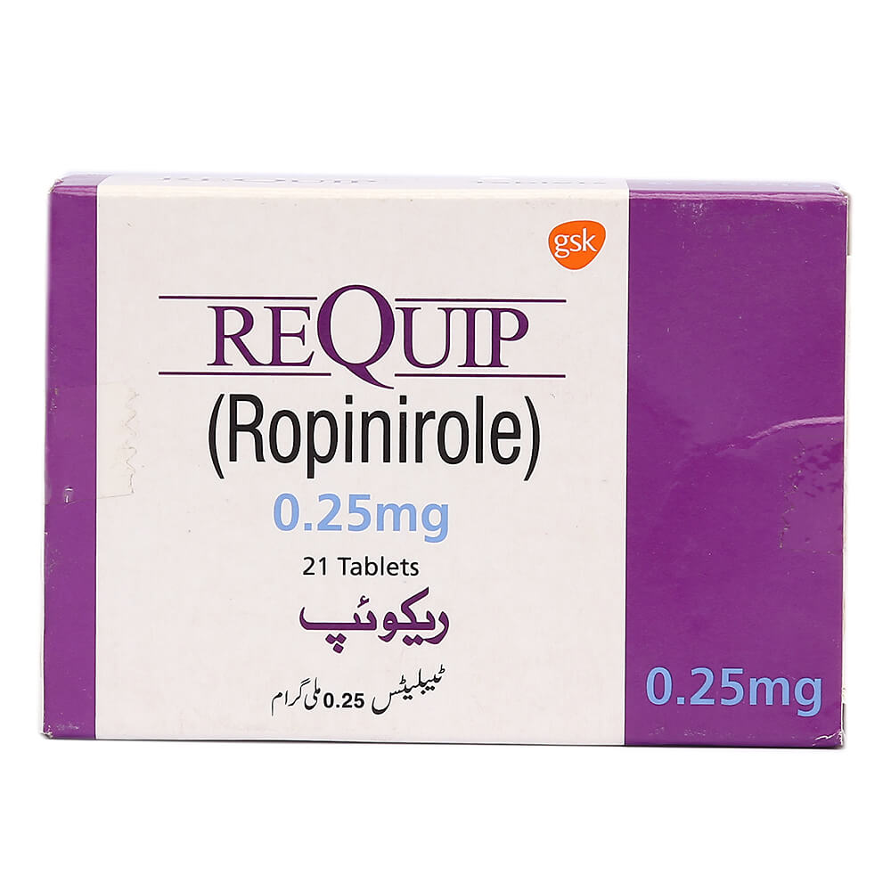
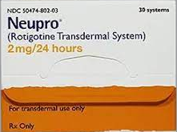
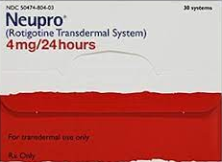
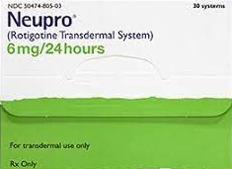
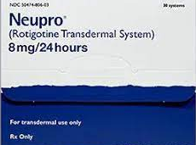
Dopamine Agonists
Images 5 - 10

Slide 15
Dopamine Agonists²⁻⁶
Drug | Ropinirole (Requip®) Pramipexole (Mirapex®) Rotigotine patch (Neupro®)
Use​ | Control motor symptoms Used with levodopa to help more advanced motor symptoms
How it works | Mimics the action of dopamine in the brain
Side Effects​ | Dizziness, low blood pressure, sudden sleepiness, nausea/vomiting, impulse control issues
Caution ​ | Reported urges to gamble, shop, eat, increase sexual activity
Tips | Rotigotine patch: avoid using the same patch site within 14 days Taken at bedtime for restless legs If discontinuing, stop gradually (applies to most PD medications)
Notes:
Other example: Bromocriptine (not 1st line)
Adjunct to help with advanced motor symptoms: severe loss of balance, stiffness in legs, slower movements
Transdermal patch sites include: stomach, thigh, hip, flank, shoulder, or upper arm
Stopping abruptly can cause withdrawal symptoms – most PD meds need to be stopped gradually
CPS: ropinirole in PD monograph
Dose: Initial: 0.25 mg TID PO, Usual: 3–6 mg TID PO
CPS: pramipexole in PD monograph
Dose: Initial: 0.125 mg TID PO, Usual: 0.5–1 mg TID PO
CPS: rotigotine patch in PD monograph
Dose: Initial: 2 mg/24 h transdermal patch once daily. Increase at weekly intervals as needed, to a maximum of 16 mg/24 h, Usual: 6–8 mg/24 h
INTERACTIONS:
AVOID: 5HT3 antagonists (e.g., ondansetron), antihypertensives and vasodilators for APOMORPHINE
CAUTION: antihypertensives, vasodilators, tricyclic antidepressants. Ropinirole interacts with ciprofloxacin to increase levels of ropinirole
REASON: low blood pressure risk
RECOMMENDATION: Monitor closely if used concurrently

Slide 16
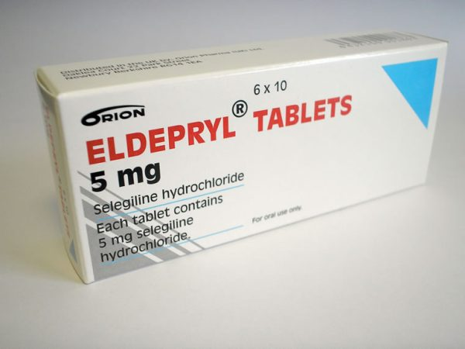
MAO-B Inhibitors
Images 11 - 12
Notes:
Monoamine oxidase B inhibitors

Slide 17
MAO-B Inhibitors²⁻⁶
Drug | Selegiline (Elderpryl®) Rasagiline (Azilect®) Safinamide (Onstryv®)
Use​ | Improve motor symptoms and “wearing off” from levodopa
How it works | Prevents an enzyme (MAO) from breaking down dopamine in the brain
Side Effects​ | Dyskinesias (involuntary movements), nausea, dizziness, constipation, weight loss, trouble sleeping, intense dreams
Caution ​ | Do not take later than noon (to prevent difficulty sleeping)
Notes:
Monoamine oxidase B inhibitors
Onstryv – covered through manufacturer (per pt experience), prescribed by UBC movement disorder clinic
CPS: selegiline in PD monograph
Dose: 2.5 mg daily– 5 mg BID PO. Give before 1 p.m.
CPS: rasagiline in PD monograph
Dose: Monotherapy: 1 mg daily PO, Adjunctive therapy: 0.5–1 mg daily PO
CPS: safinamide in PD monograph (note in Canada: only approved as add-on therapy to improve wearing off symptoms)
Dose: Adjunctive therapy: 50 mg daily PO; may increase to 100 mg daily after 2 wk, based on patient response and tolerability
INTERACTIONS:
AVOID: concurrent use with serotonergic and other CNS modulators (e.g. bupropion, pseudoephedrine, SSRIs. SNRIs)
CAUTION: Rasagilne and ciprofloxacin (lower dose rasagiline required)
REASON: increased risk of serotonin syndrome and/or hypertensive crisis
RECOMMENDATION: some MAO-B inhibitors may be safely used with concurrent SSRI therapy in PD patients with depression under careful observation and using conservative dosing

Slide 18
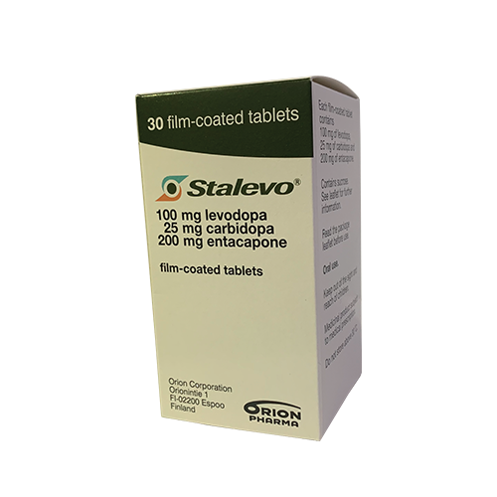
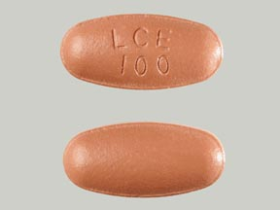
COMT Inhibitors
Images 13 - 14
Notes:
Catechol-O-Methyl Transferase (COMT) Inhibitors

Slide 19
COMT Inhibitors²⁻⁶
Drug | Entacapone (Comtan®) Levodopa-Carbidopa-Entacapone (Stalevo®)
Use​ | Improve motor symptoms and “wearing off” from levodopa
How it works | Prevents an enzyme (COMT) from breaking down dopamine in and outside of the brain
Side Effects​ | Dyskinesia (involuntary movement), nausea, diarrhea, brown-orange urine (harmless)
Caution ​ | Only use with levodopa Do not crush or chew (stains teeth)
Tips | Reduce levodopa dose when starting to avoid dyskinesia, OR Add gradually to a few levodopa doses at a time (to 1-2 doses/day)
Notes:
Catechol-O-Methyl Transferase (COMT) Inhibitors
CPS: Entacapone (pd monograph)
Dose: 200 mg PO with each dose of levodopa; maximum 8 × daily
CPS: Stalevo (pd monograph)
Dose: Usual: 50/12.5/200 mg , 100/25/200 mg or 150/37.5/200 mg TID–QID PO, depending on previous levodopa/carbidopa and/or entacapone dose
INTERACTIONS:
AVOID: combining with nonselective MAOIs (e.g., phenelzine, tranylcypromine, linezolid), dobutamine, dopamine, epinephrine and isoproterenol.
CAUTION: potentiates levodopa
REASON: increased dyskinesia with levodopa, nonselective MAOIs can cause hypertensive crisis, decreases sympathomimetics' metabolism
RECOMMENDATION: Do not stop taking meds abruptly. Taper gradually if needed

Slide 20
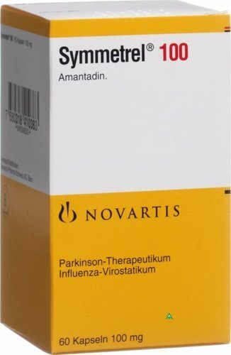
Amantadine
Images 15 - 17

Slide 21
Amantadine²⁻⁶
Drug | Amantadine (Symmetrel®)
Use​ | Decrease dyskinesias
How it works | Increases amount of dopamine released in brain
Side Effects​ | Nausea, constipation, difficulty sleeping, livedo reticularis (blu-ish, irregular marks on skin), ankle swelling
Caution ​ | Do not take in the late evening (to prevent difficulty sleeping) Avoid if you have cognitive/memory issues (increases confusion)
Notes:
CPS: amantadine (PD monograph)
Dose: Usual: 100 mg BID PO
INTERACTIONS:
AVOID:
CAUTION: Anticholinergic agents
REASON: Anticholinergic agents may increase effects
RECOMMENDATION: try dose adjustment of both drugs if combination needed

Slide 22
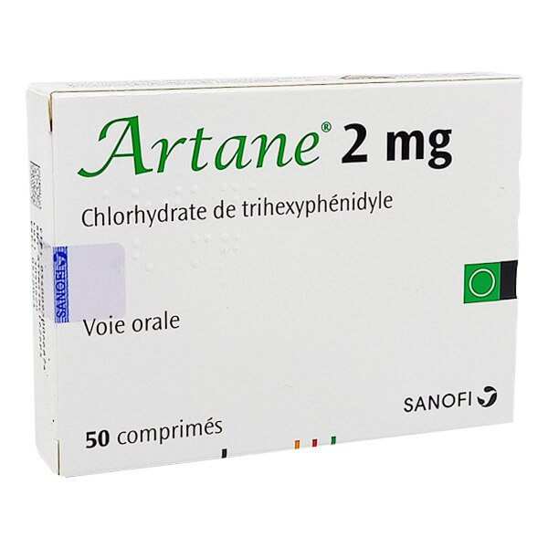
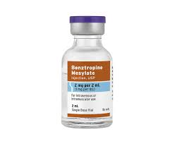
Anticholinergic Agents
Images 18 - 19

Slide 23
Anticholinergic Agents²⁻⁶
Drug | Benztropine (Congentine®) Trihexyphenidyl (Artane®)
Use​ | Decrease tremors
How it works | Balances the amount of dopamine and acetylcholine (another chemical messenger) in the brain
Side Effects​ | Dry mouth, constipation, low blood pressure, memory problems, confusion, hallucinations, difficulty peeing
Caution ​ | Not a 1st-line option May not be suitable for people over 65 years due to side effects
Notes:
Other example: Procyclidine (Kemadrin®)
CPS: benztropine (in pd monograph)
Dose: Initial dose: 0.5–1 mg daily, usual: 1–2 mg BID PO. MAX: 6mg/day or 4mg/day for elderly
* (Parkinsonian symptoms: 1–4 mg once or twice daily, orally or parenterally. Acute dystonic reactions: 2 mg im or iv, then 1–2 mg BID for 2–3 days)
CPS: trihexyphenidyl (in pd monograph)
Dose: Initial: 1 mg BID PO, Usual: 2 mg TID PO
INTERACTIONS:
AVOID:
CAUTION: Amantadine
REASON: Amantadine may increase anticholinergic effects.
RECOMMENDATION: do not stop taking these meds abruptly. Avoid in elderly.

Slide 24
Medication Summary²⁻⁶
Drug Class | Motor Symptom Improvement | Side Effects
Levodopa | +++ | ++
Dopamine Agonists | ++ | +++
MAO-B Inhibitors | + | +
COMT Inhibitors | + | +
Amantadine | Not recommended | ++
Anticholinergic | + | +++

Slide 25
Group Discussion
Q1: Do you use any of these medications? What’s your experience with them?
Q2: Did you learn anything about medications that you didn't know?
Notes:
Allow participants to first discuss among each other (discuss with person next to them). Then bring together into a big group to share some of the common theme or differences.

Slide 26
Dosing Ranges
Treatment must be individualized^{2,4}
Start with lower doses and slowly increase to a dose that works best with the least side effects^{2,4}
If changes are needed, do them gradually⁴
Track your response to any medication changes
Variations in doses are okay⁴
Differences due to age, symptoms, severity, cost, etc⁴
Notes:
1: Parkinson Disease: A management update for pharmacists

Slide 27
Example
Mark
55-year-old male
Newly diagnosed with PD
Levodopa/carbidopa 100/25mg
½ tablet three times a day
Herlinda
70-year-old female
PD for 12 years
Levodopa/carbidopa 250/25mg
1 tablets every 2 hours (with entacapone 200mg for 4 doses, and CR 200/50mg tablet at bedtime
Bottom Line: therapy is tailored to suit YOU!
*note: people depicted above are for illustration purposes only
Images 20 - 21
Notes:
names and people icons are provided by powerpoint.

Slide 28
Side Effect Management
Constipation
Nausea & Vomiting
Dry Mouth
Low Blood Pressure
Drowsiness
Trouble Sleeping
Dyskinesia
Image 22

Slide 29
Nausea & Vomiting
Common with: Most PD medications
Recommendations
Take medications with a light snack, bland foods or a meal^{9,10}
Lifestyle:
Medication:
Prescription: Domperidone, Ondansetron ^{5,10}
Eat and drink slowly. Have smaller meals more frequently^{9,10}
Do not mix hot and cold foods together
Avoid activity after eating
May go away a few weeks after starting PD medication¹⁰
Reduce medication doses and increase more slowly⁴
Notes:
Talk to doctor about adjusting medications
To reduce severe nausea, improve gastric motility and to speed levodopa’s onset of action, domperidone can be given before each dose. The dose of domperidone should be limited to 30 mg/day because of the potential for an elevated risk of QT interval prolongation.
CPS: Domperidone monograph
Prevention of gastrointestinal symptoms (nausea and vomiting) associated with the use of dopamine agonists in Parkinson disease
Class: GI motility agent
MOA: stimulates peristalsis and helps coordinate antral and duodenal contractions, improving gastric motility
Dose: 10mg TID , max 30mg (use at lowest possible dose)
Side effects: dry mouth, headache, insomnia
CPS: Ondansetron monograph
Class: antiemetic
MOA: blocks vomiting reflex
Dose: usually for chemotherapy
Side effects: headache, constipation, flushing or warmth sensations

Slide 30
Dry Mouth
Common with: Anticholinergic agents
Recommendations
Lifestyle:
Avoid or reduce caffeinated drinks, tobacco, alcohol¹¹
Sip water throughout the day¹¹
Chew sugar-free gum or candy¹¹
Medication:
OTC: Glycerin (Biotene Dry Mouth Gel)¹¹
OTC: Electrolyte solution (Moi-Stir) ¹¹
Image 23
Notes:
Anticholinergic agents such as benztropine
Biotene
Class: Saliva substitute
Dose: Apply gel onto tongue and spread thoroughly inside the mouth PRN
Side effects: no known significant adrs or interactions. Safe to swallow.
Moi-Stir
Class: Saliva substitute
Dose: Spray 1-2 puffs into mouth PRN
Side effects: no known significant adrs or interactions. Safe to swallow.

Slide 31
Low Blood Pressure
Common with: Levodopa, Dopamine agonists, COMT inhibitors, Amantadine
Recommendations
Lifestyle^{10,12,13}:
Stand up slowly
Drink 2 cups of cold water before standing
Contract muscles from below the waist before standing
Elevate head when sleeping
Slightly increase salt intake
Wear compression stockings
Medication:
Prescription: Fludrocortisone, Midodrine^{10,12,13}
Notes:
Medications like Sinemet, ropinerole, pramipexole, entacapone, and amantadine
Fludrocortisone: For severe OH ​
Class: mineralocorticoids​
MOA: electrolyte balance, helps with sodium retention, increased K+ excretion → rise in BP ​
Dose: initial: 0.1mg daily, increase by 0.1mg q1-2w to 0.4mg ​
Side effects: usually well tolerated with small dosages; sodium retention, high blood pressure, muscle weakness​
​
Midodrine​
Class: alpha1-adrenergic agonists ​
MOA: increases BP by increasing vascular tone and urinary retention ​
Dose: initial: 2.5-5mg TID AC; none after 5pm; increase by 2.5mg TID q1-2w (max 15mg tid) ​
Side effects: supine hypertension, shivering, itching ​

Slide 32
Dyskinesia
Common with: Levodopa, COMT Inhibitors
Recommendations
Lifestyle:
Physiotherapy, Occupational therapy, Dietician^{3,5,6}
Ask a Pharmacist to review your current medications
Medication:
Ensure dose of levodopa is as low as possible^{3,6}
Prescription: Amantadine^{3,6}
Changes to dosage or timing (if associated with peak dose)
Notes:
Medications such as sinemet and entacapone
Dose of levodopa should be kept as low as possible to maintain good function in order to reduce the development of motor complications
Physiotherapy specific to PD should be offered to people who are experiencing balance or motor function problems
Occupational therapy specific to PD should be offered to people having difficulties with activities of daily living
Consult dietician for specialist advice (most protein in final meal for people experiencing motor fluctuations, taking vitamin D supplementation, etc)
Choice of an adjunct to levodopa for people with PD who have developed dyskinesia or motor fluctuations despite optimal levodopa therapy should take into account: individual circumstances, lifestyle, benefits/harms of different drug classes
Deep brain stimulation of the STN or Gpi is effective against motor fluctuations and dyskinesia (Grade A evidence)

Slide 33
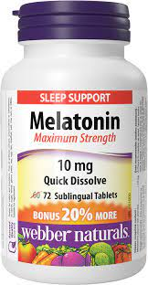
Trouble Sleeping
Common with: MAO-B Inhibitors, Amantadine
Recommendations
Lifestyle:
Good sleep hygiene (always 1st choice)^{6,10}
Avoid caffeine later in the day, keep a sleep pattern, avoid afternoon naps, exercise earlier in the day
Meditation/relaxation time (e.g. Calm on YouTube, CBT-insomnia)
Medication: take stimulating medications earlier in the day
OTC: Melatonin^{2,3,5,6,7}
Image 24
Notes:
MAO-B inhibitors such as selegiline, rasagiline, and amantadine
Melatonin: 1-2mg/day sublingual to help sleep initiation2 ,5mg time release/day to sustain sleep2, Always try sleep hygiene first ​
27: Melatonin. In: Natural Medicines [database on the Internet]. Somerville (MA): Therapeutic Research Center; 2020 [cited 2021 Aug 08]. Available from: https://naturalmedicines.therapeuticresearch.com.​
Side effects: morning grogginess, sleepiness, headache
Amy Tran, RPh (PSBC): suggests doxepin (higher doses for depression (25mg+) but lower doses (3-6mg) for insomnia
https://www.youtube.com/watch?v=IQmq-uyL8ZU
CPS: Doxepin
Class: hypnotic
Dose: 6mg OD (some patients 3mg OD may be appropriate (e.g. elderly age >65y) should be taken within 30 minutes of bedtime. To minimize the potential for next da y effects, SILENOR should not be taken within 3 hours of a meal.
MOA: antagonism of H1 receptor
Side effects: somnolence, sedation and nausea.
CPS: Zopiclone
Caution: Not drug of choice; risk of falls, cognitive impairment
Class: Hypnotic—Sedative
Dose: Initial dose: 3.75 mg HS PO. If needed, titrate to 5–7.5 mg HS PO
Maximum 7.5 mg/day in most patients. Maximum 5 mg/day in the elderly
MOA: reduces sleep latency, increases duration of sleep and decreases nocturnal awakenings with little effect on sleep architecture
Side Effects: altered taste (bitterness), drowsiness, dizziness, confusion​

Slide 34
Drowsiness
Common with: Dopamine Agonists, Anticholinergic Agents
Recommendations
Lifestyle:
Listen to upbeat music, brighten up room
Stay cool (splash cold water, turn on a fan)
Caffeinated drinks (coffee, tea)
Medication:
Caffeine supplement tabs
100-600mg/day in divided doses¹⁵
May use more stimulating PD meds (MAO-I inhibitors, amantadine)^{2,10}
Prescription: Modafinil¹⁰
Regular exercise
Image 25
Notes:
Dopamine agonists such as ropinerole, pramipexole, and anticholinergic agents like benztropine
PD meds s/e = insomnia (CPS: Parkinson Disease) ​
- Adrian: lower evidence but sometimes will use these more stimulating medications ​
​
Caffeine. In: Natural Medicines [database on the Internet]. Somerville (MA): Therapeutic Research Center; 2020 [cited 2021 Aug 08]. Available from: https://naturalmedicines.therapeuticresearch.com​
CPS: Modafinil: ​
Increases alertness ​
Caution: potential for abuse2 ​
Class: CNS Stimulant ​
MOA: exact moa unknown; its wake-promoting actions are similar to agents like amphetamine​
Dose: narcolepsy: 200-400mg divided morning and evening ​
Side effects: headaches, nausea ​
​
​

Slide 35
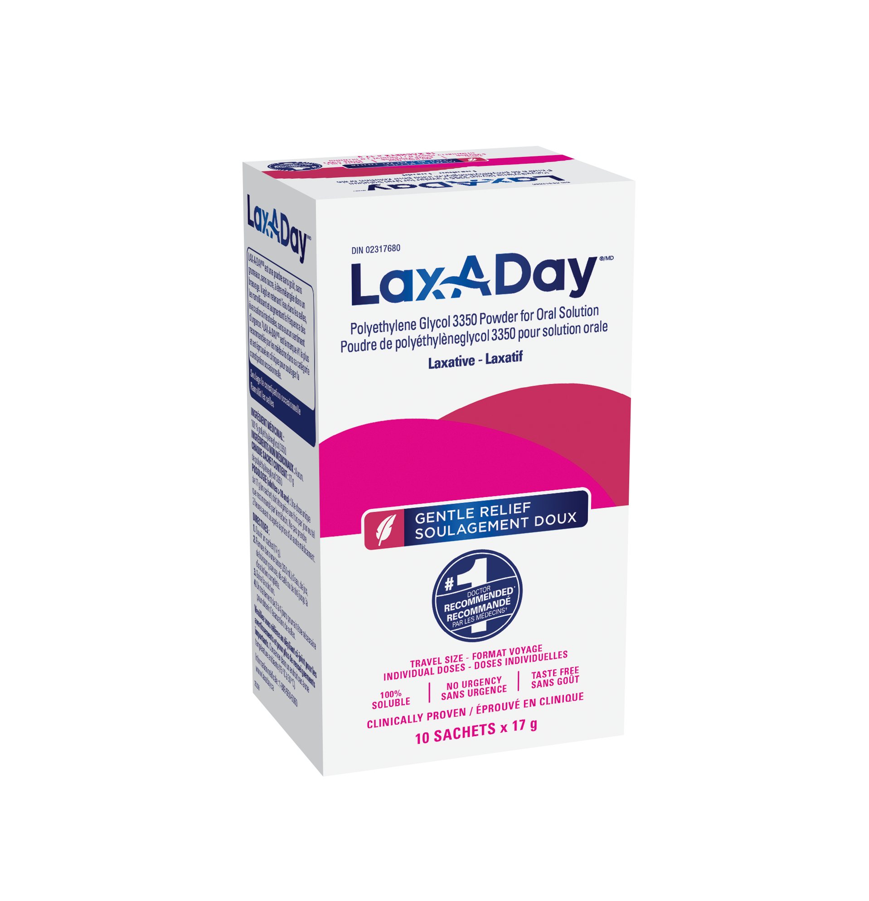
Constipation
Common with: Dopamine Agonists, Anticholinergic Agents
Recommendations
Lifestyle^{10,16}:
Drink water and fluids (e.g. 8 cups of water daily)
Medication^{10,16-19}:
OTC: Laxatives (Lactulose, PEG3350)
Add fiber to meals (e.g. brans, beans, prunes)
Exercise (e.g. walk 15-20min daily)
OTC: Bulking agents (Psyllium fiber)
OTC: Stimulants (Sennosides)
Images 26 - 28
Notes:
Dopamine agonists such as ropinerole and pramipexole, and anticholinergic agents like benztropine

Slide 36
Group Discussion
Q1: Are you currently experiencing any side effects or have experienced them in the past? For which medications?
Q2: What lifestyle and medication measures have you tried? Are there any that you will try after this session?
Notes:
Allow participants to first discuss among each other (discuss with person next to them). Then bring together into a big group to share some of the common theme or differences.

Slide 37
Take Home Messages
Not everyone will experience the same type of motor symptoms associated with PD
There are options beyond Sinemet to help motor symptoms and with “wearing off”
Side effects of medications are not uncommon and there are ways to manage them
Talk to a pharmacist about which interventions are right for you!

Slide 38
Debrief of Today’s Session
Feedback
Any requests for future sessions?
"Homework" assignment
Motor Symptom Diary

Slide 39
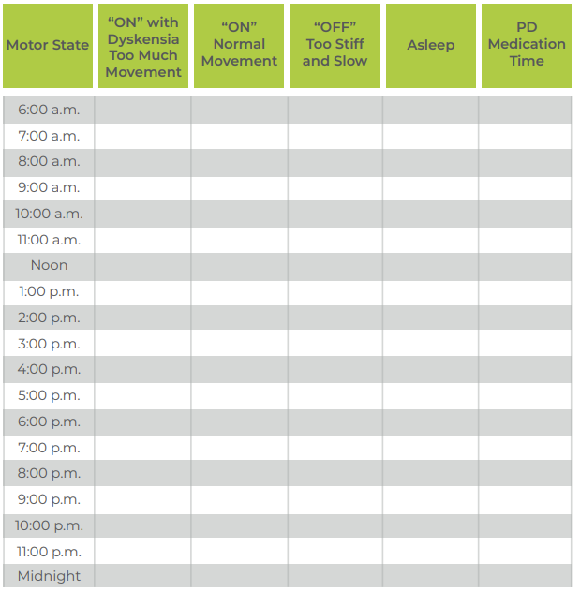
“Homework:” Motor Symptom Diary
Paper versions like Parkinson Canada's "Daily Diary". Found HERE.
Apps like American Parkinson Disease Association's "APDA Symptom Tracker"
Download: https://www.apdaparkinson.org/apda-symptom-tracker/
Images 29 - 30
Notes:
Parkinson Canada Symptom Diary: https://www.parkinson.ca/wp-content/uploads/Worksheet6_Careparter_Parkinson%E2%80%99s-Disease-Daily-Diary.pdf
APDA Symptom Tracker: https://www.apdaparkinson.org/apda-symptom-tracker/

Slide 40
Additional Resources
Medication Management Resources
Motor Symptoms Readings: https://www.parkinson.bc.ca/resources-services/resources/#motor
Parkinson’s Medications YouTube Series by ParkinsonSocietyBC: https://www.youtube.com/channel/UC65k63uHIXHFp-stRyQsBaQ
Parkinson's Support Groups
PSBC Regional Support Groups & Carepartner Support Groups:
Contact: info@parkinson.bc.ca , 1-800-668-3330
https://www.parkinson.bc.ca/resources-services/support-groups/
PWP Monthly Support Groups: https://parkinsonwellnessproject.org/support-groups

Slide 41
References
Moustafa AA, Chakravarthy S, Phillips JR, Gupta A, Keri S, Polner B, Frank MJ, Jahanshahi M. Motor symptoms in Parkinson's disease: A unified framework. Neurosci Biobehav Rev [Internet]. 2016 [cited 2021 Aug 25];68:727-740. doi: 10.1016/j.neubiorev.2016.07.010.
Grimes DA. Parkinson Disease. In: Therapeutics [Internet]. Ottawa (ON): Canadian Pharmacists Association; c2016 [updated 2021 Apr 21; cited 2021 Aug 25]. Available from: http://www.myrxtx.ca. Also available in paper copy from the publisher.
Hamilton Health Sciences. Parkinson’s Disease [Internet]. Hamilton (ON): Movement Disorders Clinic; 2017 [updated 2017 Jul 13; cited 2021 Aug 25]. Available from: https://www.hamiltonhealthsciences.ca/wp-content/uploads/2019/08/ParkinsonsDisease-trh.pdf
Mah G. Parkinson Disease: A management update for pharmacists. Canadian Healthcare Network [Internet]; 2020 [cited 2021 Aug 25]. Available from: canadianhealthcarenetowrk.ca
Patel T, Pileggi H, Lamba J, Fonseca J, Glustein J. Medications to Treat Parkinson’s Disease. Parkinson Canada [Internet]. [cited 2021 Aug 25]. Available from: https://www.parkinson.ca/wp-content/uploads/Medications-to-treat-Parkinson%E2%80%99s-disease.pdf
Grimes D, Fitzpatrick M, Gordon J, Miyasaki J, Fon EA, Schlossmacher M et al. Canadian guideline for Parkinson disease. CMAJ. 2019 Sep 09;191 (36):989-1004.
CPS [Internet]. Ottawa (ON): Canadian Pharmacists Association; c2016 [updated 2021 Apr 22; cited 2021 Aug 25].Sinemet [product monograph]. Available from: http://www.e-therapeutics.ca. Also available in paper copy from the publisher.​
CPS [Internet]. Ottawa (ON): Canadian Pharmacists Association; c2016 [updated 2014 Feb 06; cited 2021 Aug 25].Sinemet CR [product monograph]. Available from: http://www.e-therapeutics.ca. Also available in paper copy from the publisher.​
Hughes C. Nausea and Vomiting. In: Therapeutics [Internet]. Ottawa (ON): Canadian Pharmacists Association; c2016 [updated 2021 Apr 14; cited 2021 Aug 25]. Available from: http://www.myrxtx.ca. Also available in paper copy from the publisher.
Postuma R, Galatas C. A Guide to the Non-Motor Symptoms of Parkinson’s Disease [Internet]. 2012 [cited 2021 Aug 25]. Available from: https://www.parkinson.bc.ca/media/33807/guide-to-the-non-motor-symptoms-of-parkinsons-disease.pdf ​
Kletas V. Dry Mouth. In: Therapeutics [Internet]. Ottawa (ON): Canadian Pharmacists Association; c2016 [updated 2020 Nov 04; cited 2021 Aug 25]. Available from: http://www.myrxtx.ca. Also available in paper copy from the publisher.
Figueroa JJ, Basford JR, Low PA. Preventing and treating orthostatic hypotension: As easy as A, B, C. Cleve Clin J Med [Internet]. 2010 [cited 2021 Aug 25];77(5):298-306. doi:10.3949/ccjm.77a.09118​
Solbiati M, Sheldon R. Syncope. In: Therapeutics [Internet]. Ottawa (ON): Canadian Pharmacists Association; c2016 [updated 2021 Apr 07; cited 2021 Aug 25]. Available from: http://www.myrxtx.ca. Also available in paper copy from the publisher. ​
Parkinson Society BC. Parkinson’s Medications – Part 4: Medications for Insomnia [YouTube]. Tran, A. 2020 Jul 06 [cited 2021 Aug 25]. Available from: https://www.youtube.com/watch?v=IQmq-uyL8ZU&t=2641s.
Caffeine. In: Natural Medicines [database on the Internet]. Somerville (MA): Therapeutic Research Center; 2020 [cited 2021 Aug 25]. Available from: https://naturalmedicines.therapeuticresearch.com​
Chaun H, Andrews AN, Woo M. Constipation in Adults. In: Therapeutics [Internet]. Ottawa (ON): Canadian Pharmacists Association; c2016 [updated 2021 Apr 14; cited 2021 Aug 25]. Available from: http://www.myrxtx.ca. Also available in paper copy from the publisher. ​
CPS [Internet]. Ottawa (ON): Canadian Pharmacists Association; c2016 [cited 2021 Aug 25]. Gastrointestinal Products: Laxatives. Available from: http://www.e-therapeutics.ca. Also available in paper copy from the publisher.​
Senna. In: Natural Medicines [database on the Internet]. Somerville (MA): Therapeutic Research Center; 2018 [cited 2021 Jul 29]. Available from: https://naturalmedicines.therapeuticresearch.com.​​
MacFadyen JS, Vernon GM, Safra EJ. Understanding Parkinson’s Constipation and PD. [Internet] 2014. [cited 2021 Aug 25]. Available from: https://www.parkinson.org/sites/default/files/attachments/constipation_16.pdf ​
RYTARY (carbidopa and levodopa) Extended-Release Capsules. [Internet] 2016. [cited 2021 Aug 25]. Available from: https://www.accessdata.fda.gov/drugsatfda_docs/nda/2015/203312orig1s000toc.cfm
Mittur A, Gupta S, Modi NB. Pharmacokinetics of Rytary®, An Extended-Release Capsule Formulation of Carbidopa–Levodopa. Clin Pharmacokinet [Internet]. 2017 [cited 2021 Aug 25];56, 999–1014. Available from: https://doi.org/10.1007/s40262-017-0511-y
CPS [Internet]. Ottawa (ON): Canadian Pharmacists Association; c2016 [updated 2020 Feb 10; cited 2021 Aug 25].Duodopa [product monograph]. Available from: http://www.e-therapeutics.ca. Also available in paper copy from the publisher.​
Parkinson Society BC. DUODOPA Therapy. [cited 2021 Aug 25]. Available from: https://www.parkinson.bc.ca/about-us/advocacy/duodopa-therapy/

Slide 42
Image Reference
Image 1: Drugs, 2022
Image 2: Image 2 by Unknown Author is licensed under CC BY
Image 3: Drugs, 2022
Image 4: Drugs, 2022
Image 5: GoodRx, 2023
Image 6: GoodRx, 2023
Image 7 : GoodRx, 2023
Image 8 : GoodRx, 2023
Image 9: Emeds, 2023
Image 10: Drugs, 2023
Image 11: Prescriptiongiant, 2023
Image 12: Vinmec, 2019
Image 13: Drugs, 2022
Image 14: nairoukhclick, 2019
Image 15: yourpetpa, 2022
Image 16: drugs, 2022
Image 17: goodrx, 2021
Image 18: Vinmec, 2019
Image 19: Medline, 2023
Image 20: Image 21 by Unknown Author is licensed under CC BY-NC-ND
Image 21: pixnio, 2023
Image 22: Clipartszone, 2023
Image 23: Biotene, 2023
Image 24: Webbernaturals, 2023
Image 25: Wikimedia, 2005
Image 26: laxasolutions, 2022
Image 27: Metamucil, 2023
Image 28: Senokot, 2023
Image 29: Parkinson, 2023
Image 30: Apdaparkinson, 2023
Image 31: Okanaganpharmacy, 2023
Image 32: Rytary, 2023
Image 33: abbviepro, 2022

Slide 43
Thank You!

Slide 44
Appendix

Slide 45
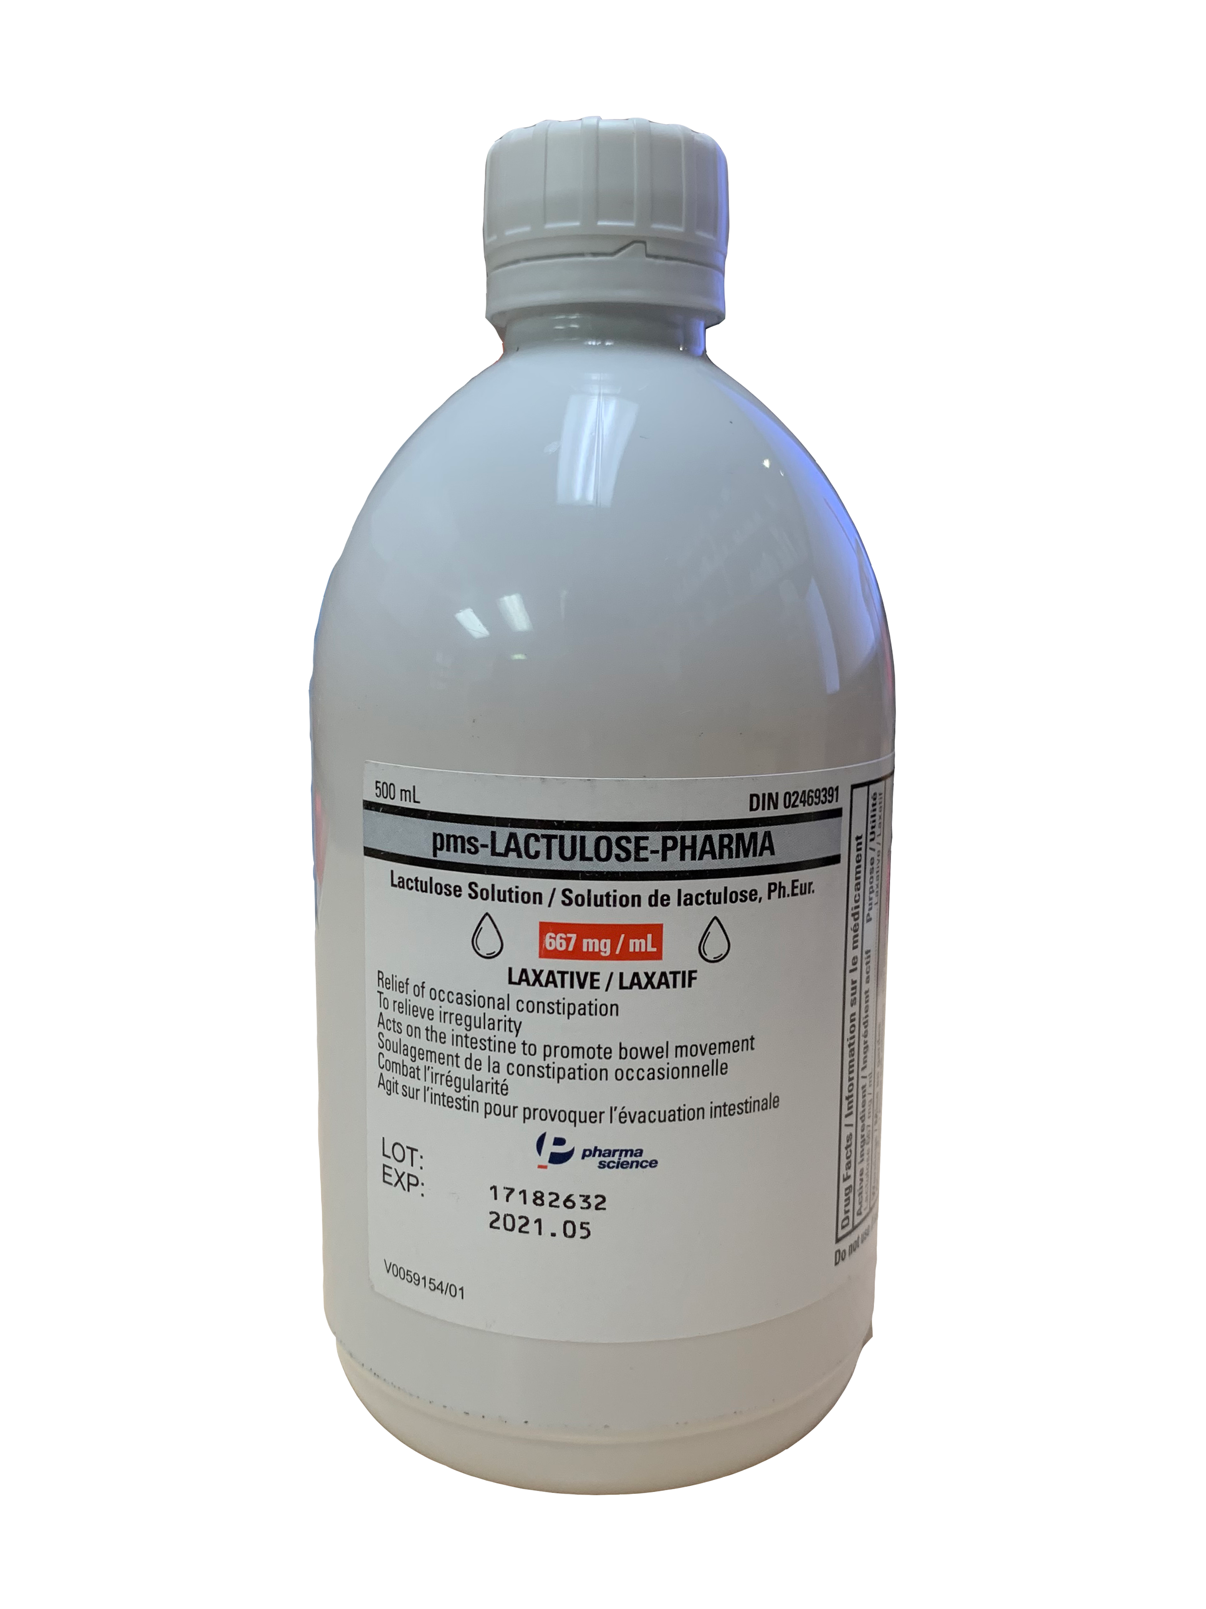
Medications for Constipation^{10,16-19}
 | Laxatives |  | Bulking Agent | Stimulant
Example | Lactulose | PEG 3350 | Psyllium Fiber | Sennosides
Dose | 15-30mL one or two times a day | 17 grams (capful) once daily | 3.4 grams one to three times a day | 2 tablets daily at bedtime
Onset | 24-48 hours | 2-4 days | 12-72 hours | 6-12 hours
Side Effects | Bloating, stomach upset, diarrhea |  | Bloating, stomach discomfort | Stomach pain, cramps, discolored urine or feces
Images 26 - 31
Notes:
Metamucil: 3.4 g = 1 tablespoon (15 mL)

Slide 46
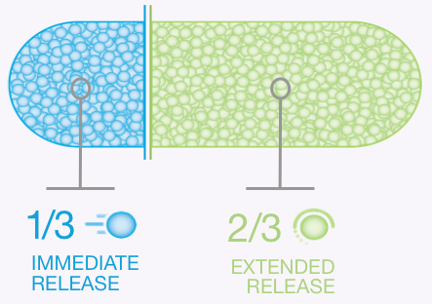
Rytary®
Levodopa and carbidopa extended-release capsules
Approved by FDA in 2015²⁰
Not yet available in Canada
Study found drug levels in people's systems after taking the medication stayed high for longer compared with IR carbidopa/levodopa and carbidopa/levodopa/entacapone²¹
Image 32
Notes:
https://rytary.com/how-rytary-is-thought-to-work
Pharmacokinetics of Rytary, An Extended-Release Capsule Formulation of Carbidopa–Levodopa Aravind Mittur1 • Suneel Gupta1 • Nishit B. Modi (2017)
LINK: https://link.springer.com/content/pdf/10.1007/s40262-017-0511-y.pdf
P: patients with PD
I: Rytary (ER carbidopa–levodopa)
C: IR carbidopa-levodopa, CR carbidopa-levodopa, carbidopa-levodopa-entacapone
O: ER carbidopa–levodopa sustains levodopa plasma concentrations above 50% of Cmax for a longer duration (4–5 h) than IR carbidopa–levodopa (approximately 1.5 h), CR carbidopa–levodopa (2–3 h), and carbidopa–levodopa– entacapone (2–2.5 h) in healthy subjects and subjects with PD.

Slide 47
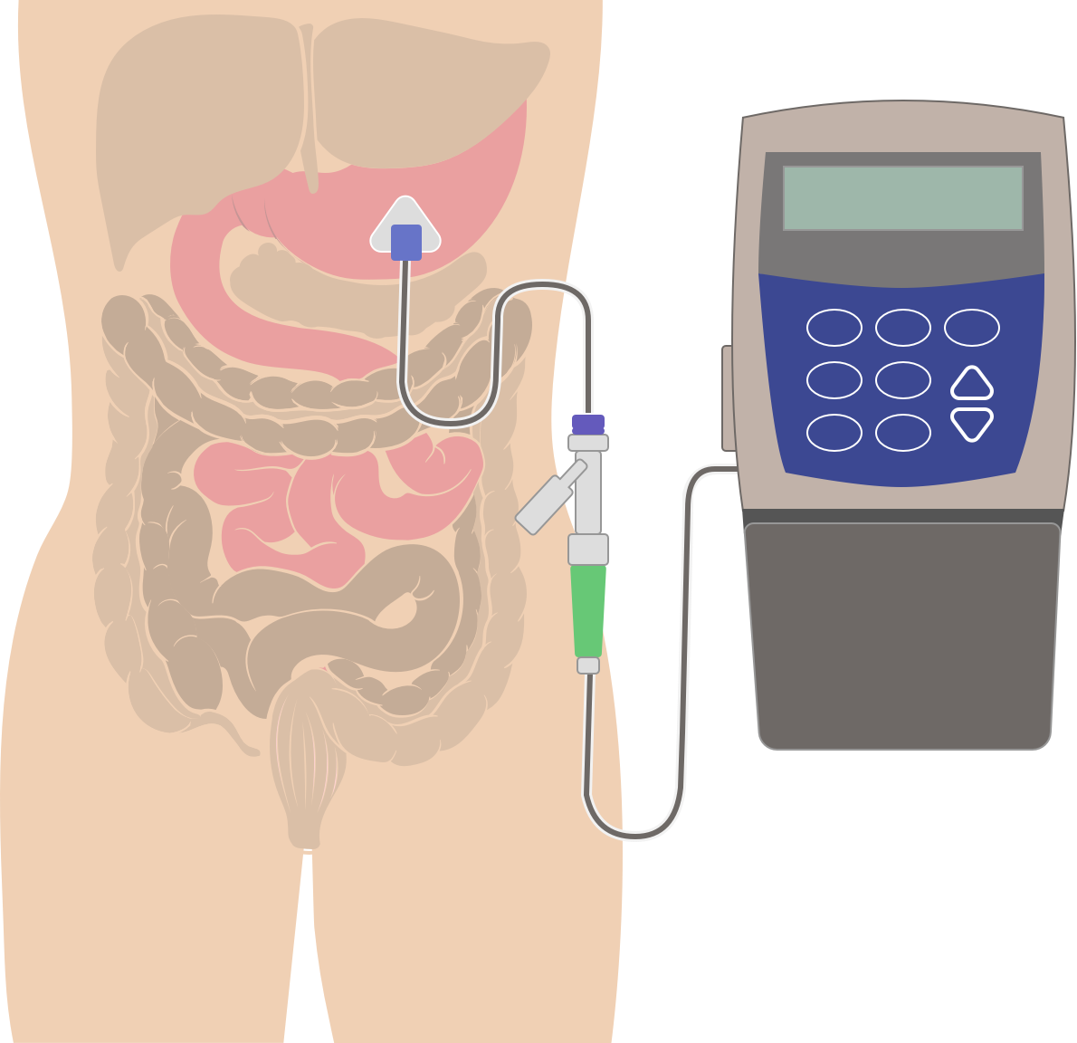
Duodopa®
Levodopa and carbidopa intestinal gel
Approved in Canada in December 2020²³
Continuous infusion to allow for constant levels of medication in the body²²
For people with ongoing motor symptoms and hyper-dyskinesia (excessive involuntary movements)²²
Image 33
Notes:
https://www.parkinson.bc.ca/about-us/advocacy/duodopa-therapy/
Intestinal gel form of levodopa/carbidopa that is delivered throughout the day using a small portable pump that is connected to a tube in your abdomen (Hamilton health sciences)

